Slide 1
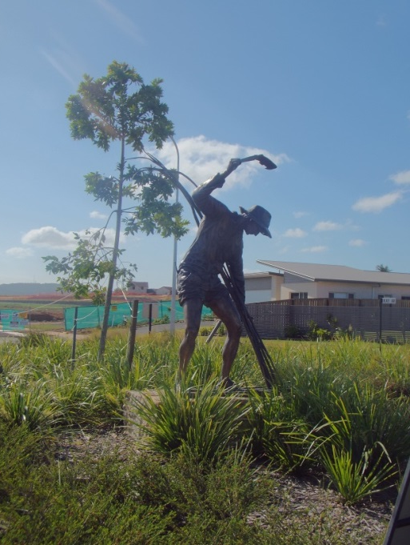



Rethinking rural responses to globalization: an assemblage approach
IGU Commission on the Sustainability of Rural Systems Annual Colloquium
Lisbon and Porto – July 2015
Michael woods
Aberystwyth University
m.woods@aber.ac.uk
Twitter: @globalrural

Slide 2
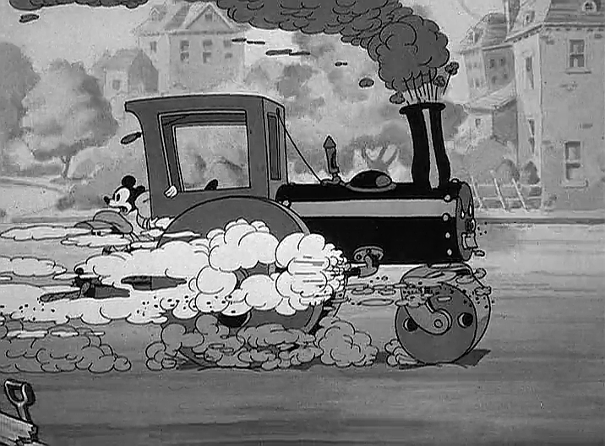
Globalization is not a steamroller

Slide 3
Relational theories of globalization
“Globalization is not a single all-embracing movement (nor should it be imagined as some outward spread from the West and other centres of economic power across a passive surface of ‘space’). It is a making of space(s), an active reconfiguration and meeting-up through practices and relations of a multitude of trajectories, and it is there that lies the politics.”
Massey (2005), For Space, p 83

Slide 4
Relational theories of globalization
“In a relational understanding of neoliberal globalisation ‘places’ are criss-crossings in the wider power-geometries that constitute both themselves and ‘the global’. On this view local places are not simply always the victims of the global; nor are they always politically defensible redoubts against the global. Understanding space as the constant open production of topologies of power points to the fact that different ‘places’ will stand in contrasting relations to the global.”
Massey (2005), For Space, p 101

Slide 5
The global countryside
“Globalization processes introduce into rural localities new networks of global interconnectivity, which become threaded through and entangled with existing local assemblages, sometimes acting in concert and sometimes pulling local actants in conflicting directions. Through these entanglements, intersections and entrapments, the experience of globalization changes rural places, but it never eradicates the local. Rather, the networks, flows and actors introduced by globalization processes fuse and combine with extant local entities to produce new hybrid formations. In this way, places in the emergent global countryside retain their local distinctiveness, but they are also different to how they were before.”
Woods (2007), in Progress in Human Geography, pp 499-500

Slide 6
Global Processes
Policies and Grassroots Initiatives
Catalysts
Regional Responses and Outcomes
Globalization impacts
Regional Contexts and Capacities
Regional Learning
An interpretative model of globalization effects on place, from the DERREG project (www.derreg.eu)

Slide 7
Assemblage approach
Assemblage ‘theory’ has gained popularity in Anglophone human geography as a framework for researching social structures and systems
Divergent body of ideas drawing variously on Michel Foucault, Bruno Latour and Gilles Deleuze and Felix Guattari
“The term is often used to emphasise emergence, multiplicity and indeterminacy, and connects to a wider redefinition of the socio-spatial in terms of the composition of diverse elements into some form of provisional socio-spatial formation”
Anderson and McFarlane (2011) in Area, p 124

Slide 8


Assemblage approach

Slide 9
DeLanda’s Assemblage Theory
DeLanda posits 5 core attributes of assemblages:
1) Assemblages are composed of both material and expressive components, and individual components may have both material and expressive roles
2) An assemblage is stabilized and destabilized through processes of territorialization and deterritorialization.
3) An assemblage is given an identity through coding, including practices of naming, classification and rule-setting. Decoding processes dissent from established meanings, break rules and give rise of heterogeneity.

Slide 10
DeLanda’s Assemblage Theory
4) Assemblages are dynamic, contingent and engaged in recurrent interactions with other assemblages, from which larger assemblages have the possibility to emerge.
5) Assemblages are defined by their relations of exteriority; they can be broken down in components which may themselves be assemblages, and relations between components can be modified without changing the nature of the component itself.
“a component part of an assemblage may be detached from it and plugged into a different assemblage in which its interactions are different” DeLanda (2006) A New Philosophy of Society, p. 10.

Slide 11
Assemblage and Globalization
Globalization as a process of assembling and re-assembling components (agencement)
  Transfer of components between assemblages
  Recoding of assemblages and their components
Transnational networks, structures and systems as global assemblages
  Created through interaction of smaller assemblages
  Components may be opened up as assemblages themselves
  Tendency towards internal homogeneity

Slide 12
Assemblage and Globalization
Places are also assemblages
The transformation of places through globalization involves interaction between a place-assemblage and the translocal assemblages with which it shares components (e.g. a factory)
Globalization is reproduced through places by attaching, discarding, re-arranging and re-coding components of translocal assemblages that are also part of place-assemblages, such that one cannot change without affecting the other
Space for local agency as actors respond to globalization by seeking to re-arrange components into new assemblages that benefit the social and economic interests of the locality

Slide 13
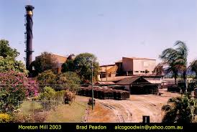
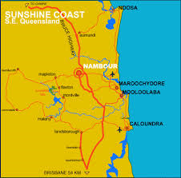
Closure of Moreton Sugar Mill, Nambour, QLD, 2003
“With poor harvests, falling world prices and growing competition from Brazil, the owners of the mill at Nambour – Bundaberg Sugar – say the Sunshine Coast operation is no longer viable.”
ABC 7.30 Report, 15 July 2003

Slide 14
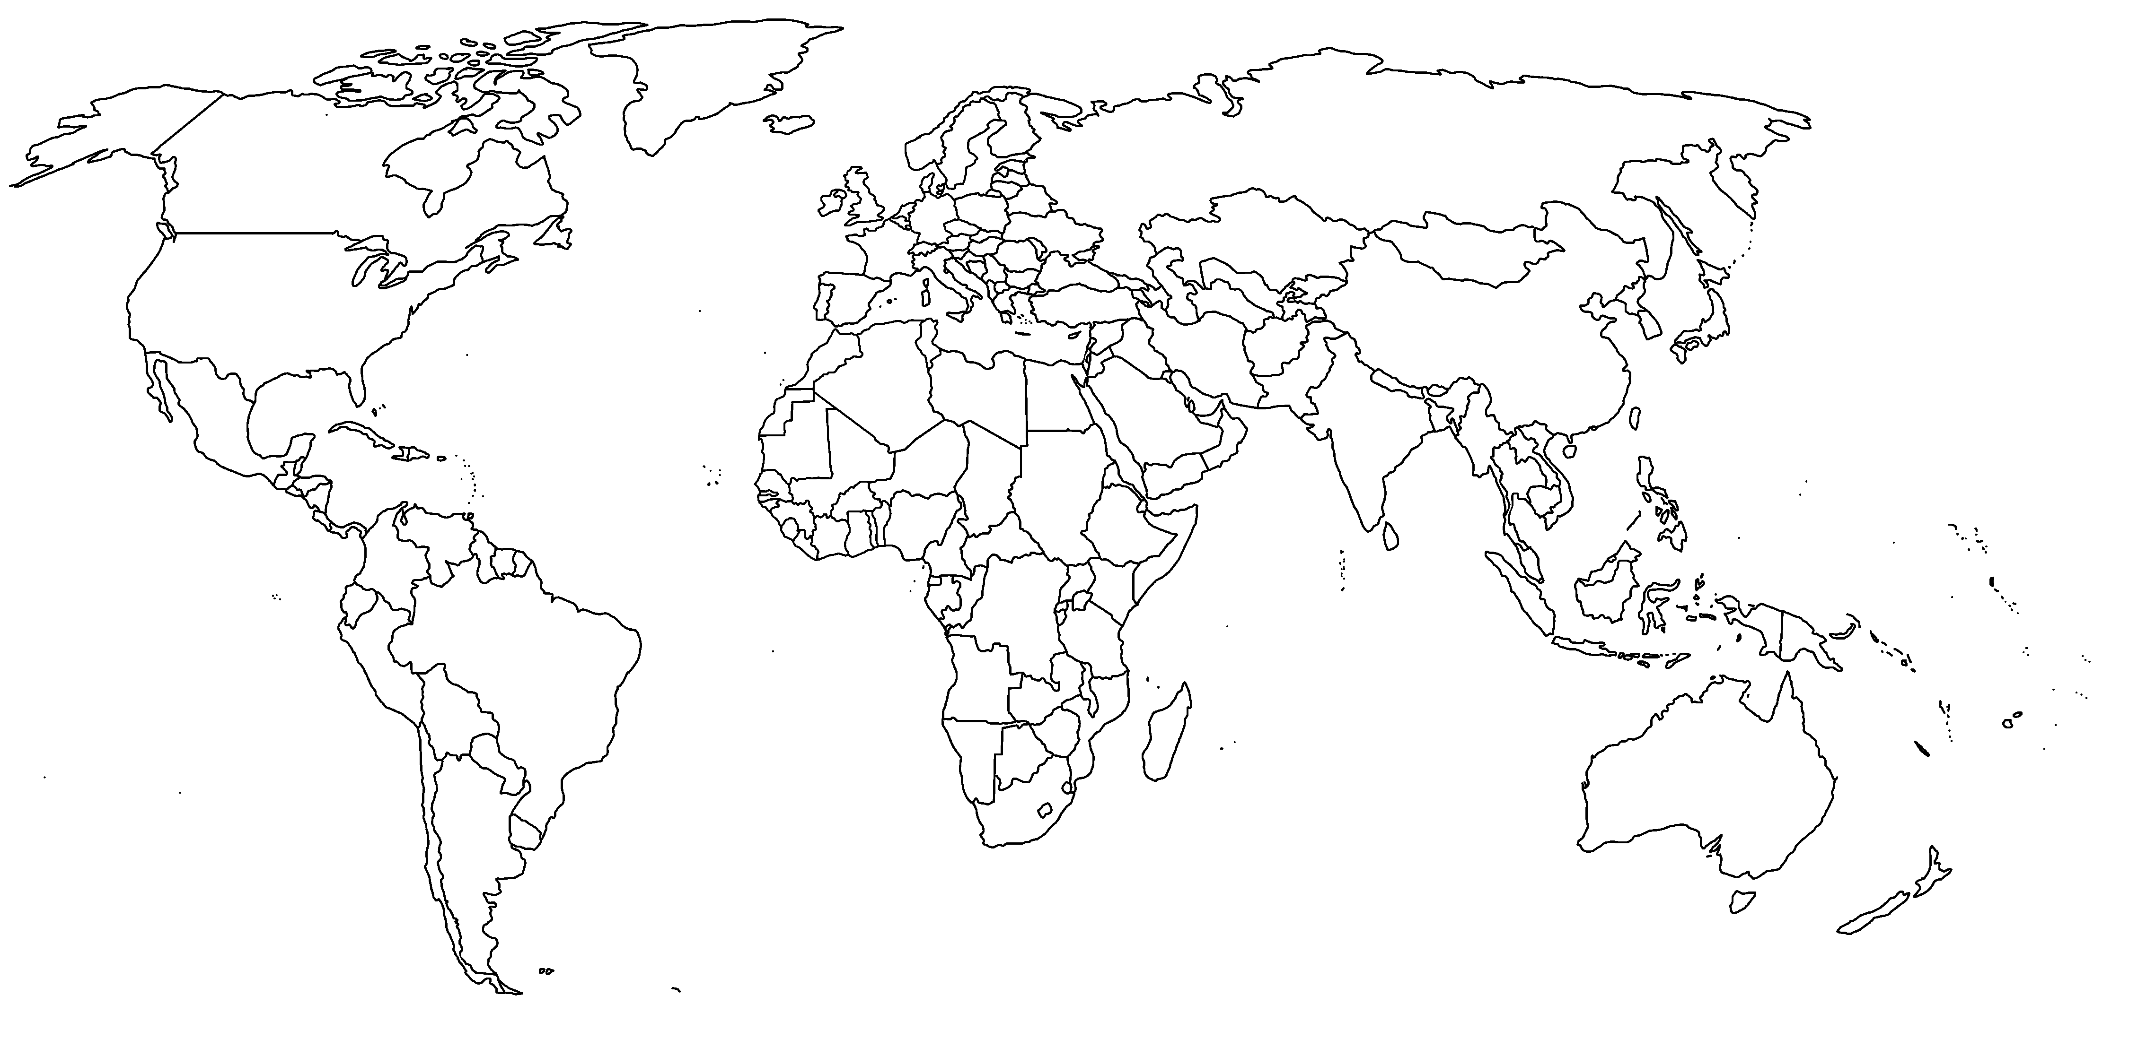

Norrland Sweden
Newfoundland
Wales
West of Ireland
Hebei and Shandong provinces
South of Spain
Tanzania
Queensland
Rio Grande do Sul
Hawkes Bay
GLOBAL-RURAL project
European Research Council Advanced Grant
2014-2019
@globalrural
www.globarlruralproject.wordpress.com

Slide 15
Moreton Mill sugar assemblage
Cane-land
Cane plants
Cutters and cutting equipment
Cane trains
Mill
Milling equipment
Mill labour
Raw crushed sugar
Waste and by-products

Slide 16
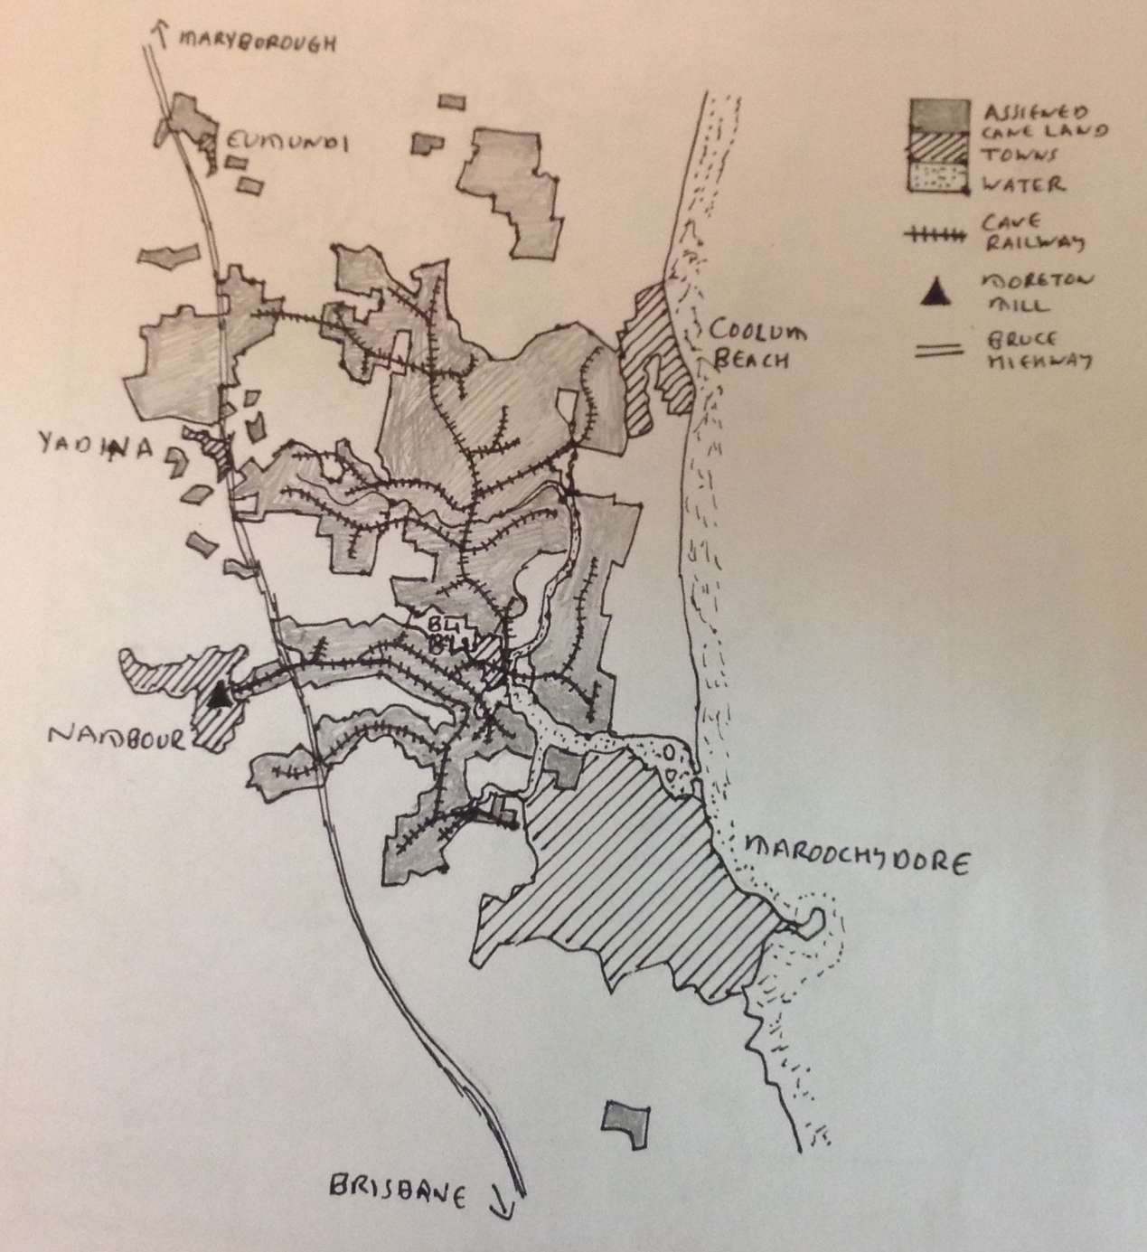

Slide 17
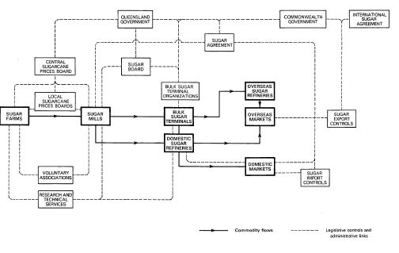
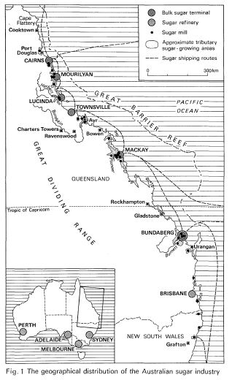
Australian sugar assemblage
Highly regulated industry with distinctive territorialisation
Monopoly structure in which Queensland Sugar acquires nearly all raw sugar when crushed and acts as a single-desk exporter
Supply controlled through system of assignments, with cane-land assigned to a particular mill with production quota
Segmented spatial territorialisation with little competition between mills
Both figures from Hoyle (1980)

Slide 18
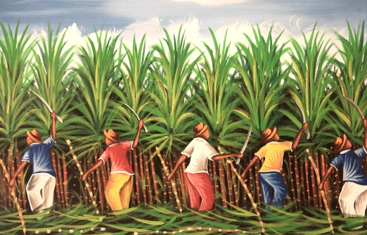
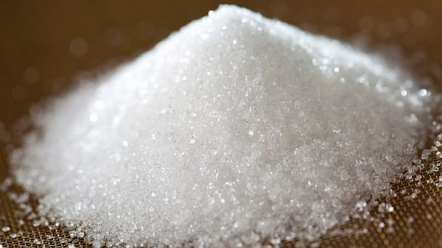

Global sugar assemblage
Components: Cane, beet, raw sugar, refined sugar, mills, refineries, storage, transport, packaging, consumer products, labour, consumers, capital, corporations, regulatory institutions, etc.
Territorialization: Commodity chains connecting production and consumption, shaped by regulatory structures and agreements

Slide 19
Globalization and the Mill Closure
Restructuring of the global sugar industry
Collapse of old supply relations, re-territorialisation towards Asian markets and increased supply to global markets from Brazil
Re-coding of sugar prices on the world market
Rigid territorialisation of Australian sugar industry, limiting opportunities for competition and efficiency savings
Characteristics of material components in the Moreton Mill assemblage > increasing profitability only by increasing assigned land
Competition for land with other local assemblages – residential development and tourism
Re-coding of mill within corporate assemblages as sold from one transnational corporation to another

Slide 20
Response to the mill closure
Components that made up the Moreton Mill assemblage remained in situ
Closure of the mill had detached these components from the Australian sugar assemblage, and thus cut access to markets
Without a market, the material role of these components had been lost – they no longer functioned to produce sugar
Material role in the place-assemblage of Nambour also changed – no longer functioned to provide employment and generate income

Slide 21
Sugar and the Nambour assemblage
1970s: 2,300 people employed by sugar industry at peak season and AUS$4m generated for local economy
“The economy of Nambour presents a fairly diversified picture but with a heavy dependence on the sugar industry” (Field Study of Nambour and District 1971)
Viability Report 1989: 550 direct jobs, 1100-3300 indirect jobs, direct value of production of up to $25 million p.a.
“Agriculture has been our life. It’s what has been the strength and wealth of Nambour over the years and to lose it like this is very, very sad …. The supermarkets, the car dealers, the lawn mower people, will all have a wash off of it, so we’ll all feel it” (President of the Chamber of Commerce on the mill closure)

Slide 22
Reassemblage
Initial responses focused on keeping the local sugar assemblage together by attaching it to another larger assemblage with access to markets.
Detach the mill from its corporate assemblage
  Farmers formed co-operative to try to buy the mill and run it themselves
  Bundaberg Sugar refused to sell the site to them
Attach to another sugar mill’s assemblage
  Some cane transported to Maryborough (150km north)
  Sugar cane needs to be processed within 16 hours of being cut and is bulky and expensive to transport
  Only economically viable for growers in north of Moreton district on bitumen roads
  10 cane-growers in Nambour district supplying Maryborough 2014

Slide 23

Reassemblage
Attach to the global ethanol assemblage
  Same initial stages as for edible sugar, enabling several components to retain same material role
  Introduction of new components (processing plant, capital)
  New exterior relations
  Markets conditions not in line with coding by proposers
  Australian government failed to deliver measures to stimulate an ethanol market that would have created a stable assemblage for the producers to connect to

Slide 24
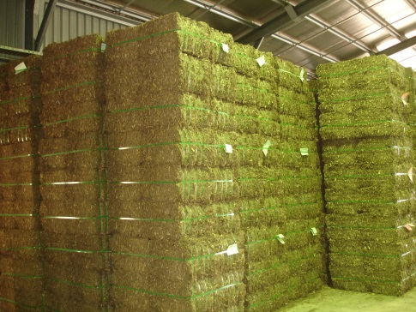
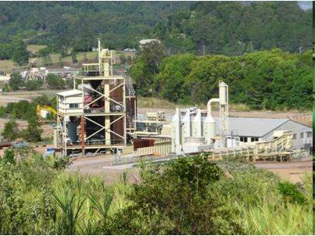
Reassemblage
Construct a new assemblage with a new product for new markets
  Locally developed process to turn cane into stockfeed for cattle, marketed as ‘cow candy’
  Used some machinery from Moreton Mill but not site
  Capital investment required for new plant – government funding replaced by Chinese investment
  Extended territorialisation with direct links to buyers in Japan and South Korea
  Expectations of generating AU$90 million a year from exports, processing 300,000 tonnes of sugarcane a year, and generating at least 18 jobs

Slide 25
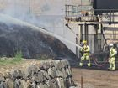
Reassemblage
By 2012, Biocane had gone into administration, the plant had closed and the assemblage had collapsed
  Dissidence of non-human components not behaving as they had been coded
  Spontaneous combustion of charring materials caused a fire at the plant that halted production for months
  Yield of sugarcane reduced by two unusually wet seasons

Slide 26
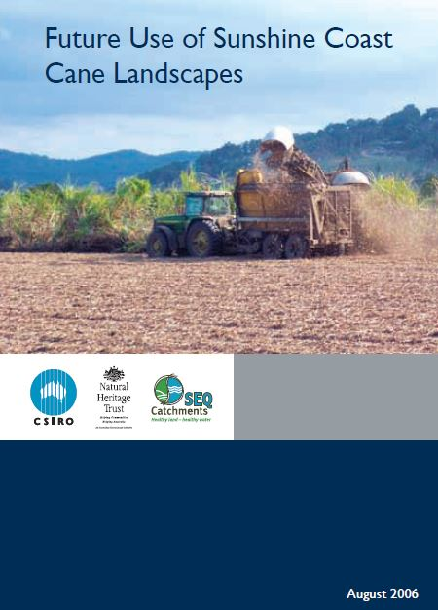
Reassemblage
Dismantling the sugar assemblage and attaching components to alternative assemblages
Converting cane land to new uses
Land suitability study undertaken to identify alternative agricultural uses = recoding land
“For most Nambour growers there was very little else they could grow but cane, as tree crops such as macademias take 14 years to begin to pay their way and small crops such as tomatoes, beans, corns and capiscums are already over-supplied much of the year … Even ploughing out the cane and turning the land over to grazing was not viewed as a desirable alternative by the local council and starting a large feedlot sourcing silage from ex-cane farms was evidently out of the question.” (Australian Sugar Yearbook 2004, p 18)

Slide 27
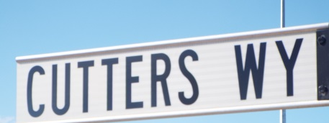
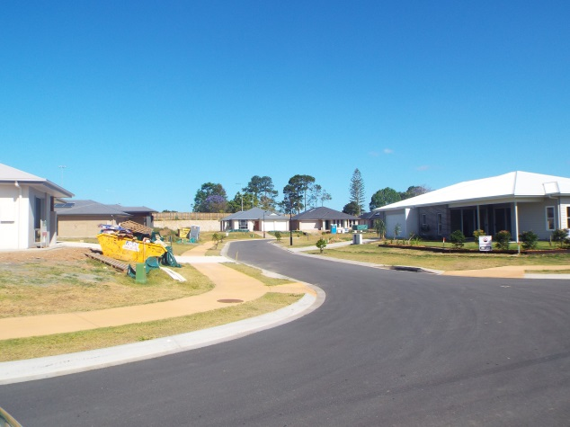
Reassemblage
Preferred option would have been to sell land for housing development
Blocked by zoning laws introduced in 1980s to protect cane supply for the mill
Reaffirmed by South East Queensland Regional Plan 2004 in response to concerns about urbanization and the loss of green space
Limited exceptions

Slide 28
Expressive roles
If material functions of components proved difficult to replace, their expressive roles proved to be surprisingly resilient
Mill, sugar and trains also played expressive roles significant to the identity of Nambour
“The dark plume hanging over the town was not the only smoke in the air as bush fires were raging all around the district, but the mill stack was pumping out carbon, oblivious to the housewives’ cries of frustration at having their washing blackened. It was all in a good cause, they were told. The ash from the stack, and the heavy sweet smell of molasses, were the symbols of prosperity not just for the farmers, but for the whole town.” (Richardson 2013, in Sunshine Coast Daily, 26/10/13).

Slide 29
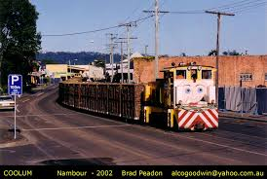

Slide 30
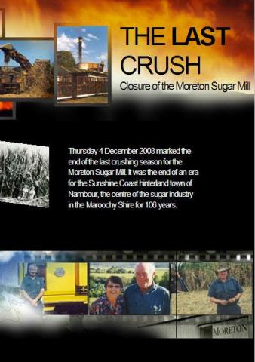
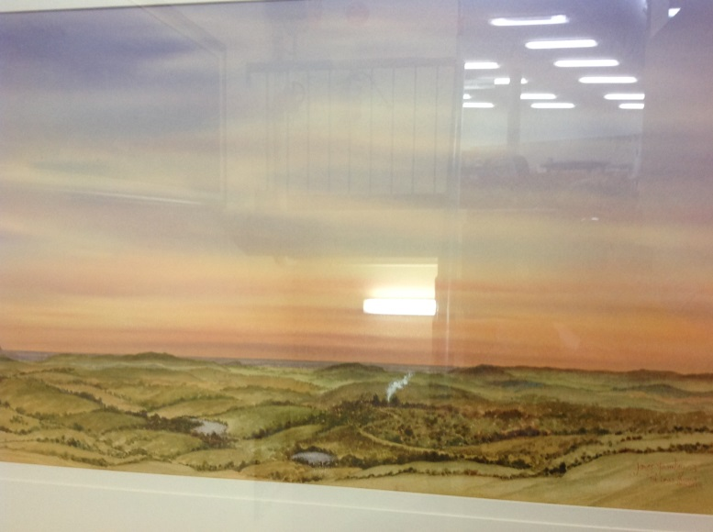



The Last Hurrah Nambour
by James Fearnley
(Nambour Library)
“Whatever happens to the cane farms, Nambour and the Sunshine Coast will never be the same again”
ABC 7.30 Report, 15/07/03

Slide 31
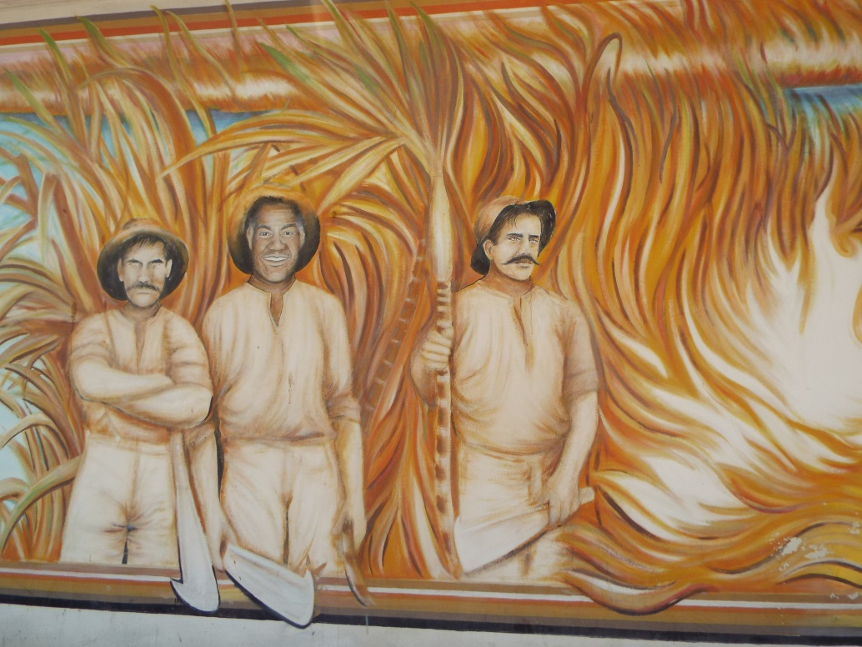
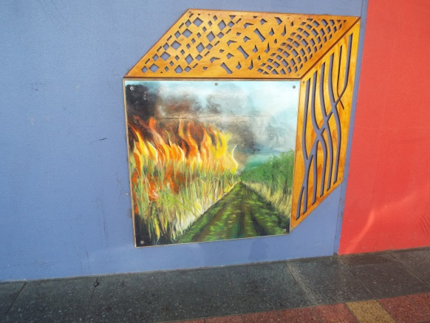
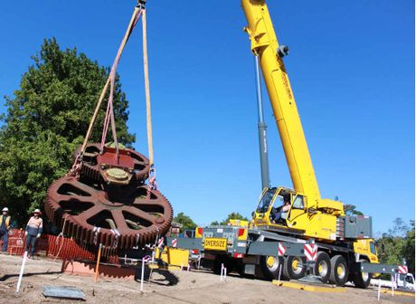
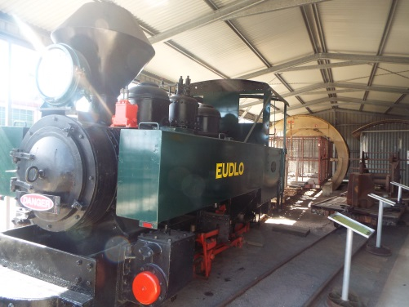
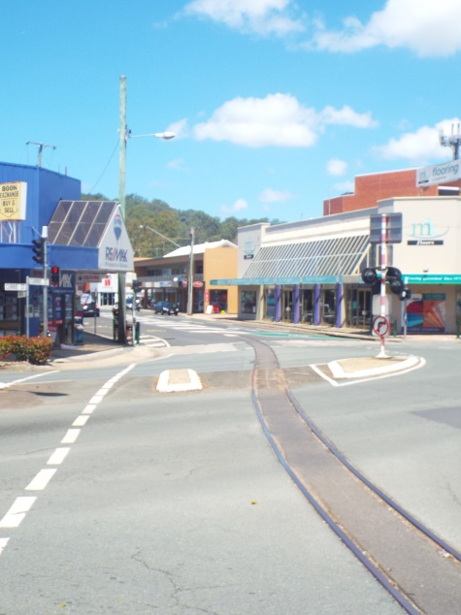
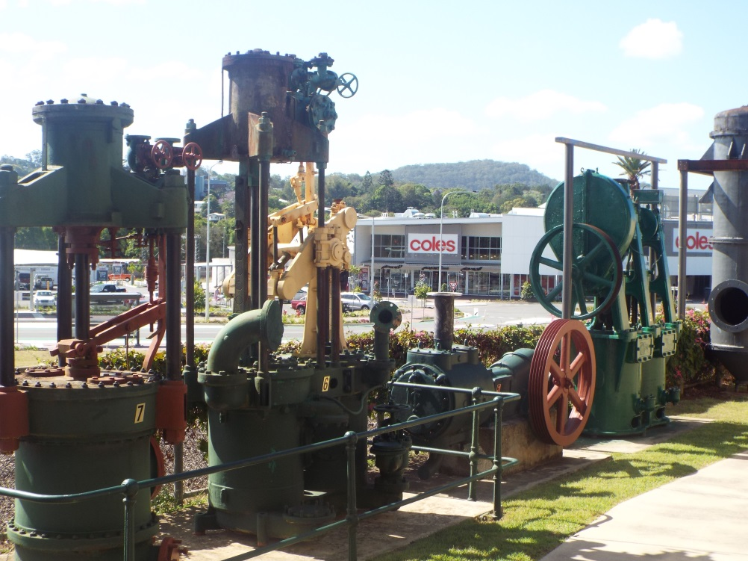
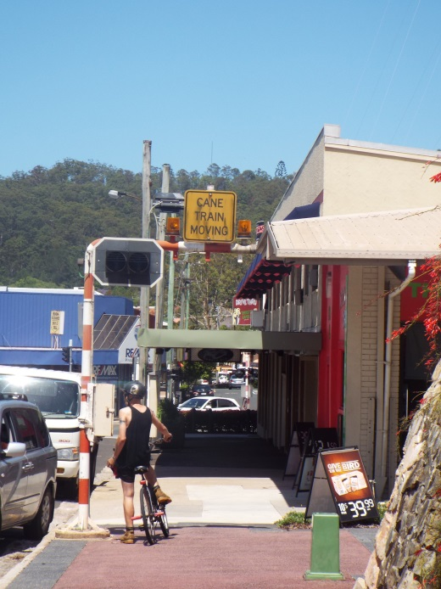

Slide 32
Waiting for a new heritage rail tourism assemblage?

Slide 33

Conclusions
Rural areas are not the inevitable, helpless victims of globalization
Depends on the local response to globalization impacts
Social capital, institutional capacities etc important in explaining differential outcomes between places, but an assemblage approach encourages us to look beyond the social
Assemblage approaches reveal the micro-processes and practices through which globalization is reproduced
Responses to globalization involve re-assembling components in new ways, potentially with material and/or expressive roles
Material functions and expressive functions can become detached, and expressive roles can outlive material roles
Successful responses require incorporation of new components, new external relations and attachments, and appropriate coding of components

