Slide 1
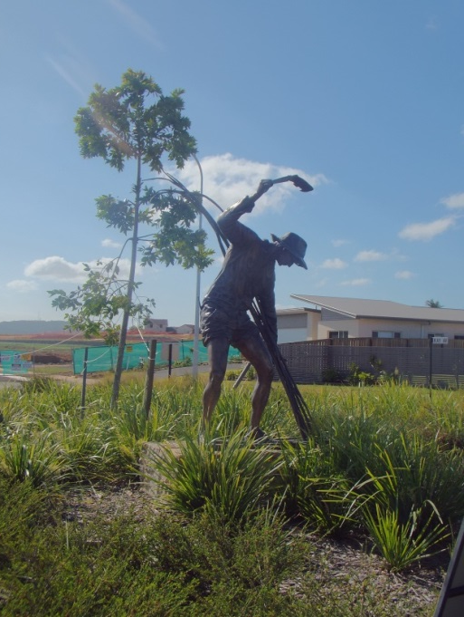



Global Economic Restructuring and Place
Nambour in the global sugar assemblage
Quadrennial UK-US-Canadian Rural Geography Conference
Wales – July 2015
Michael Woods
Aberystwyth University
m.woods@aber.ac.uk
www.globalruralproject.wordpress.com
Twitter: @globalrural

Slide 2
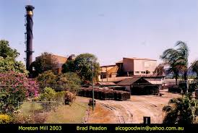
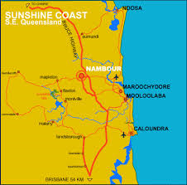
Closure of Moreton Sugar Mill, Nambour, QLD, 2003
“With poor harvests, falling world prices and growing competition from Brazil, the owners of the mill at Nambour – Bundaberg Sugar – say the Sunshine Coast operation is no longer viable.”
ABC 7.30 Report, 15 July 2003

Slide 3
Questions
Why it was the Moreton Mill that closed out of the 31 sugar mills operating in Australia at the time (and out of the eight sugar mills operated by Bundaberg Sugar)
Why the closure happened at the end of the 2003 season.
How far can the mill closure be attributed to global factors
What was the influence of national, regional and local actants.
Examining the mill closure not as a single-point impact of globalization, but as part of an ongoing restructuring of locality in the context of globalization, thus asking questions about the impact of the mill closure on Nambour as a place, and about attempts to replace the economic function of the mill in the local economy

Slide 4
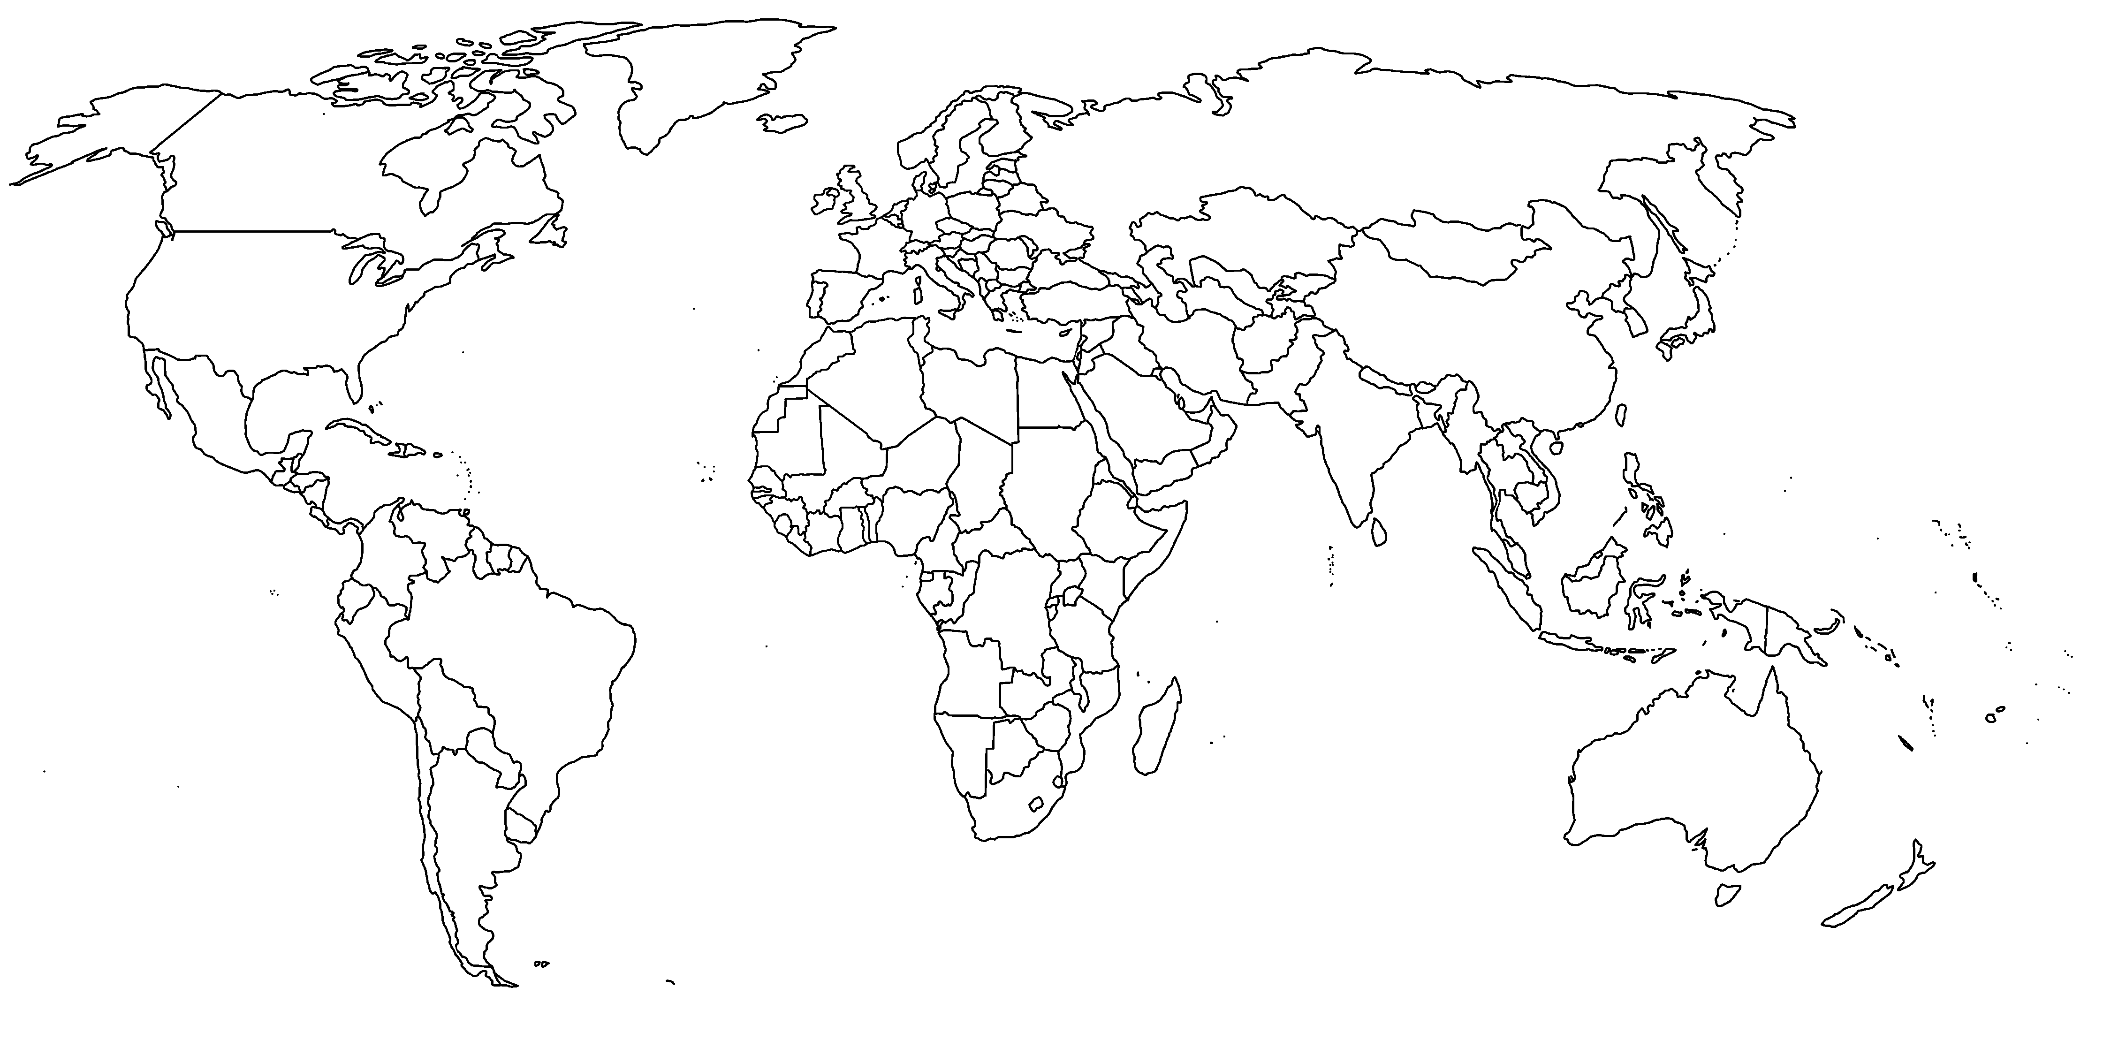

Norrland Sweden
Newfoundland
Wales
West of Ireland
Hebei and Shandong provinces
South of Spain
Tanzania
Queensland
Rio Grande do Sul
Hawkes Bay
GLOBAL-RURAL project
European Research Council Advanced Grant
2014-2019
@globalrural
www.globarlruralproject.wordpress.com

Slide 5
Assemblage approach
Emphasises the relational, heterogeneous and contingent nature of social, economic and environmental formations
“assemblages are composed of heterogeneous elements that may be human and non-human, organic and inorganic, technical and natural.”
Anderson and McFarlane (2011) in Area, p 124
“The term is often used to emphasise emergence, multiplicity and indeterminacy, and connects to a wider redefinition of the socio-spatial in terms of the composition of diverse elements into some form of provisional socio-spatial formation”
Anderson and McFarlane (2011) in Area, p 124

Slide 6


Assemblage approach

Slide 7
Assemblage approach
An assemblage comprises material and expressive components
An assemblage is stabilized and destabilized through processes of territorialization and deterritorialization
An assemblage is given an identity through coding and decoding
Assemblages are dynamic and constantly changing
Assemblages are characterized by ‘relations of exteriority’

Slide 8
Assemblage approach
Assemblages are characterised by ‘relations of exteriority’
“[The capacities of an assemblage] do depend on a component’s properties but cannot be reduced to them since they involve reference to the properties of other interacting entities” (De Landa, ANPS, p 11)
“a component part of an assemblage may be detached from it an plugged into a different assemblage in which its interactions are different” (De Landa, ANPS, p 10)

Slide 9
Globalization and assemblage
Globalization as assemblage (verb) or assembling (agencement)
Globalization as involving interactions between interconnecting assemblages (noun)
  Global or translocal assemblages (cf Collier & Ong 2006)
  National assemblages
  Local assemblages, characterized by relations of proximity
Places as assemblages

Slide 10
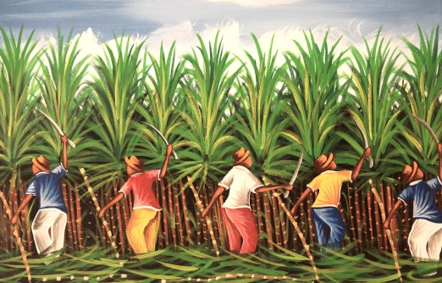
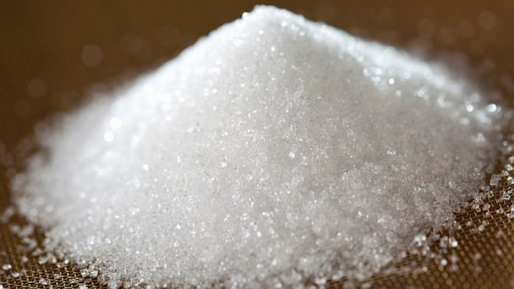

Global sugar assemblage
Components: Cane, beet, raw sugar, refined sugar, mills, refineries, storage, transport, packaging, consumer products, labour, consumers, capital, corporations, regulatory institutions, etc.
Territorialisation: Commodity chains connecting production and consumption, shaped by regulatory structures and agreements
Failure of the 1937 International Sugar Agreement
Striated territorialisation of bilateral preferential agreements between producers and major markets (e.g. UK imperial preference system)
Underpinned by tariffs, subsidies and negotiated preferential prices

Slide 11

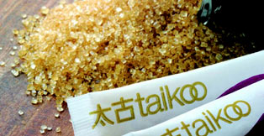
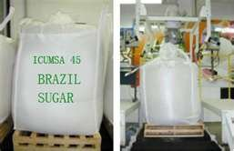
Global sugar assemblage
Recoding of sugar in popular culture from luxury to unhealthy food
Decline in sugar consumption in west balanced by rise in consumption in Asia > reterritorialization
Negotiation of new agreements for supply to emerging markets, competition between producer nations
Increase in supply of sugar from Brazil to world market (linked to reconfiguration of Brazilian sugar assemblage with deregulation and end of Proalocool Program), 8% market in 1981 > 21% in 2001
Global over-supply of sugar and long-term decline of world market price

Slide 12
World production and consumption of sugar
(Data from Australian Sugar Yearbook 2001)
Moreton Mill closure Dec 2003
Monthly average price of New York Daily Price, Contract No 11, for raw sugar, 1985-2015 (Data from www.indexmundi.com)

Slide 13
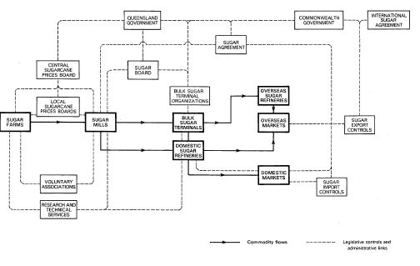
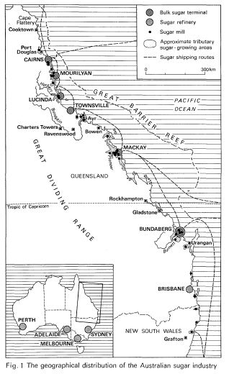
Australian sugar assemblage
Highly regulated industry with distinctive territorialisation
Monopoly structure in which Queensland Sugar acquires nearly all raw sugar when crushed and acts as a single-desk exporter
Supply controlled through system of assignments, with cane-land assigned to a particular mill with production quota
Segmented spatial territorialisation with little competition between mills
Both figures from Hoyle (1980)

Slide 15
Australian sugar assemblage
“A key feature of the sugar industry is the strong interdependency between cane growers and mill owners. Sugarcane must be milled within 16 hours of harvesting to prevent deterioration. Similarly, sugar mills represent dedicated capital, which, without a steady supply of cane, have little or no value. Thus, a high degree of coordination between cane growers and mill owners is necessary to maximise returns (for example, coordinating transport arrangements, agreeing on optimal harvesting times, etc.)”
Boston Consulting Group (1996),
report for Sugar Industry Review Working Party

Slide 16
Australian sugar assemblage
Over 80% of Australian raw sugar exported in late 1990s
Australia more exposed to world market fluctuations than any other major sugar producer
Re-orientation of exterior relations following end of British imperial preference system, search for new markets, especially Asia – but volatile
Advocate for liberalisation of world sugar markets and access to protected markets such as USA
Dismantling of protection of domestic market, removing tariff on imported sugar at estimated cost of $26.7 million to sugar industry

Slide 17
Australian sugar assemblage
Australian competitive advantage in global assemblage relied on productivity, technical innovation and proximity to emerging markets
Advantages eroded by mobility and mutability of components: incorporation of Australian innovations in other national assemblages, notably Brazil
Loss of share in Asian markets to Brazil; drop in share of world market from 22% in 1993 to 15% in 2001
Continuing low world market price of sugar
Poor weather depressed Queensland sugar harvest in 1998

Slide 18
Moreton Mill sugar assemblage
Cane-land
Cane plants
Cutters and cutting equipment
Cane trains
Mill
Milling equipment
Mill labour
Raw crushed sugar
Waste and by-products

Slide 19
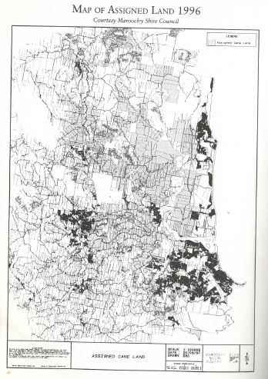
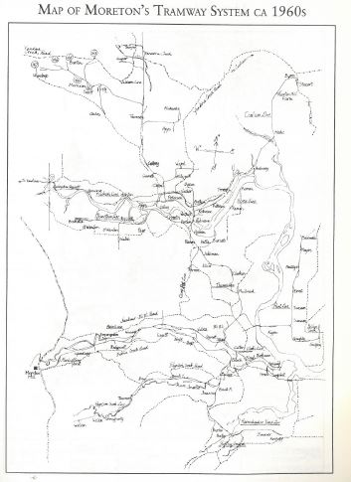
Moreton Mill sugar assemblage

Slide 20
Moreton Mill sugar assemblage
“The profitability of a mill summarises the return for the sector is relational to inputs, specifically the large amount of capital invested in a highly specialised infrastructure. Profitability at a given price for raw sugar is fundamentally determined by the volume of cane a mill receives, and therefore by its supply area. A threshold amount of cane throughput and its associated raw sugar production are required to ensure profitability.”
Walker et al. (2004) Regional Planning and the Sugar Industry, p 52

Slide 21
Moreton Mill sugar assemblage
Consensus view that viability of mill depended on increasing production
Increasing production required expanding the assigned land: reterritorialisation by recoding and enrolling new components
Competition for land with alternative assemblages, especially urban development and tourism
Efforts to protect cane-land through local zoning laws not sufficient?

Slide 22
Moreton Mill sugar assemblage
Long-term viability of the Moreton Mill sugar assemblage constrained by the materiality, arrangement and adaptability of its components, but ultimately defined by interaction with other assemblages, local and global:
  Geographical location and competition from other local assemblages
  Reconfiguration of the global sugar assemblage and fluctuations in the world market price for raw sugar
  The recoding of Moreton Mill within the corporate assemblage of its owners

Slide 23






Owners of Moreton Mill
2000-2003
Finasucre
1991-2000
Tate and Lyle plc
1988-1991
Bundaberg Sugar Ltd
1976-1988
Howard Smith Ltd
1894-1976
Moreton Central Mill Ltd

Slide 24
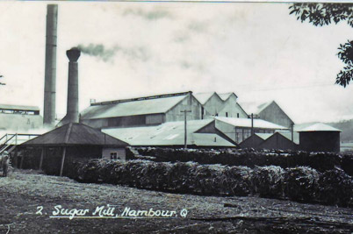
Closure of Moreton Mill at the end of the 2003 crushing season

Slide 25
Reassemblage
Initial responses focused on finding alternative uses for cane sugar; i.e. attaching the components to a new assemblage
Attach to another sugar mill’s assemblage
  Some cane transported to Maryborough (150km north)
  Only economical in times of higher world sugar prices and only for growers in north of Moreton district on bitumen roads
  10 cane-growers in Nambour district supplying Maryborough 2014
Attach to the global ethanol assemblage
  Introduction of new components (processing plant, capital)
  New exterior relations
  Still required cane to be crushed
  Growers cooperative sought to buy Moreton Mill
  Owners refused to sell

Slide 26
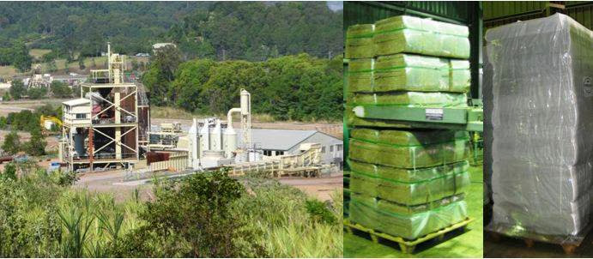
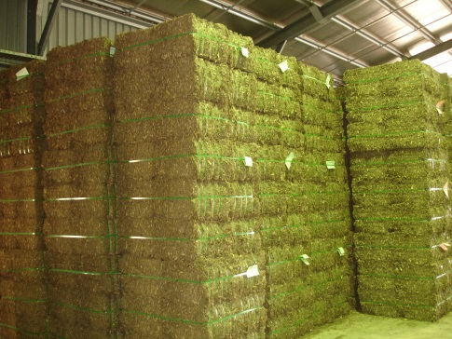
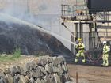
Reassemblage
Construct a new assemblage with a new product for new markets
  Locally developed process to turn cane into stockfeed for cattle, marketed as ‘cow candy’
  Biocane identified markets in Japan and South Korea
  Used some machinery from Moreton Mill but not site
  Capital investment required for new plant – government funding replaced by Chinese investment
  Technical difficulties drained capital reserves and production and supply hit by two wet seasons
  The components did not behave as they had been coded
  Biocane went into administration in 2010

Slide 27
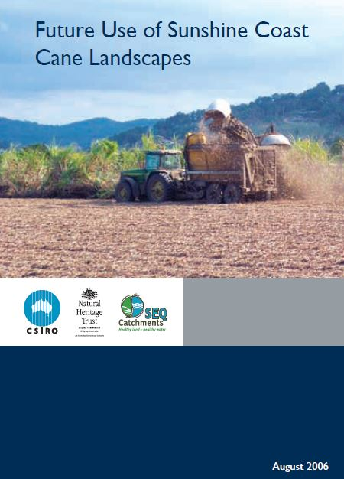
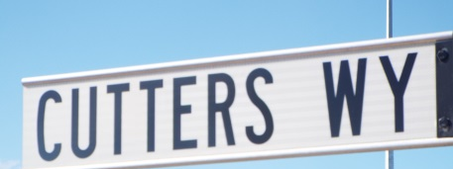
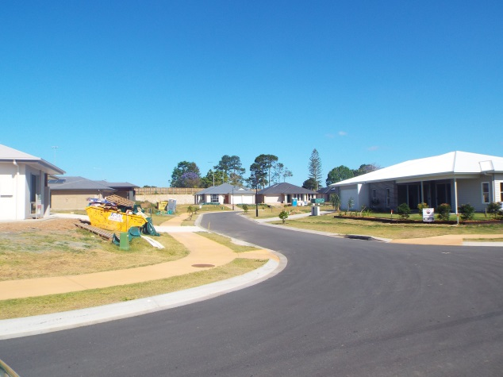
Reassemblage
Dismantling the sugar assemblage and attaching components to alternative assemblages
Converting cane land to new uses
Land suitability study undertaken by CSIRO to identify alternative agricultural uses = recoding land
Individual farmers converting to turf, farm forestry etc, but for many no real alternative
Sale of land for housing development
  Still restricted by zoning to protect cane land
  Reaffirmed by SE Queensland Regional Plan 2004
  Limited exceptions, e.g. Cutters’ Ridge estate

Slide 28
Nambour as an assemblage
Mill, canefields, trains and sugar all key components in the place-assemblage of Nambour
Material role of these components included generating employment and income
1970s: 2,300 people employed at peak season and AUS$4m generated for local economy
“The economy of Nambour presents a fairly diversified picture but with a heavy dependence on the sugar industry” (Field Study of Nambour and District 1971)
Viability Report 1989: 550 direct jobs, 1100-3300 indirect jobs, direct value of production of up to $25 million p.a.
“The sugar industry makes major contributions to the output, income and employment in the region. It is vitally important that this contribution be maintained” (Viability Report 1989)

Slide 29
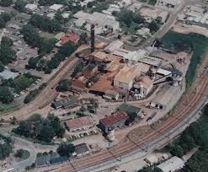
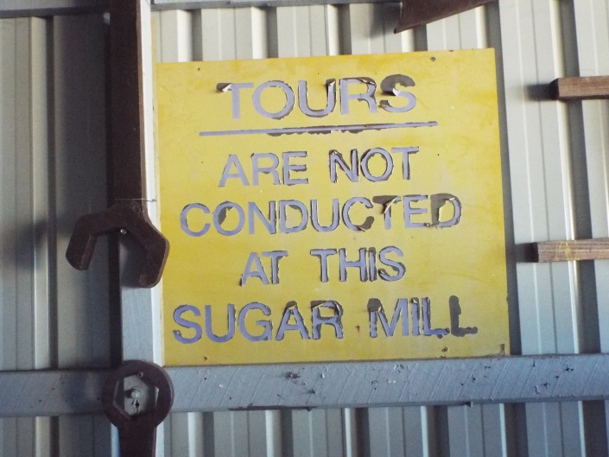
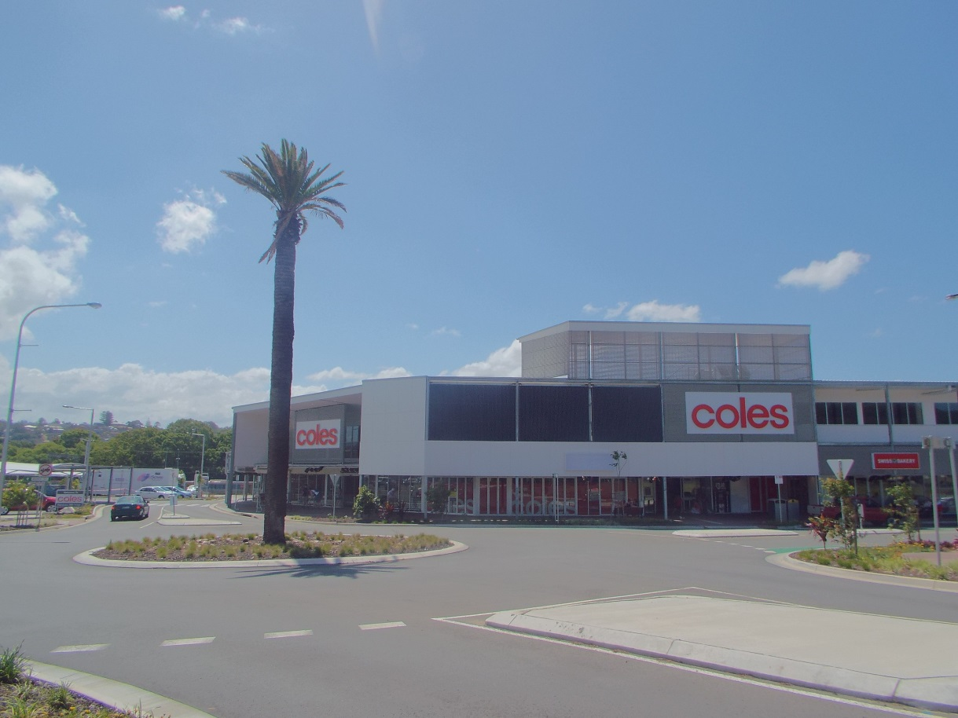
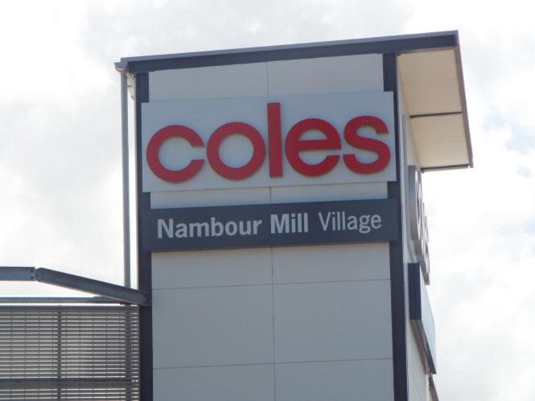

Slide 30
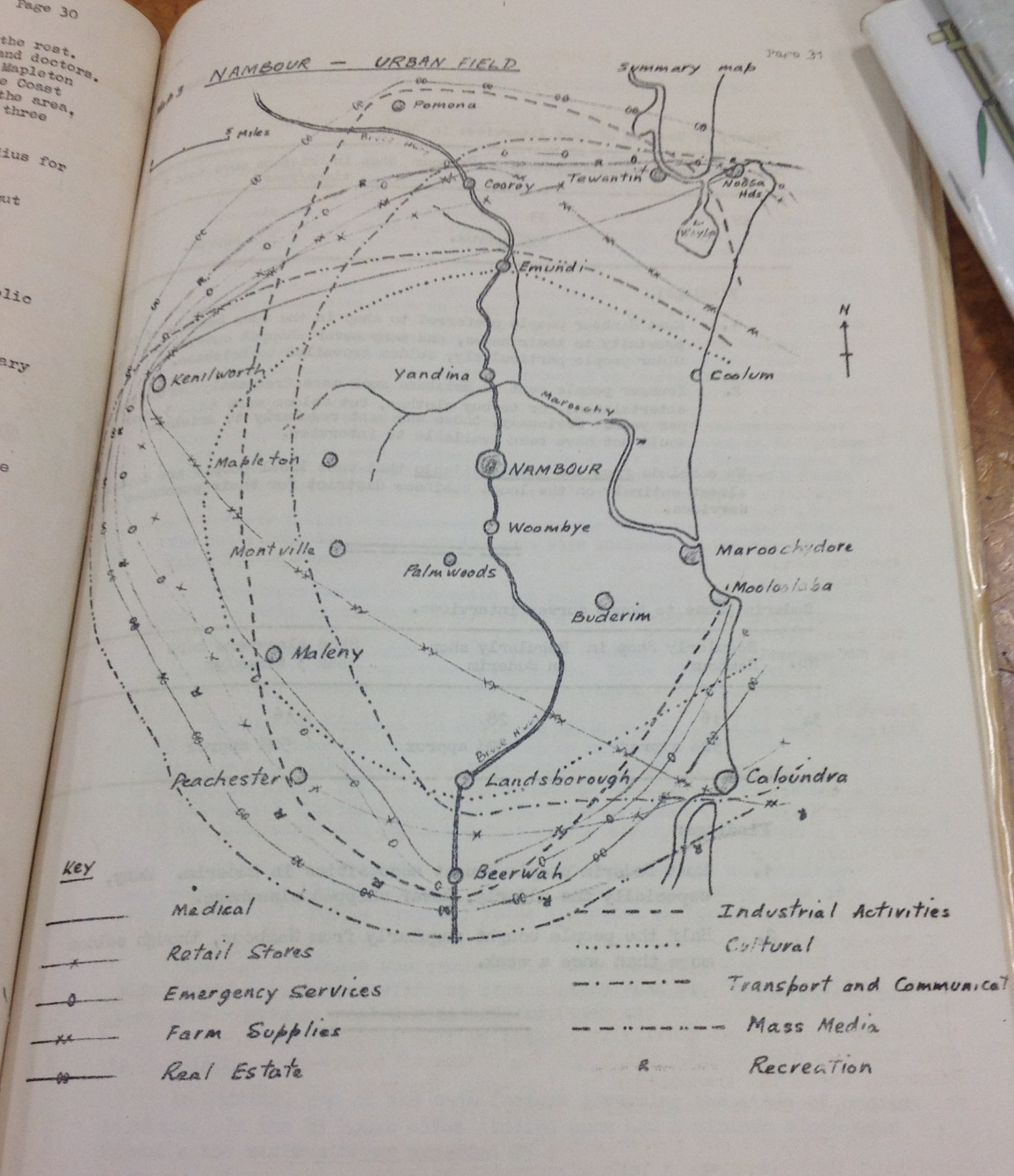

Slide 31
Nambour as an assemblage
Mill, sugar and trains also played expressive roles significant to the identity of Nambour
“The dark plume hanging over the town was not the only smoke in the air as bush fires were raging all around the district, but the mill stack was pumping out carbon, oblivious to the housewives’ cries of frustration at having their washing blackened. It was all in a good cause, they were told. The ash from the stack, and the heavy sweet smell of molasses, were the symbols of prosperity not just for the farmers, but for the whole town.” (Richardson 2013, in Sunshine Coast Daily, 26/10/13).

Slide 32
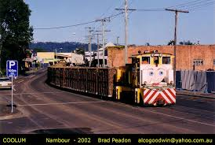

Slide 33
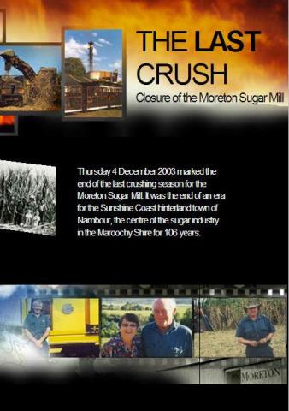
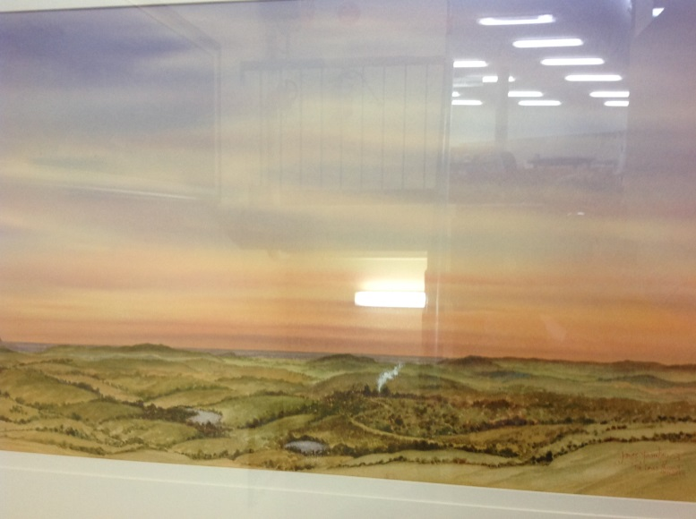



The Last Hurrah Nambour
by James Fearnley
(Nambour Library)
“Whatever happens to the cane farms, Nambour and the Sunshine Coast will never be the same again”
ABC 7.30 Report, 15/07/03

Slide 34
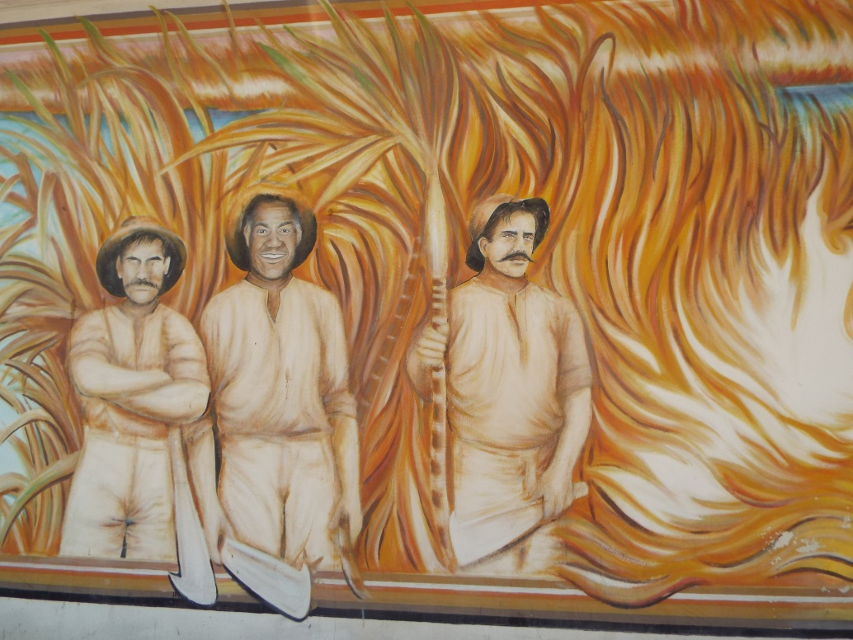
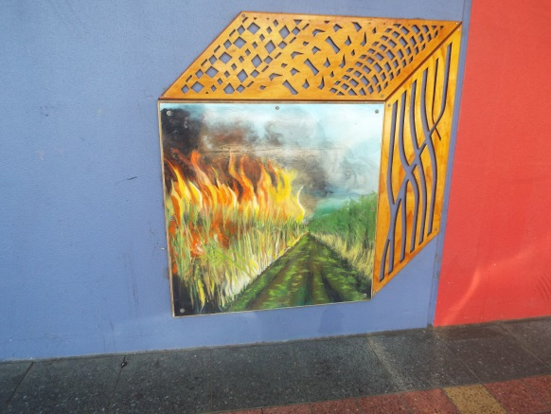
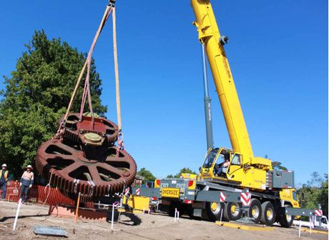
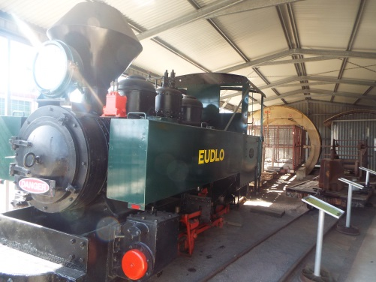
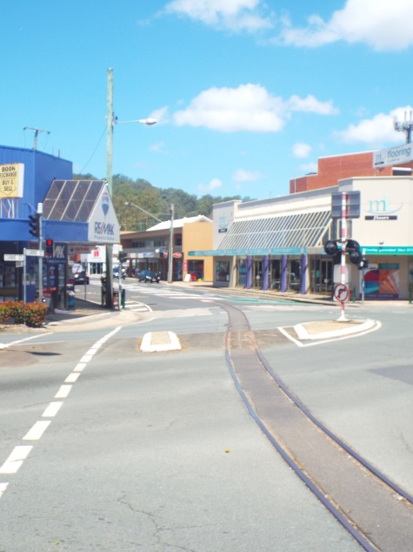
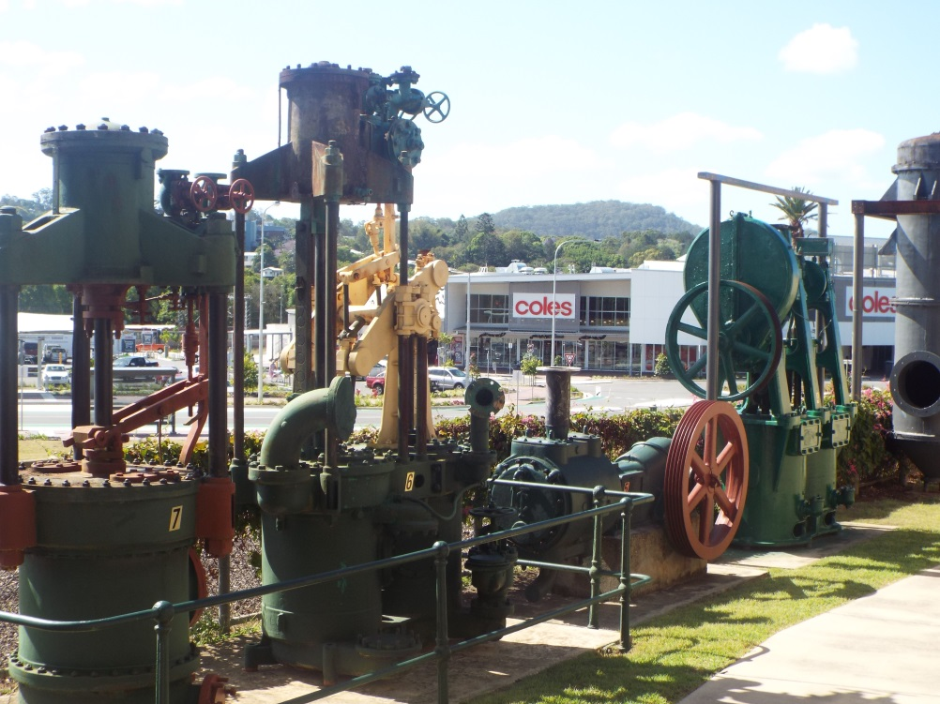
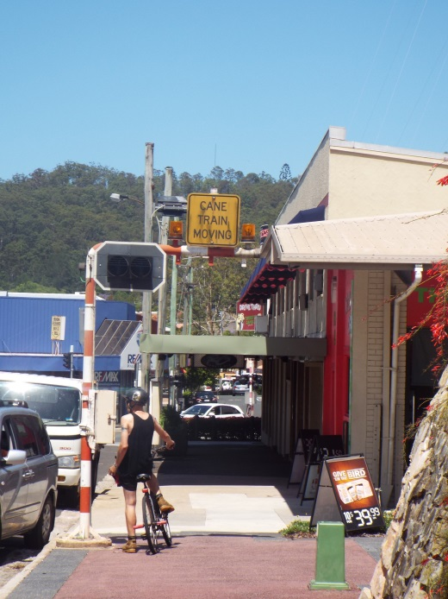

Slide 35
Conclusions
Insights from an assemblage approach:
Illuminates the microprocesses and connections through which global processes impact on localities
Global restructuring involves the addition, removal and mutation of components in global assemblages
External pressures from re-coding of assemblages and components
Re-territorialisation that changes how components relate to each other

Slide 36
Conclusions
Material and discursive nature of components constrains the capacity of local assemblages to respond to external changes
Globalization impacts on local places by cutting external links, removing or changing the role of key components
Local responses need to replace lost components to hold assemblages together
Dismantling of assemblages with components detached and attached to other assemblages
The expressive role of industries can continue in rural localities even once the material role has been lost

