Slide 1
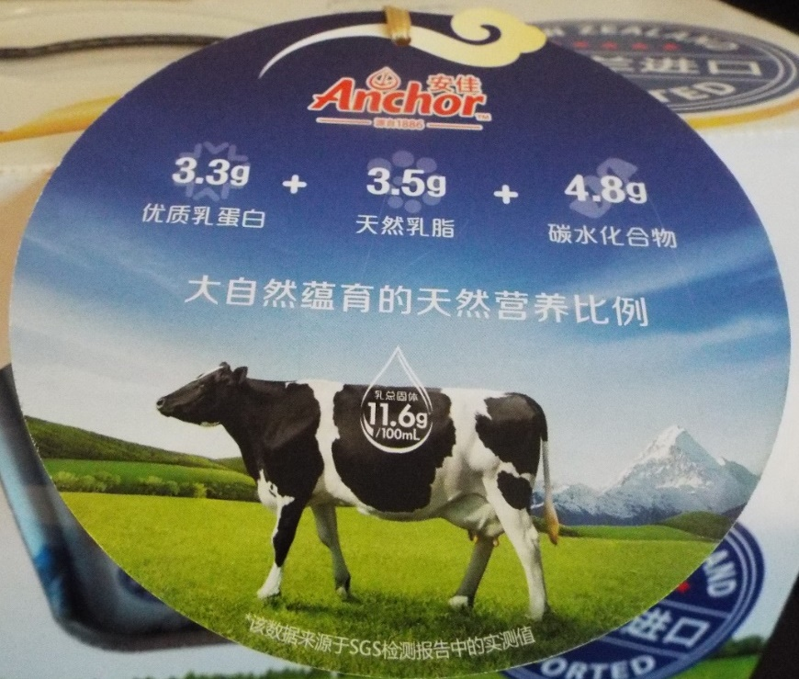



Assembling Globalization and Reterritorializing Rural Infrastructure: China and the New Zealand Dairy Assemblage
Presentation slides available at: http://globalruralproject.wordpress.com
Michael Woods
Aberystwyth University
m.woods@aber.ac.uk

Slide 2
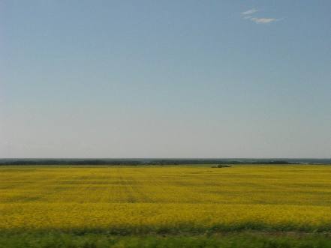
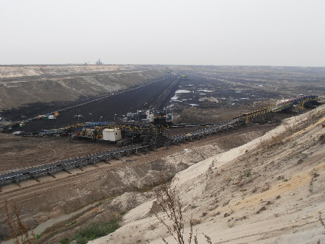
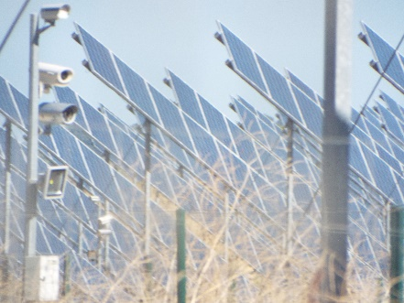
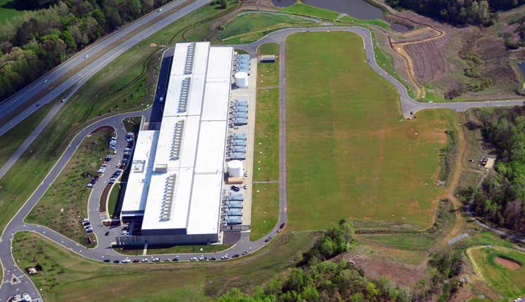
Globalization 2.0 and the Global Countryside
Re-centring and de-centring globalization
Infrastructure within and beyond the global city
Rural resources and rural infrastructure
Globalization reproduced through rural spaces
The ‘global countryside’?

Slide 3
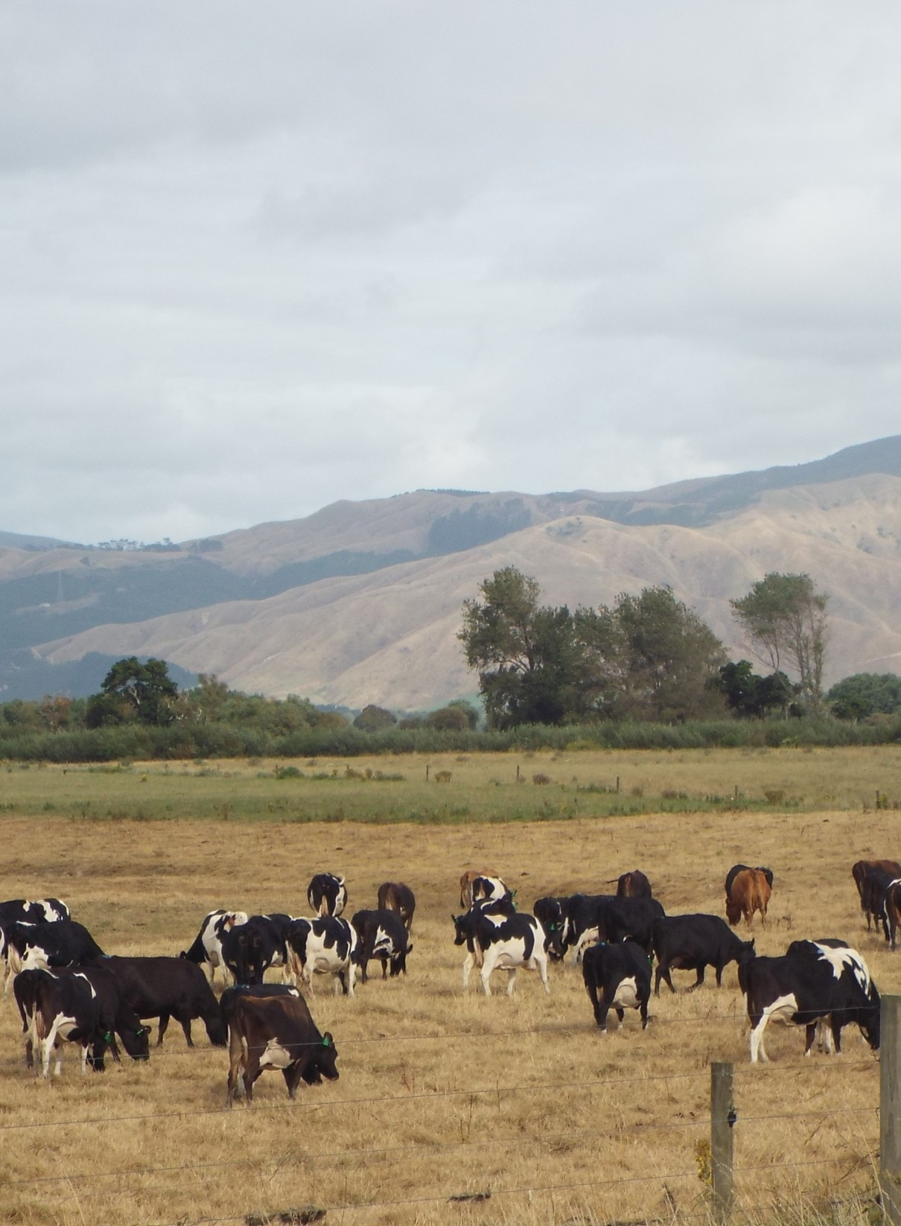
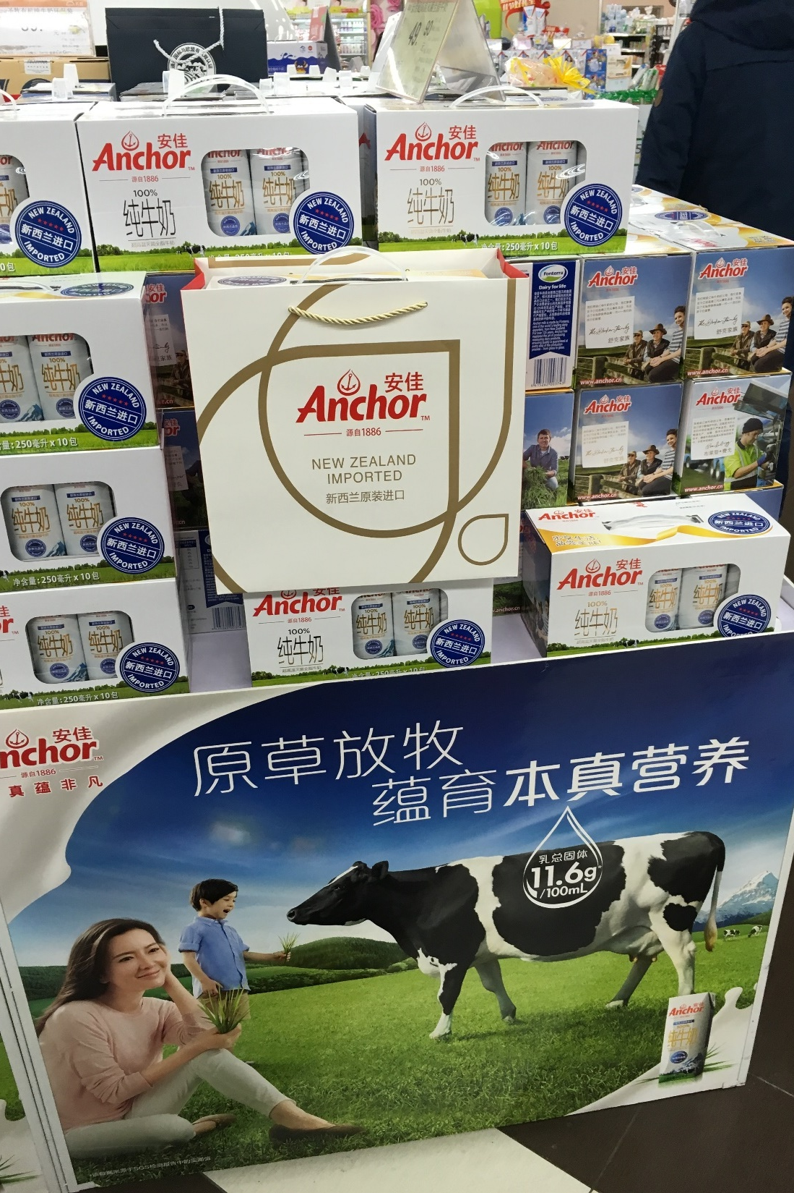

Slide 4
Assemblage and Globalization
Previous AAG paper on ‘Assemblage, Place and Globalization’, available at http://globalruralproject.wordpress.com
Following De Landa’s (2005, 2016) characterisation of assemblages as:
Consisting of heterogeneous components with material and expressive roles
Given shape by territorialization, deterritorialization and reterritorialization (spatial and non-spatial)
Given meaning by coding, decoding & recoding
Defined by the exteriority of their relations
Tending towards internal homogeneity
Dynamic and always in a state of becoming

Slide 5
Assemblage and Globalization
Globalization as the re-assembling (reterritorialization and recoding) of components to form global assemblages
Globalizaton involves re-arranging components within assemblages
Globalization occurs through recurrent interactions between assemblages
Globalization is also articulated in the deterritorialization of assemblages
Globalization proceeds through cycles of coding, decoding and recoding
Globalization as standardization results from tendencies towards the internal homogeneity of assemblages

Slide 6
Assemblage and Infrastructure
Infrastructure facilitates connectivities within and between assemblages
Infrastructure can be enabling and prescribing
De Landa (2005) example of suburban railways
Flying range of aircraft
Deep-water capacity of ports
Connectivity of materials in telecommunications networks
Jane Bennett on agency of infrastructural assemblages

Slide 7
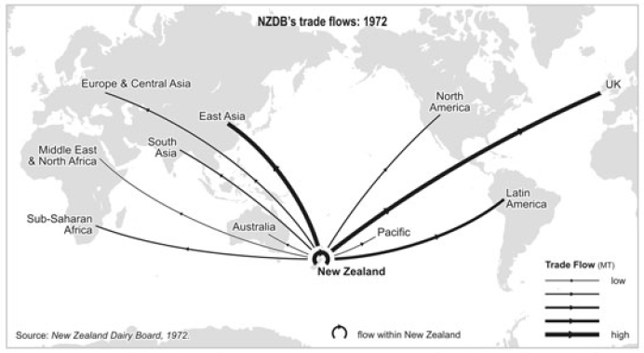
Trade flows of New Zealand Dairy Board 1972
Source: Gray and Le Heron (2010) in New Zealand Geographer

Slide 8
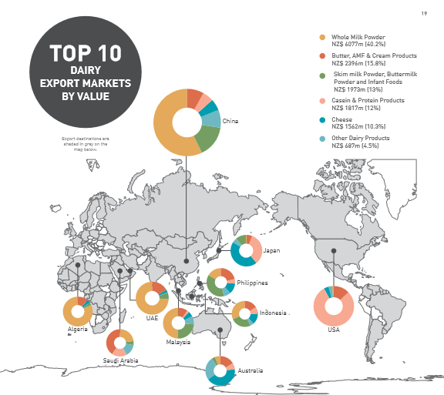
New Zealand Dairy Exports 2014
Source: NZMPI (2015) Situation and Outlook for Primary Industries 2015.

Slide 9
Source: FAOStats
Political economy explanations
Political ecology explanations
The role of infrastructure?

Slide 10
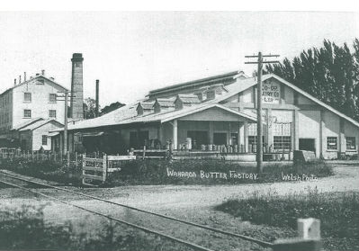
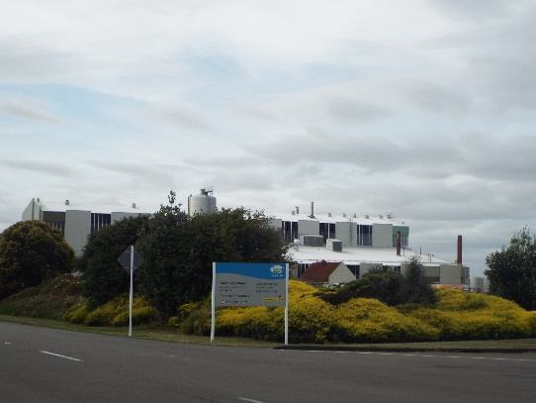
Industrial Infrastructure
NZ dairy industry historically territorialized around butter production
Reterritorialization around whole milk powder production for Asian markets
Construction of milk powder processing plants
Investment in R&D infrastructure

Slide 11
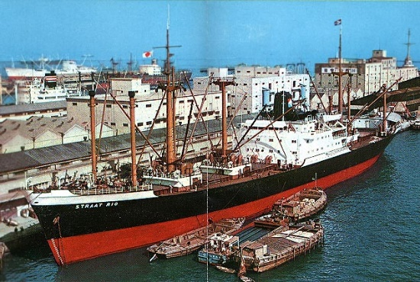
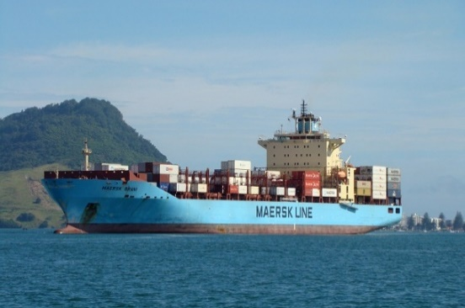
Transport Infrastructure
Serendipity and establishment of Royal Victoria Line shipping link to China
RVL merged into Maersk, handles >90% of NZ dairy exports
As a global transport assemblage, Maersk facilitates access to Chinese ports
Limitations of NZ port capacity

Slide 12
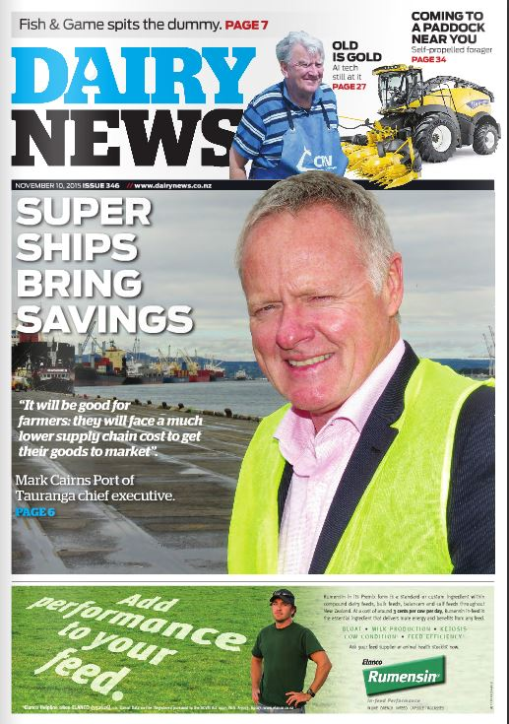
Transport Infrastructure
Joint venture between Fonterra (dairy exporter), Silver Fern Farms, Maersk and Port of Tauranga in NZ$350m upgrade of port facilities
Deepening of shipping channels to handle larger ships
Upgrade in size of ships using port from 4500 teu vessels to 6500 teu and 9640 teu vessels
Tauranga now handles 97% of NZ dairy exports

Slide 13
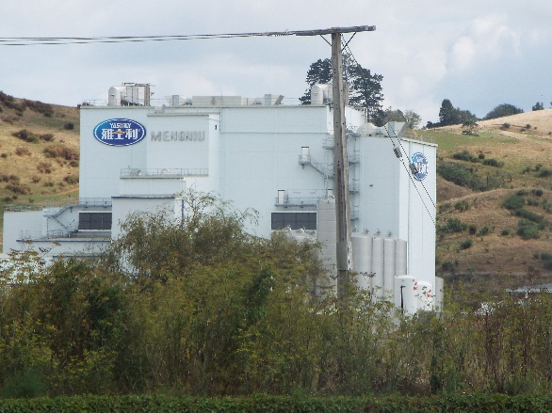
Dynamic Assemblages
Constant reterritorializing as corporate components seek commercial advantages
Fonterra investing in processing plants in China and enrolling Chinese suppliers
Chinese dairy companies buying and building processing plants in NZ and enrolling NZ farmers
Yashily plant at Pokeno, NZ

Slide 14
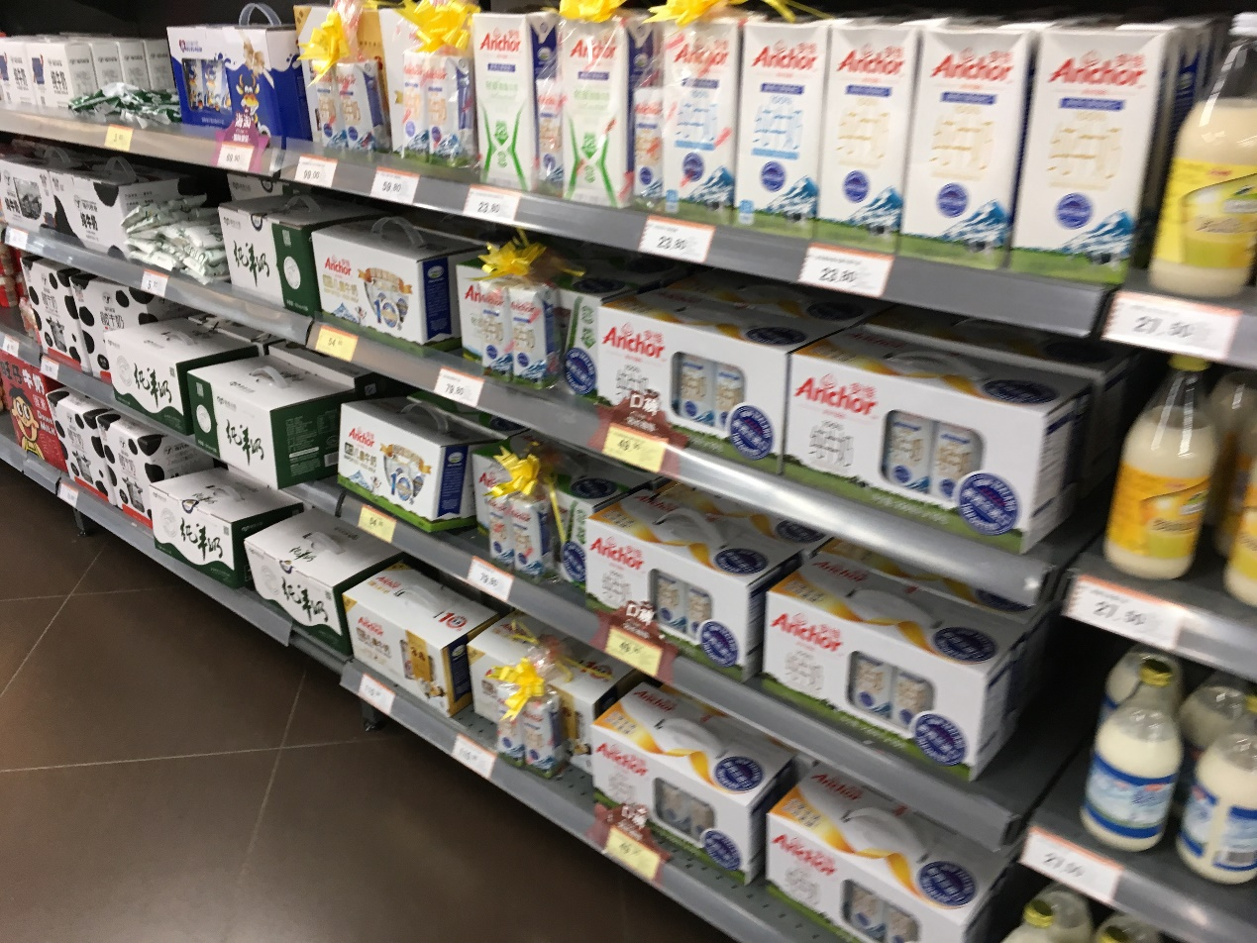
Chinese consumers detaching from milk powder assemblage and attaching to liquid milk assemblage

Slide 15
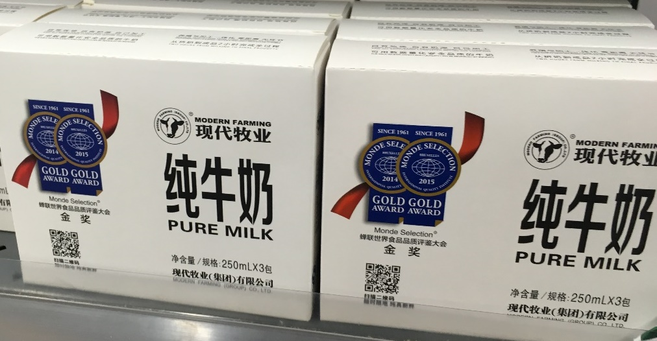
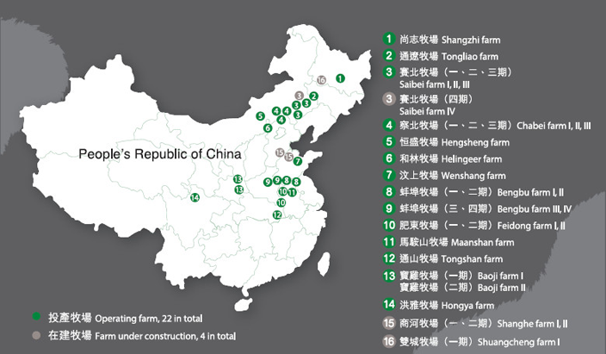
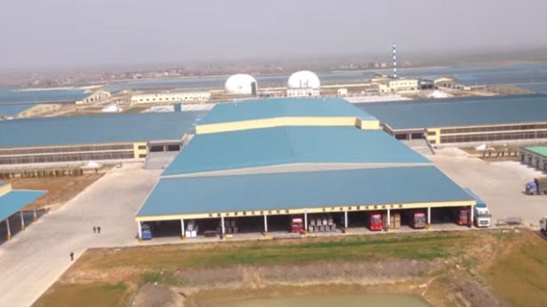
Dynamic Assemblages
Global assembling of Chinese dairying
Clover from California for fodder
Cattle from breeders in South Africa and Uruguay
Capital from New York-based investment company Kohlberg Kravis Roberts & Co

Slide 16
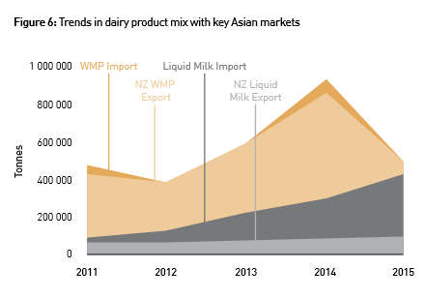
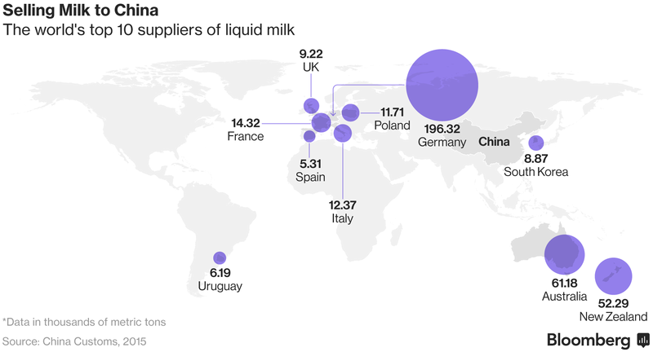
Source: Situation and Outlook for Primary Industries, December 2015 Update
Source: Bloomberg.com, 26 Oct 2016

Slide 17
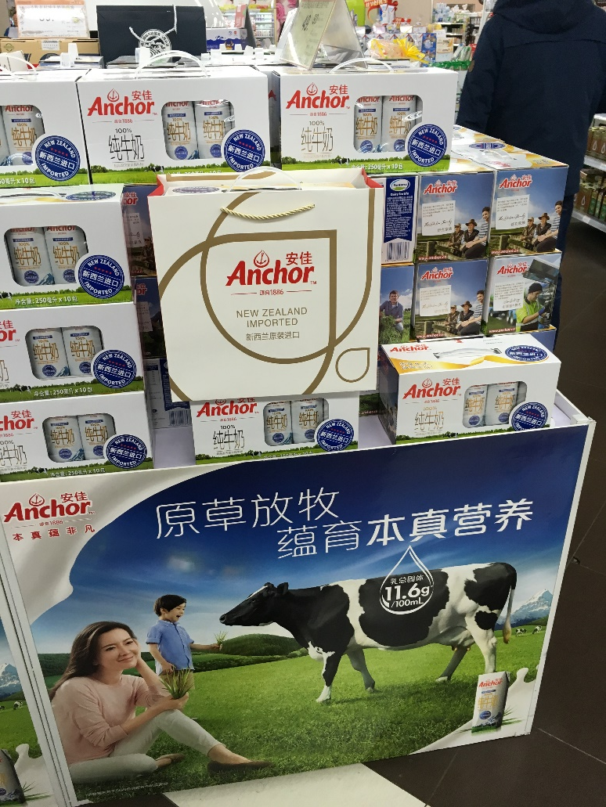
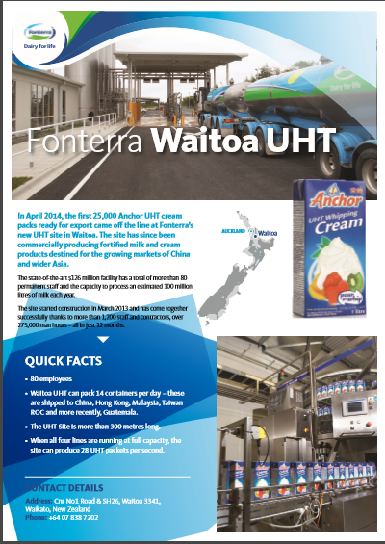
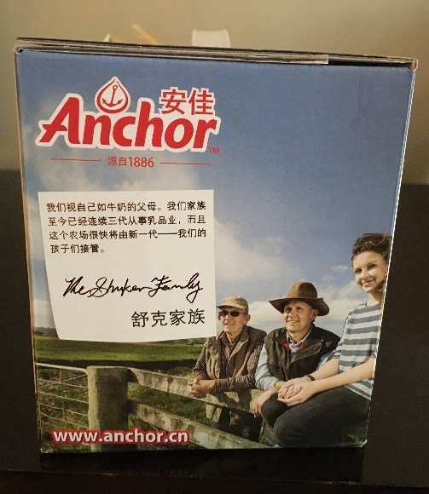
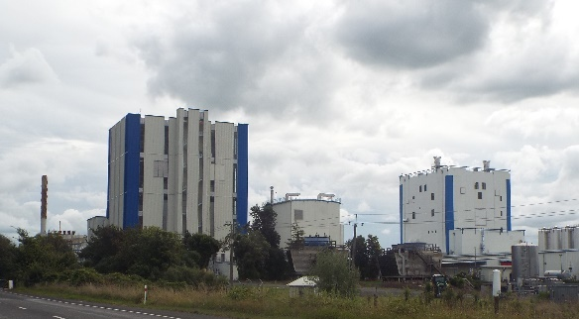
Dynamic Assemblages
Reterritorializing around liquid milk infrastructure
Fonterra’s new UHT plant supplying China, Hong Kong, Malaysia, Taiwan and Guatemala

Slide 18
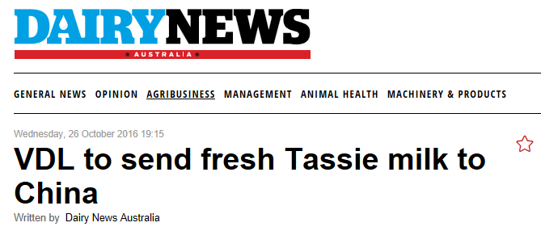
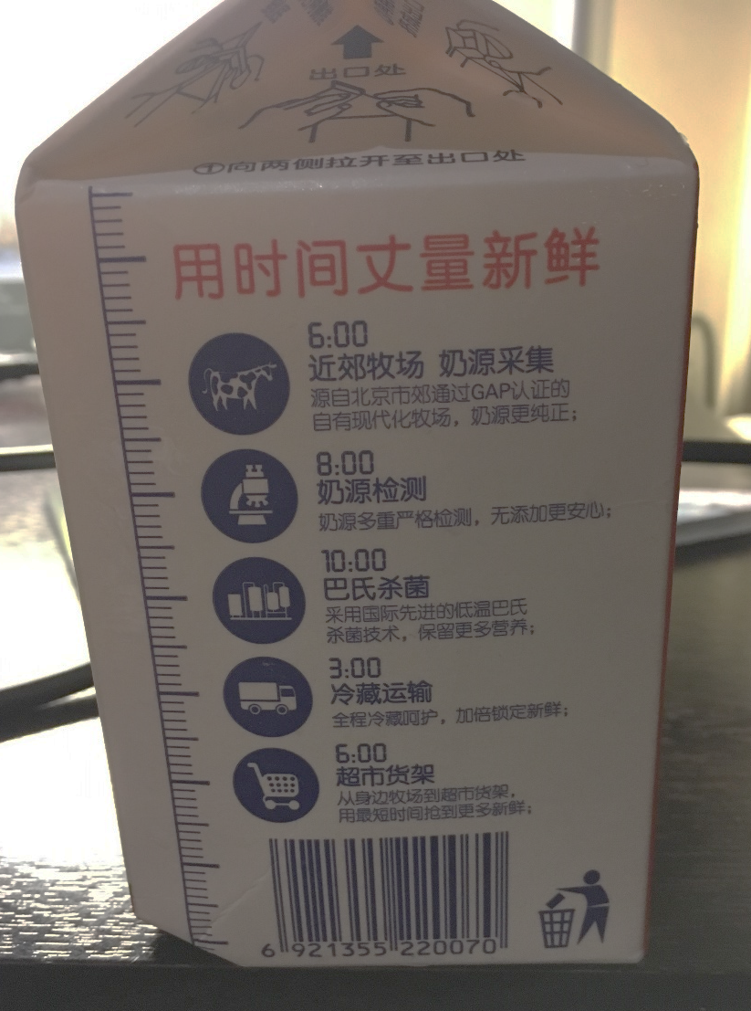
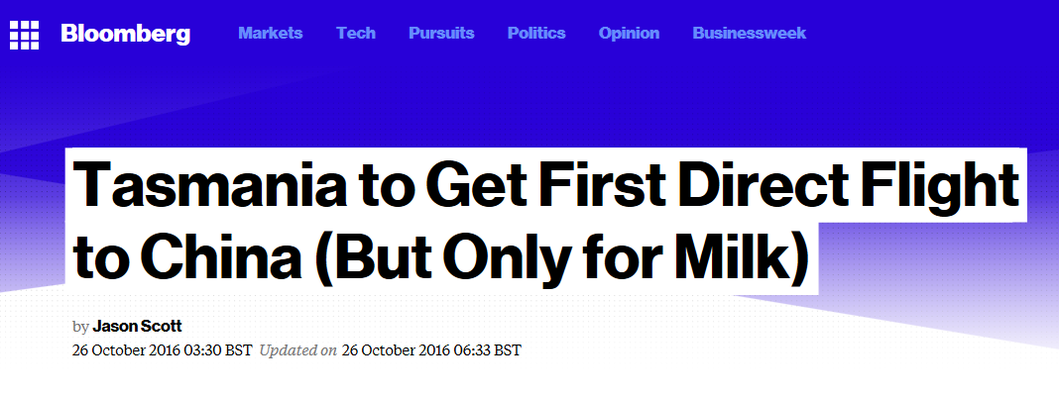

Slide 19
Big infrastructure and little infrastructure
Source: DairyNZ

Slide 20
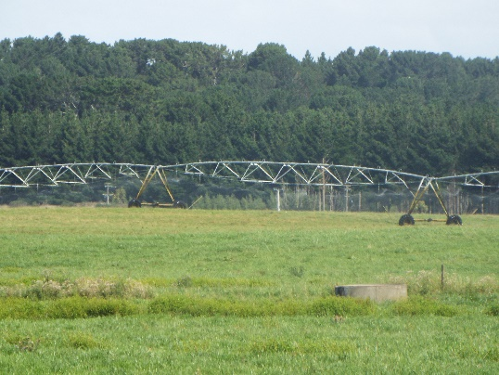
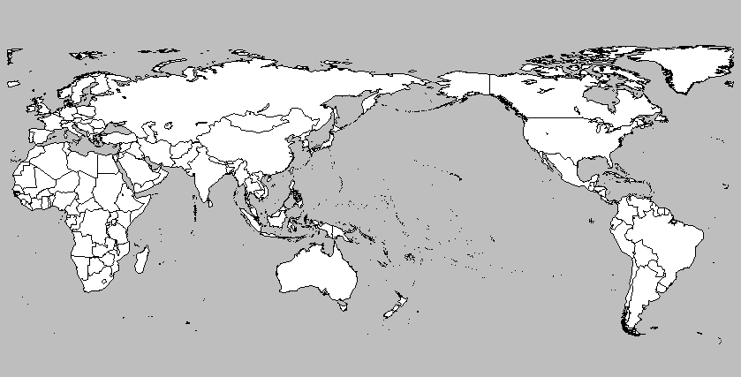

Irrigation
Dairy farms consume average of 83,000 litres of water per day compared with 14,000 litres for beef or sheep farms
On-farm irrigation systems
Local irrigation infrastructure (dams, reservoirs, canals)

Slide 21
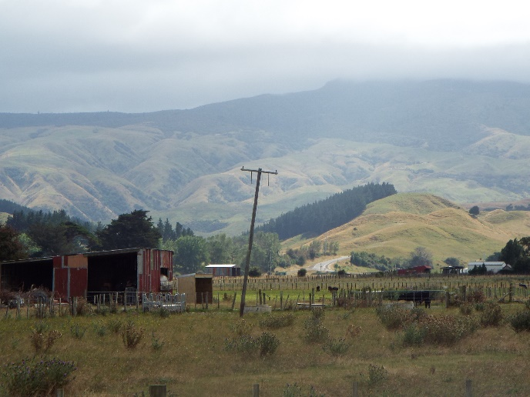
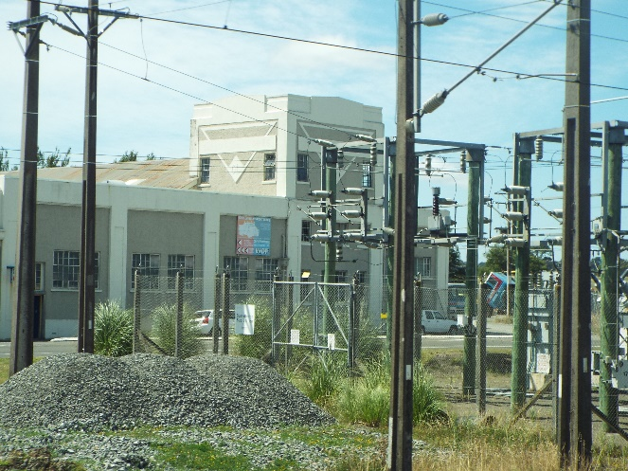
Electricity
Conversion to dairy increases a farm’s electricity demand by factor of 30 or 40
Large dairy farm uses 1 megawatt of electricity = town of 1000 people
Upgrading of local electricity infrastructure
In some districts 20% expansion of electricity supply infrastructure in 1 year

Slide 22
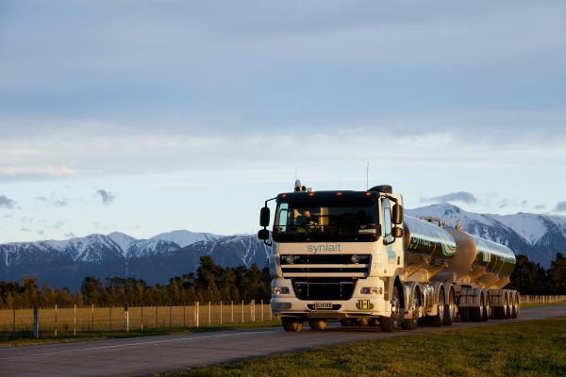
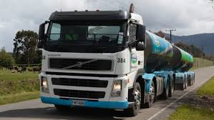
Roads
Construction traffic for dairy conversions
Increased tanker traffic
Increased traffic volumes on rural roads
Concerns about impact on fabric of rural roads

Slide 23
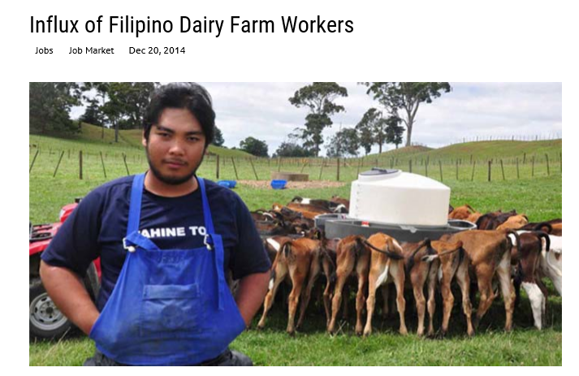
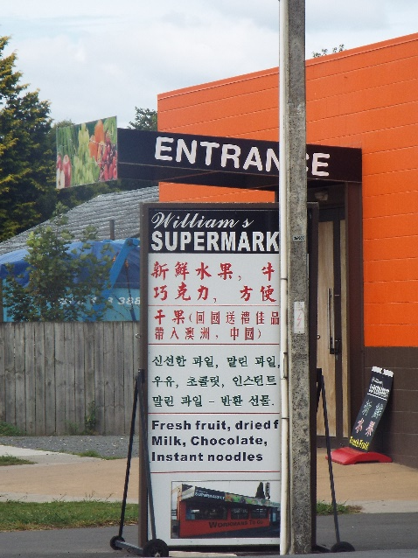
Soft Infrastructure
Professional services, e.g. veterinary surgeons
Filipino and Indonesian migrant workers and Chinese managers
  Connective infrastructure of flights to Philippines, Indonesia etc
  Bolstering threatened rural infrastructure such as schools, stores, churches
  Demand for new soft infrastructure, e.g. English language classes, bilingual signage

Slide 24
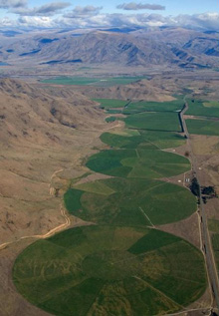
Rural Place-Assemblages
Infrastructural developments for dairying are changing the composition of rural places as assemblages
New connectivities
Changing material and expressive roles of components
Mackenzie Basin, South Island, NZ

Slide 25
Conclusions
Globalization 2.0 expands beyond the city
Rural infrastructure facilitating connectivities and mobilities of people, food and resources
‘Big’ and ‘small’ infrastructure
Assemblage approach highlights material roles of infrastructure and distribution of agency
Also the dynamism of assemblages
Impacts of macro-scale global patterns on local places, and reproduction of globalization through locally-embedded infrastructure and practices

Slide 26
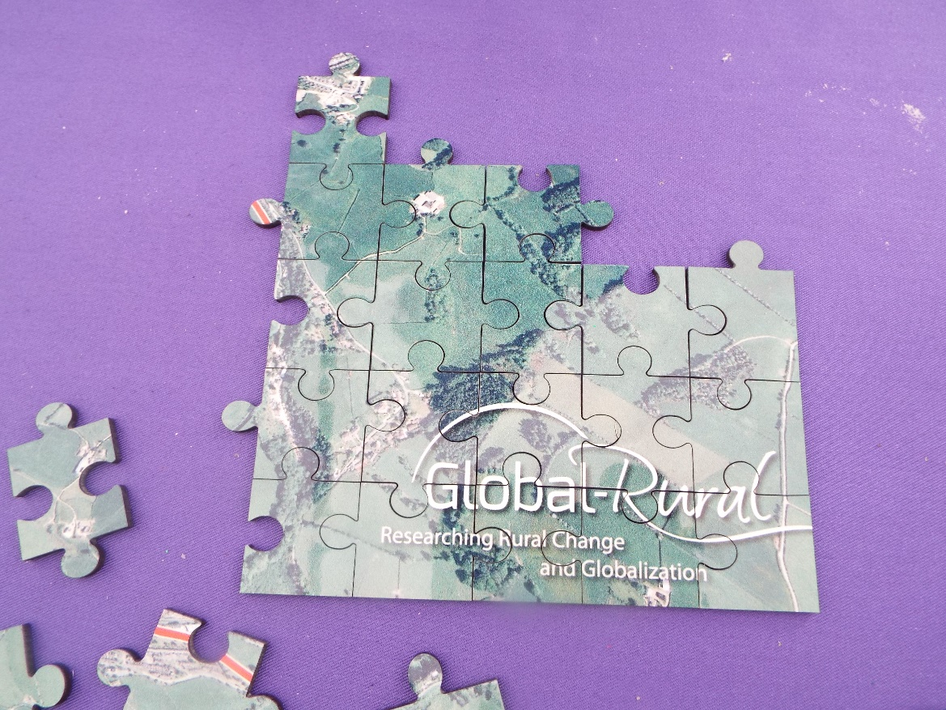
Michael Woods
m.woods@aber.ac.uk
Twitter: @globalrural
Presentation slides available at: www.globalruralproject.wordpress.com

