Slide 1
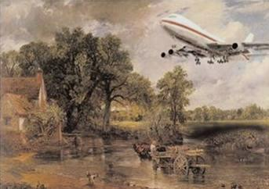



'Stop the world, I want to get off?’
How rural communities respond to globalization
Devon Communities Together Rural Futures Conference 2017 – Changing Worlds
Professor Michael Woods
Aberystwyth University
m.woods@aber.ac.uk
@globalrural

Slide 2
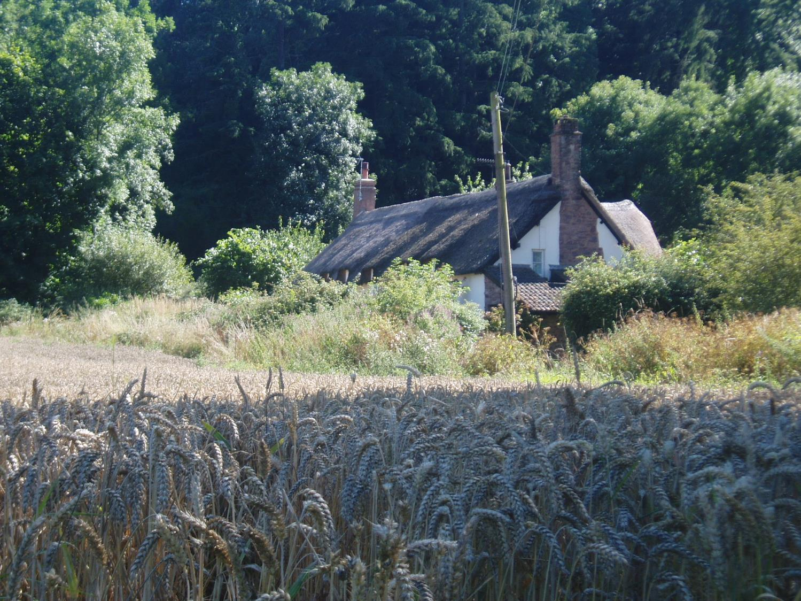
Myth 1: The Countryside is a refuge from globalization

Slide 3
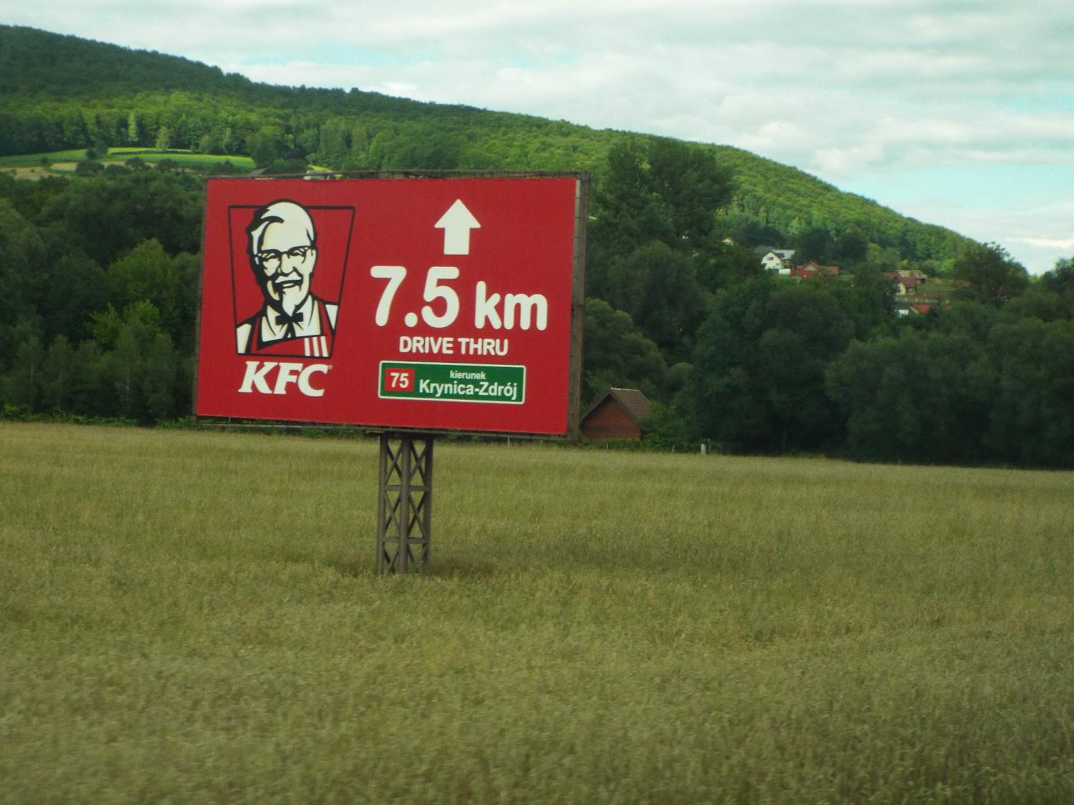
Myth 2: We are all becoming homogenized

Slide 4
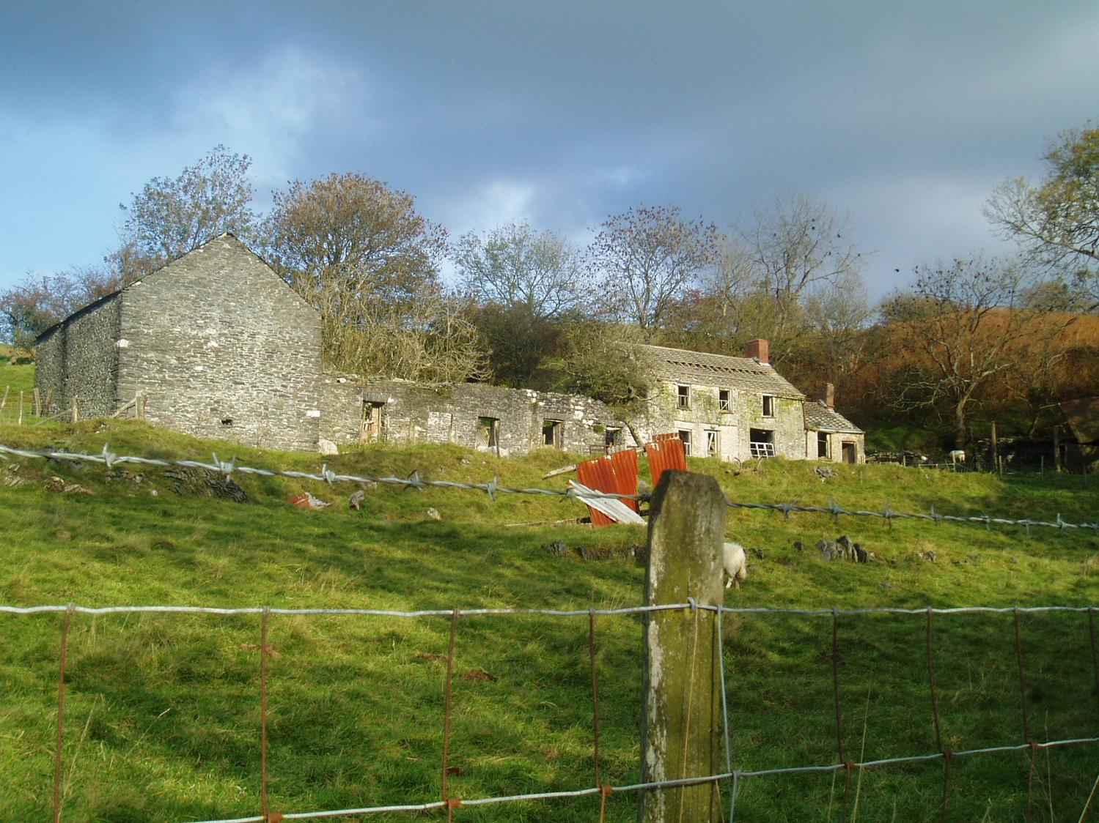
Myth 3: Rural communities are victims of globalization – and there’s nothing we can do about it

Slide 5

What is globalization?
“Globalization refers to a multidimensional set of social processes that create, multiply, stretch, and intensify worldwide social interdependencies and exchanges while at the same time fostering in people a growing awareness of deepening connections between the local and the distant.”
Manfred Steger (2003) Globalization: A Very Short Introduction, p 13

Slide 6
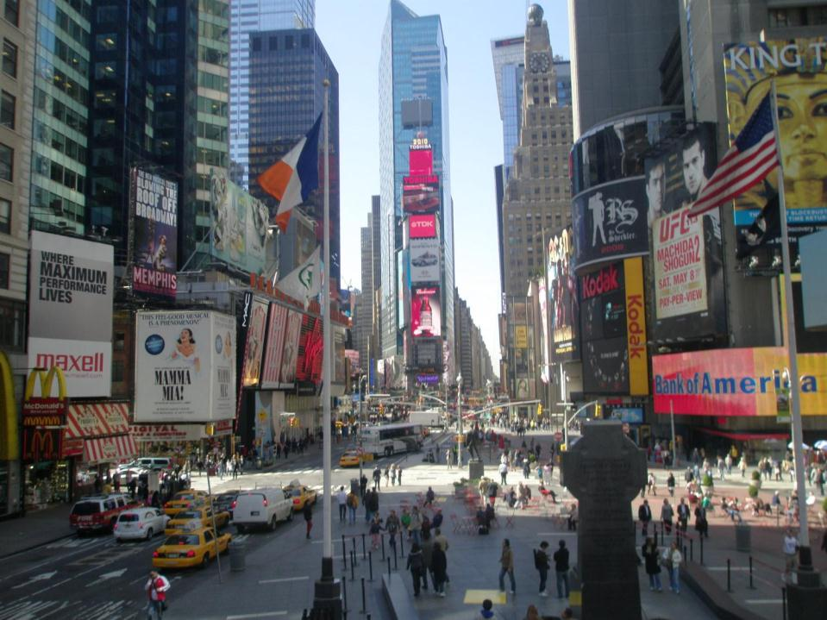
Not just the global city….

Slide 7
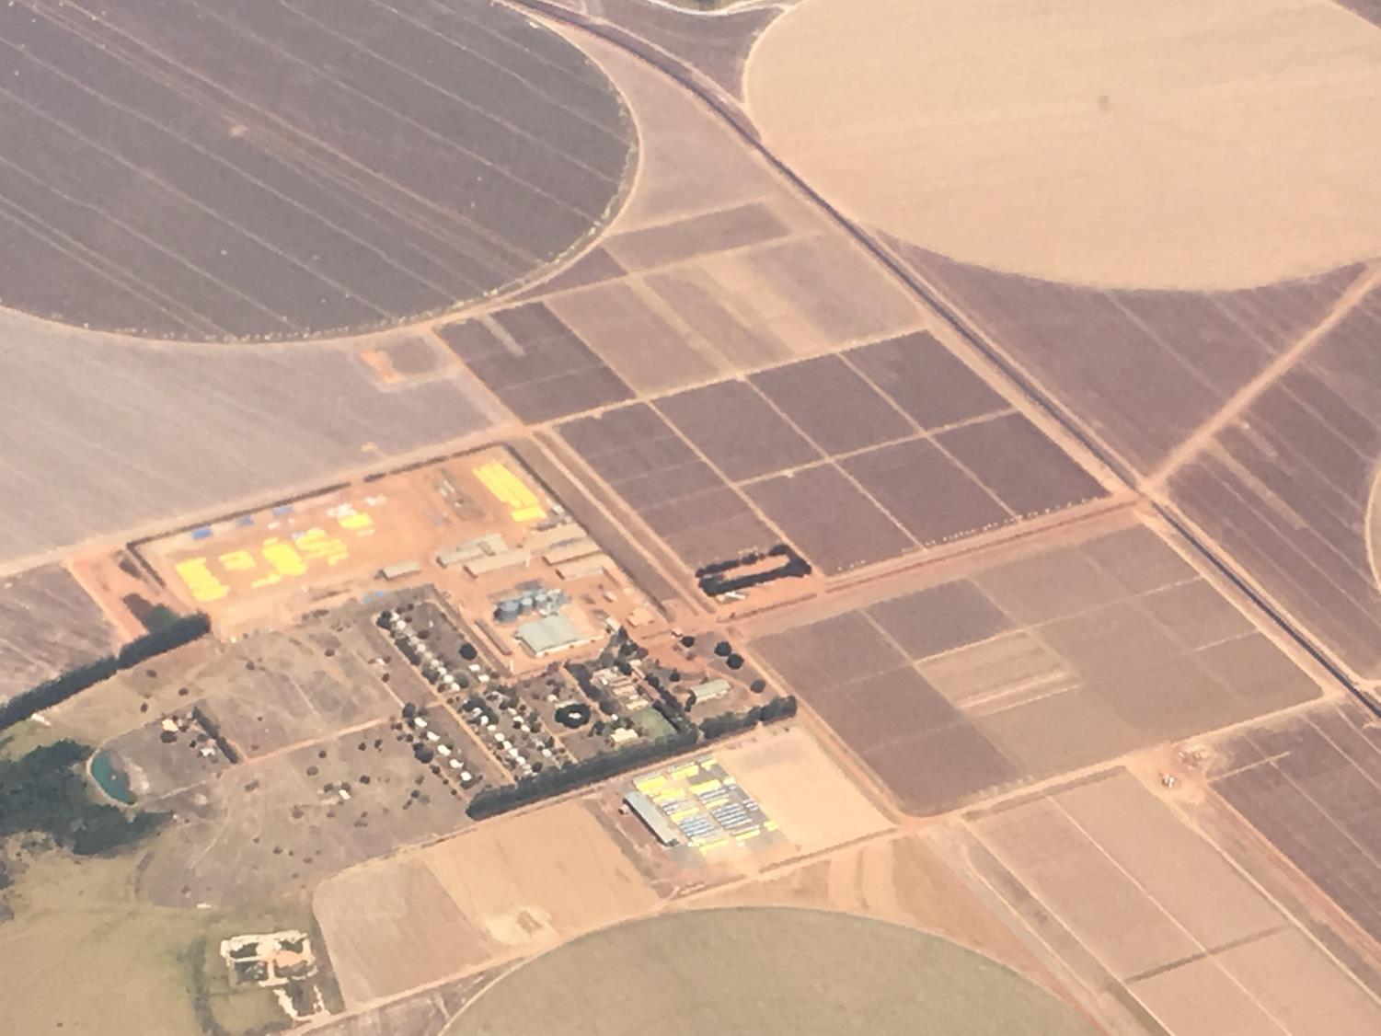
…but also the global countryside

Slide 8
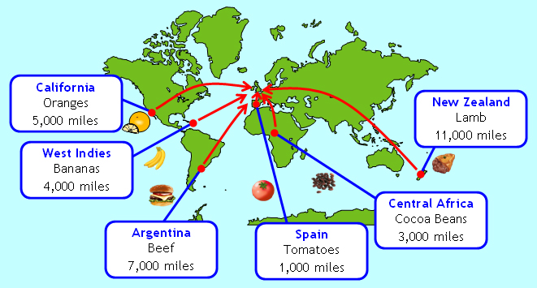
Food supply chains stretched over longer and longer distances
Source: Parkfield ICT

Slide 9
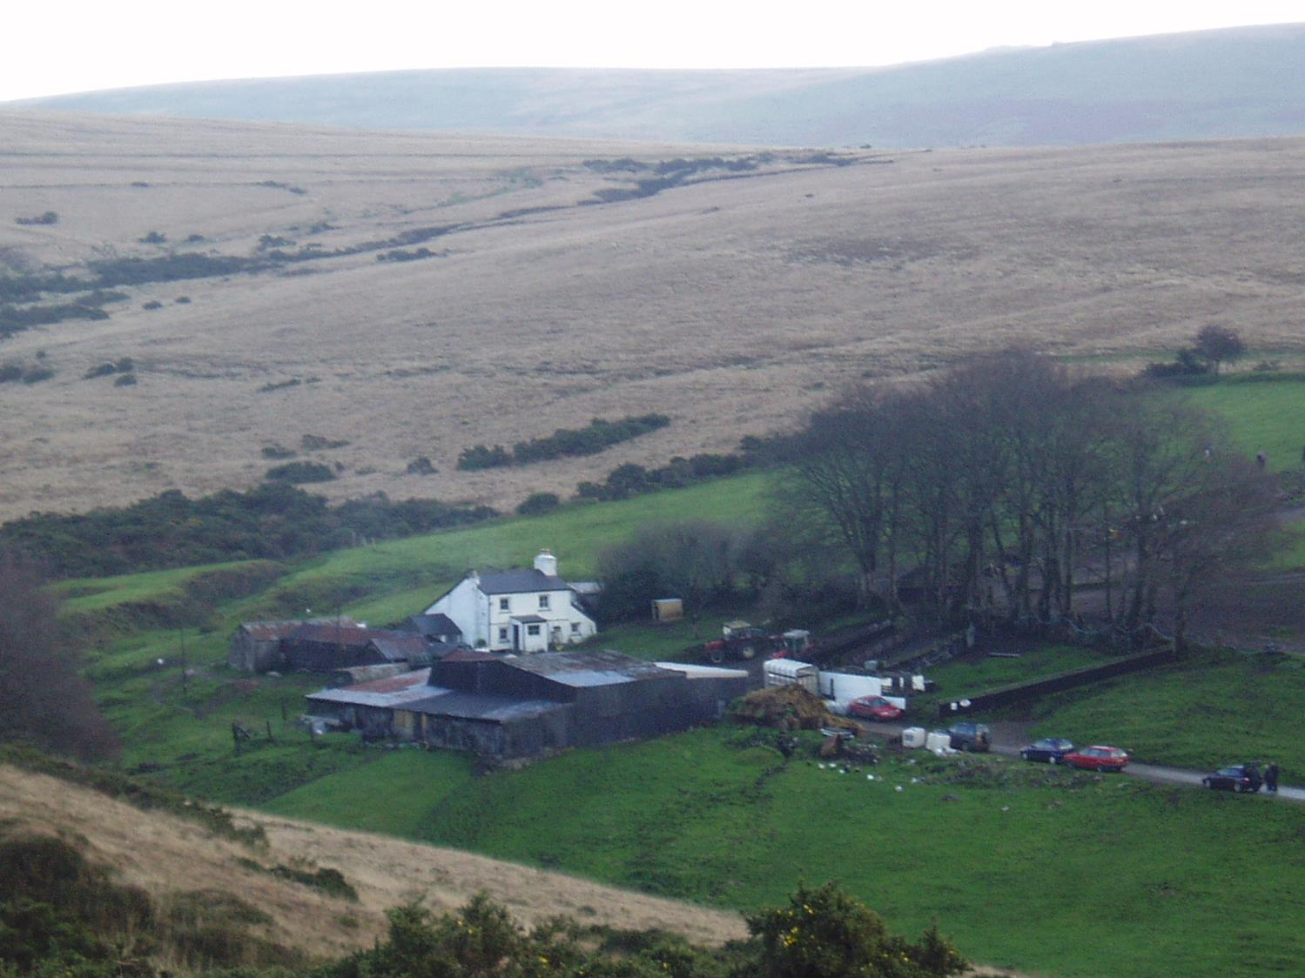
Globalization of agriculture
Liberalisation of global trade
Improved and faster transport
Enhanced preservation and refrigeration technologies
Pressures on food prices and food security

Slide 10
Globalization of agriculture
Concentration of agricultural production in cheapest/most favourable locations
Increased competition for domestic farmers from imports
Farmgate prices influenced by world market prices
Increased power of agribusiness and transnational agri-food corporations
Internationalisation of farm labour
Financial speculation in food futures and ‘land-grabbing’

Slide 11
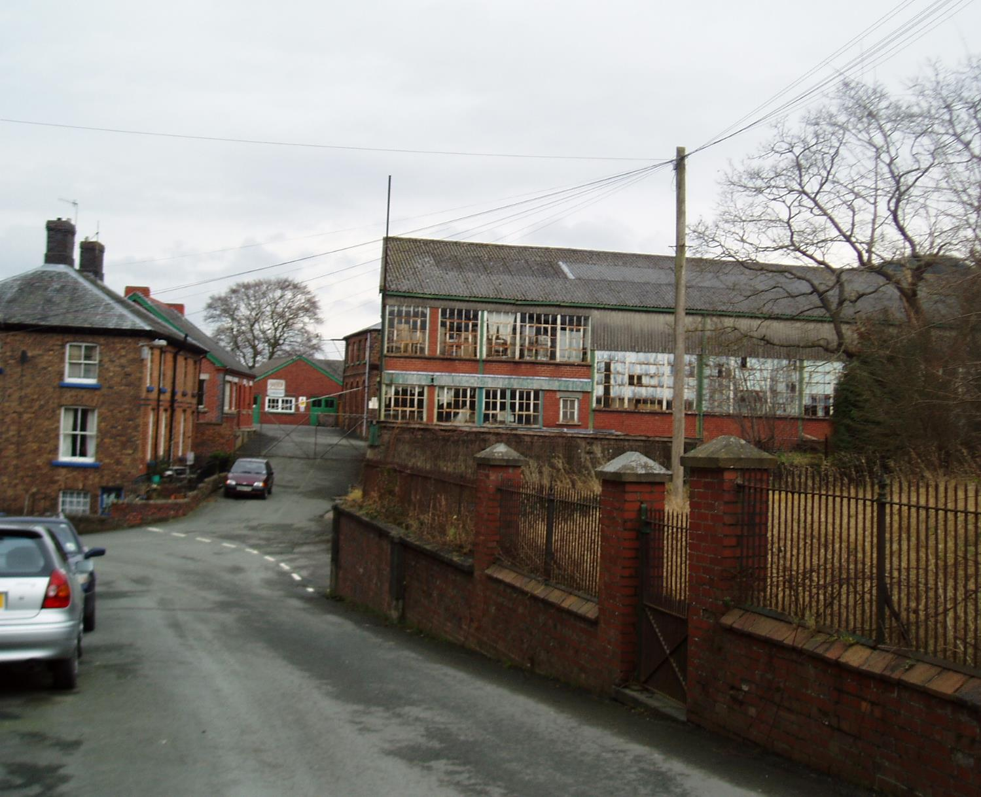
Not only agriculture
Manufacturing industry
Textiles
Food processing
Mining
Forestry

Slide 12
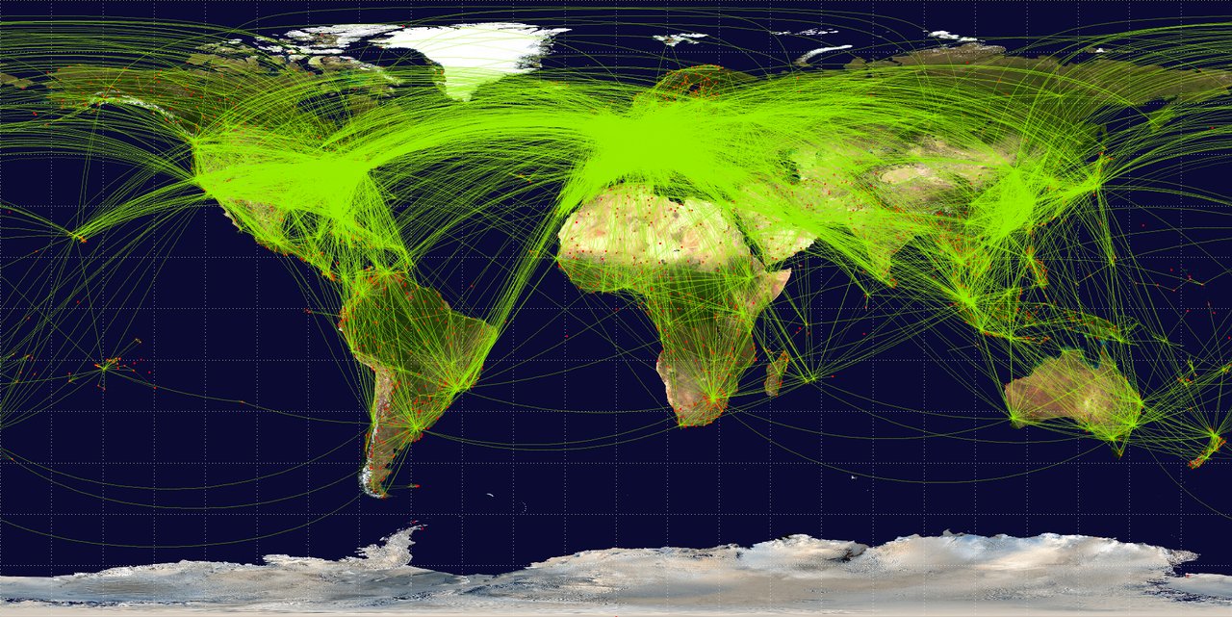
Acceleration and intensification of global mobility
World airline routes
Source: Wikimedia commons

Slide 13
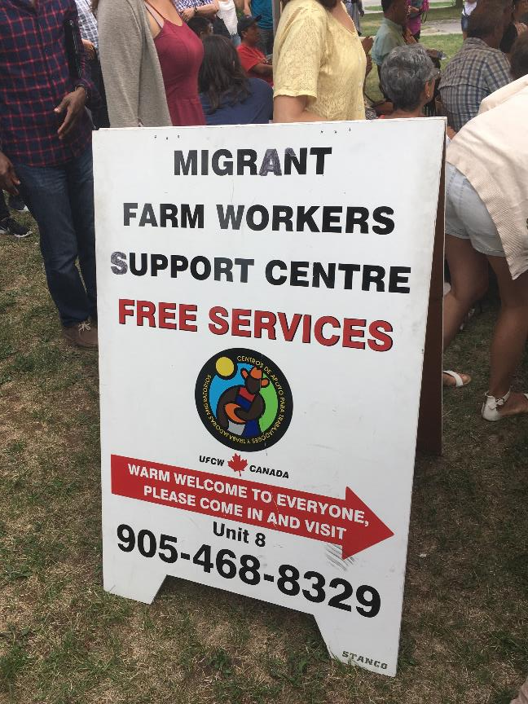
Increased flows of migration to, from and through the global countryside
Rural areas of exporters of migrant labour
Rural areas as importers of migrant labour (for agriculture, food processing, hospitality etc)
International lifestyle migration to global hot-spots
Retirement and return migration bringing into rural communities people who have lived and worked abroad

Slide 14
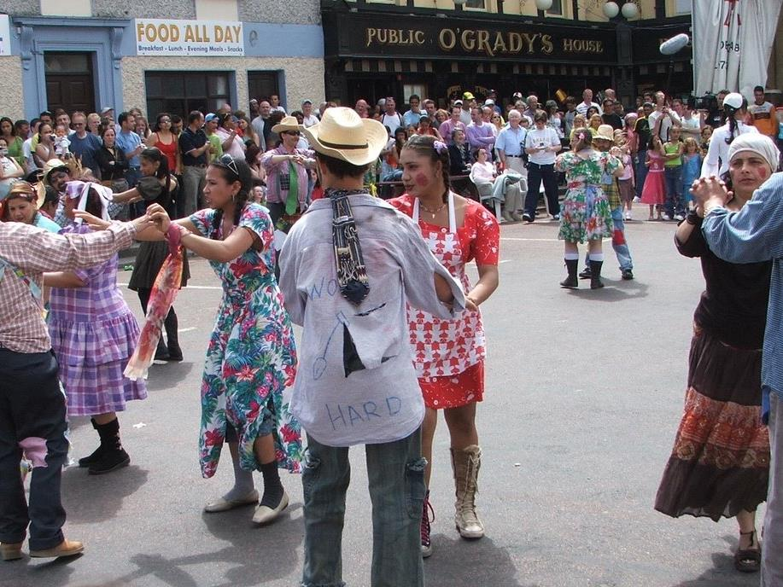
Cultural diversity of rural communities and small towns

Slide 15
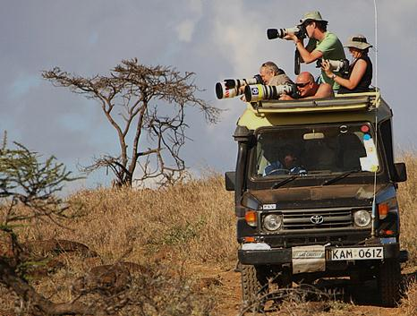
Global rural tourism
People travelling further for tourism
Over-crowding of globally-renowned rural tourist sites
New tourism frontiers in rural regions
Impacts on traditional domestic holiday destinations

Slide 16
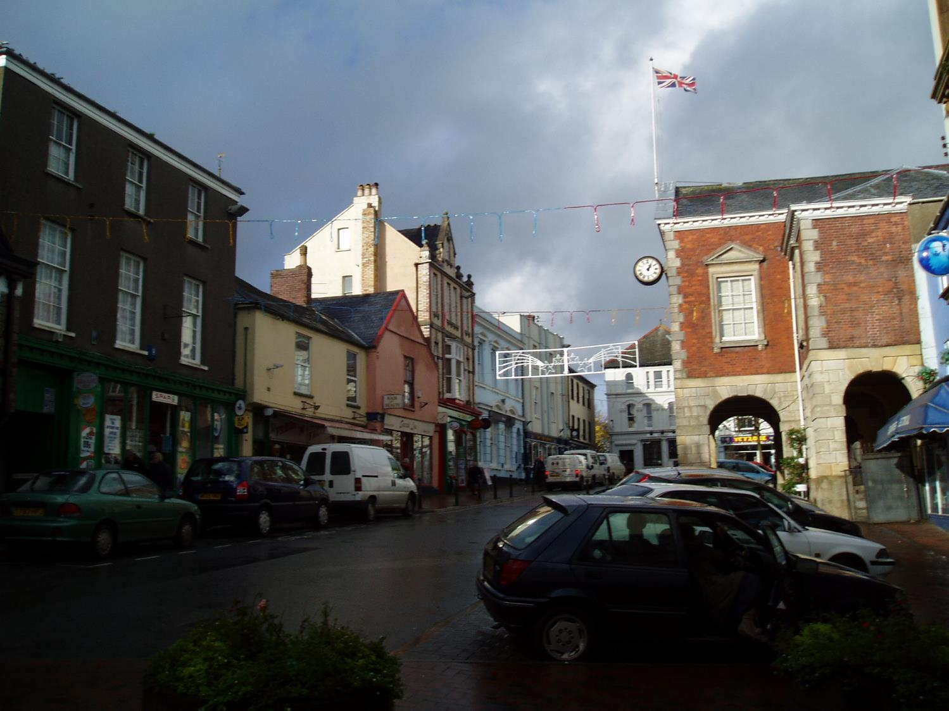
Everyday Globalization
Food that we eat
Clothes we wear
Where we shop
Music, film, TV we consume
Sports we follow
Internet & social media
Challenge to traditional rural cultures?
Impact for rural services & market towns?

Slide 17


A model of globalization impacts and responses
Global Processes
Policies and Grassroots Initiatives
Catalysts
Regional Responses and Outcomes
Globalization impacts
Regional Contexts and Capacities
From www.derreg.eu

Slide 18
A model of globalization impacts and responses
Global Processes
Policies and Grassroots Initiatives
Catalysts
Regional Responses and Outcomes
Globalization impacts
Regional Contexts and Capacities
From www.derreg.eu

Slide 19
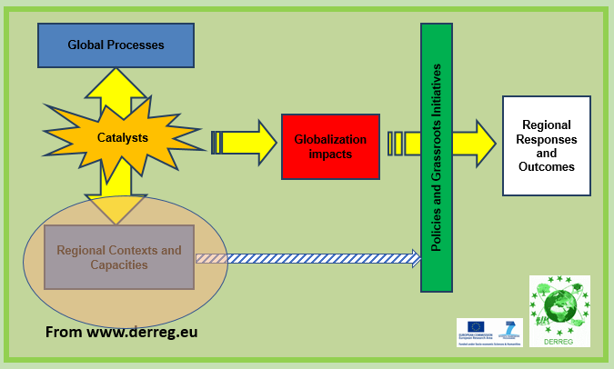
Regional contexts and capacities
Geographical location
Climate
Natural resources
Cultural & landscape resources
Transport & ICT infrastructure
Political-economic context
Governance structure
Human capital
These factors affect exposure to globalization and the community’s capacity to respond

Slide 20
A model of globalization impacts and responses
Global Processes
Policies and Grassroots Initiatives
Catalysts
Regional Responses and Outcomes
Globalization impacts
Regional Contexts and Capacities
From www.derreg.eu

Slide 21
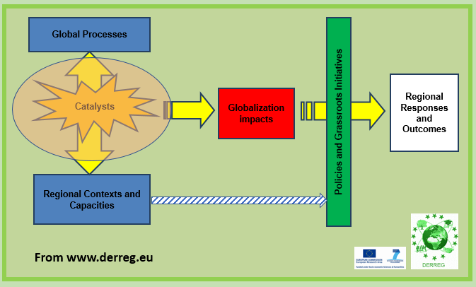
Catalysts
Turn a potential affect of globalization into an actual impact
People (entrepreneurs, corporate executives, estate agents etc)
Policies and programmes
Events (Brexit?)
Catalysts determine the timing of globalization impacts

Slide 22
A model of globalization impacts and responses
Global Processes
Policies and Grassroots Initiatives
Catalysts
Regional Responses and Outcomes
Globalization impacts
Regional Contexts and Capacities
From www.derreg.eu

Slide 23
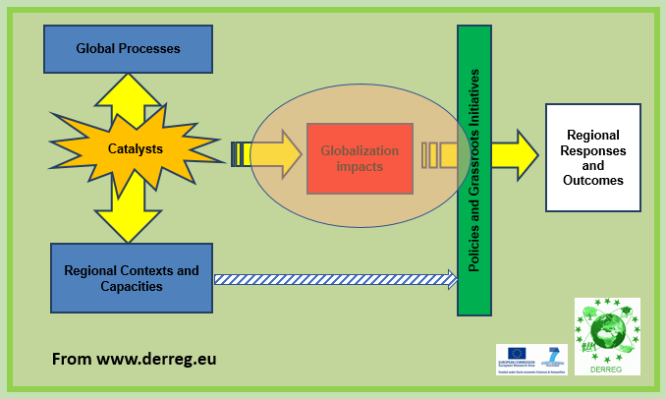
Globalization Impacts
Closure of factories due to relocation or competition
Takeover of local firms
Loss of local shops and services
New factories as FDI
Squeezed farmgate prices
Increased numbers of international tourists
Purchase of properties by foreign buyers, including as second homes
Out-migration to work abroad
Influx of foreign migrant workers
Designation of protected landscapes following international models
But impacts are not the end of the story

Slide 24
A model of globalization impacts and responses
Global Processes
Policies and Grassroots Initiatives
Catalysts
Regional Responses and Outcomes
Globalization impacts
Regional Contexts and Capacities
From www.derreg.eu

Slide 25
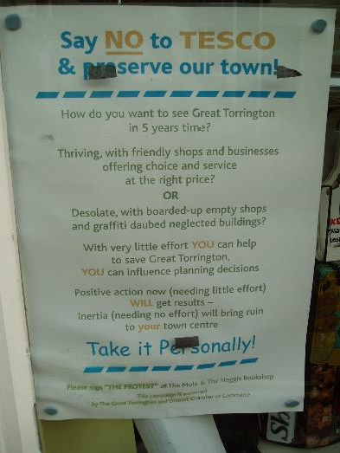
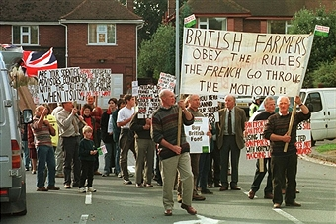
Resistance (is not futile?)
Rural communities may seek to resist or oppose globalization impacts, directly or indirectly
Protests can be successful – but only if able to mobilise a sufficient network to disrupt plans and reach the decision-makers
Most resistance fails because it is mistargeted and/or lacks broad support
Not always as simple as local vs. global

Slide 26

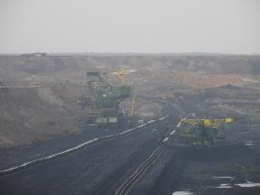
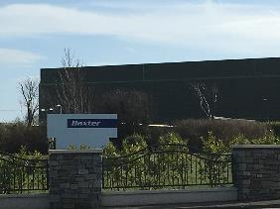
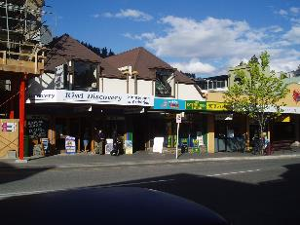
Strategies for Rural Development
Global farmlands
Global resource providers
Branch plant economies
Labour exporters
Global conservators
Global playgrounds
Niche innovators
Re-localizers

Slide 27
Strategies for Rural Development
X
Global farmlands
Global resource providers
Labour exporters
Branch plant economies
Global conservators
Global playgrounds
Niche innovators
Re-localizers
X
?
?
?
?
✓
✓

Slide 28
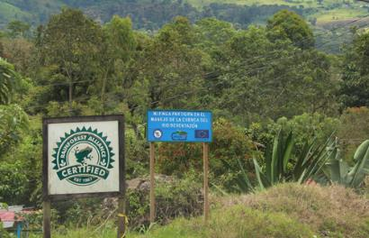

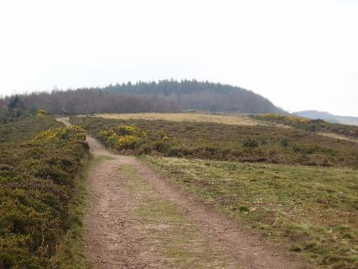
Global Conservators
Rural areas tapping into global environmental consciousness as an economic strategy
Validated with international designations (e.g. UNESCO World Heritage)
Ecotourism or sustainable craft products
Payments for ecosystem services
Question: What opportunities are there for Devon communities to benefit from conservation, ecotourism and ecosystem services?

Slide 29
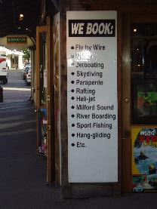
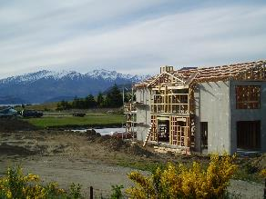
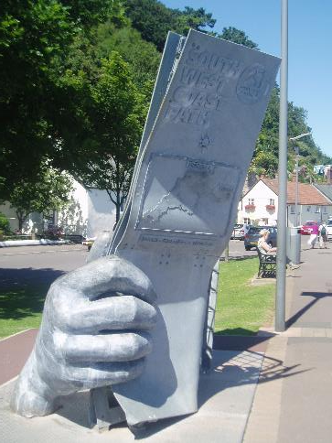
Global Playgrounds
Rural areas attracting international tourists and amenity migrants
Adventure tourism and outdoor recreations, but also landscape, nature, history, beach and coastal tourism
Question: Should Devon communities be aiming to attract more international (not just domestic) tourists, and how?

Slide 30

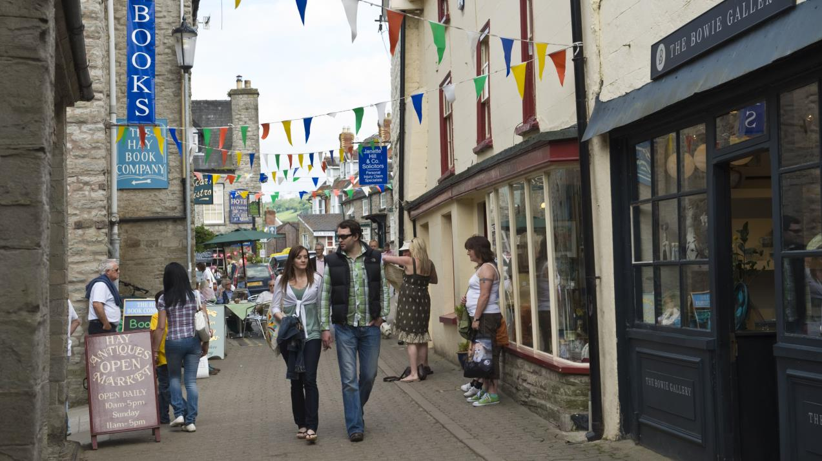
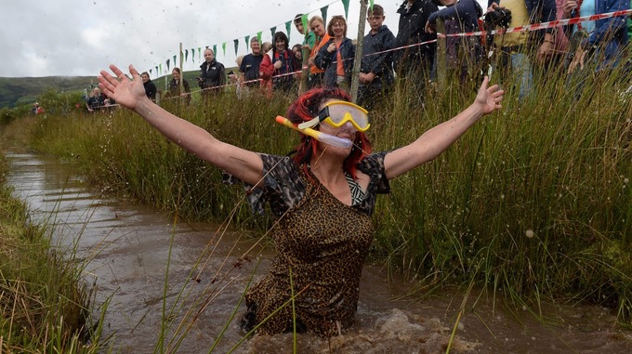

Niche Innovators
Rural businesses expanding by tapping into global niche markets
Developing businesses with niche requirements (e.g. quiet, pollution-free, vibration-free environments)
Rural areas attracting visitors with niche events and attractions
Question: What niche products does rural Devon have to offer?

Slide 31
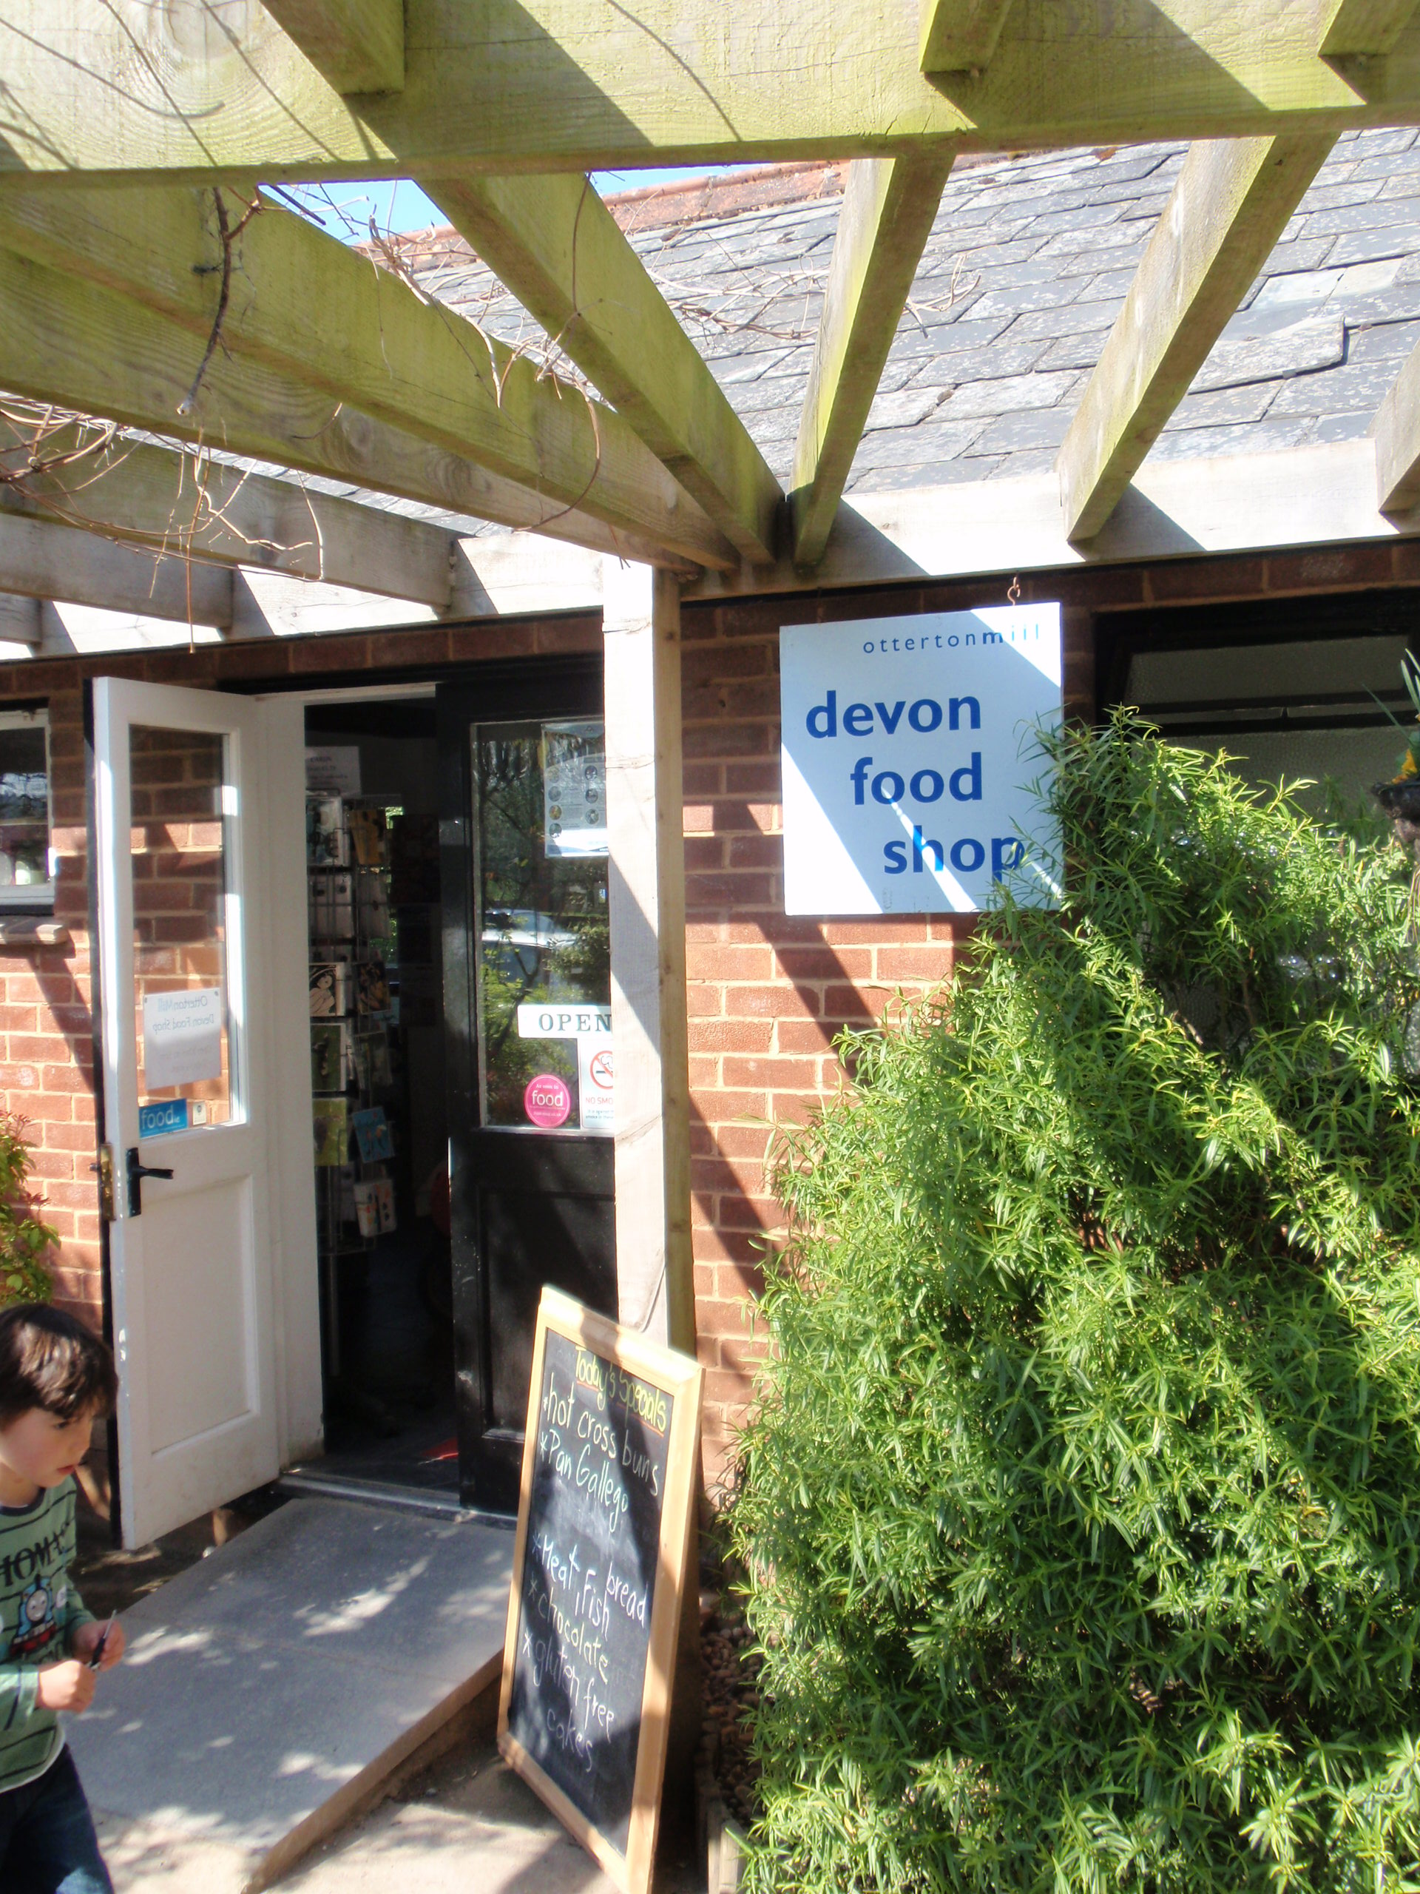

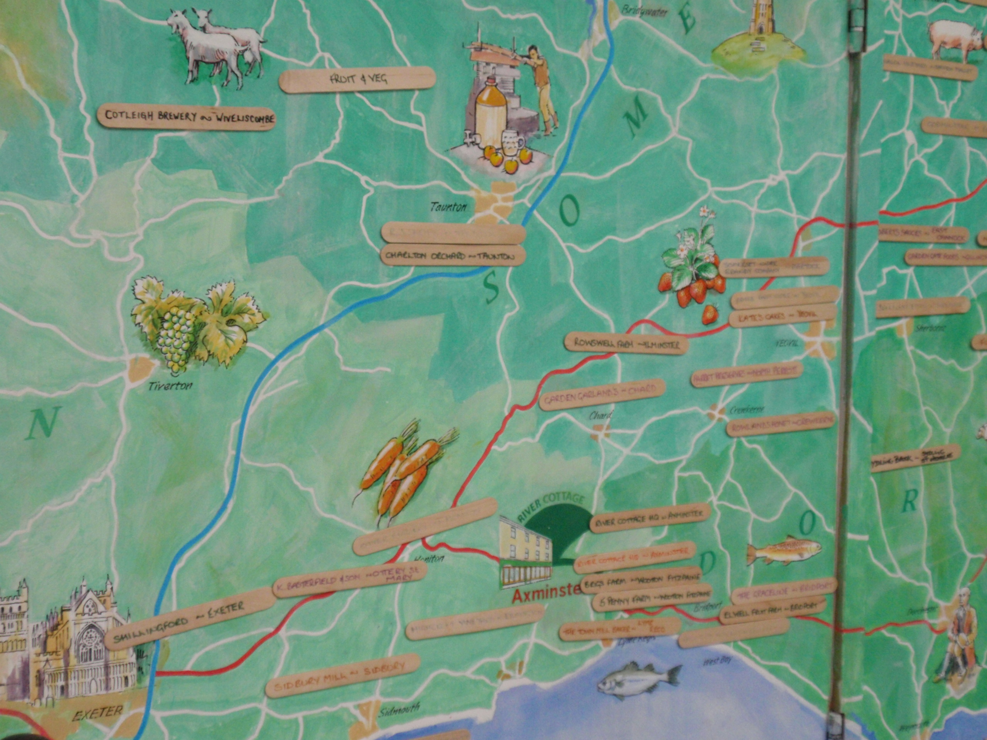
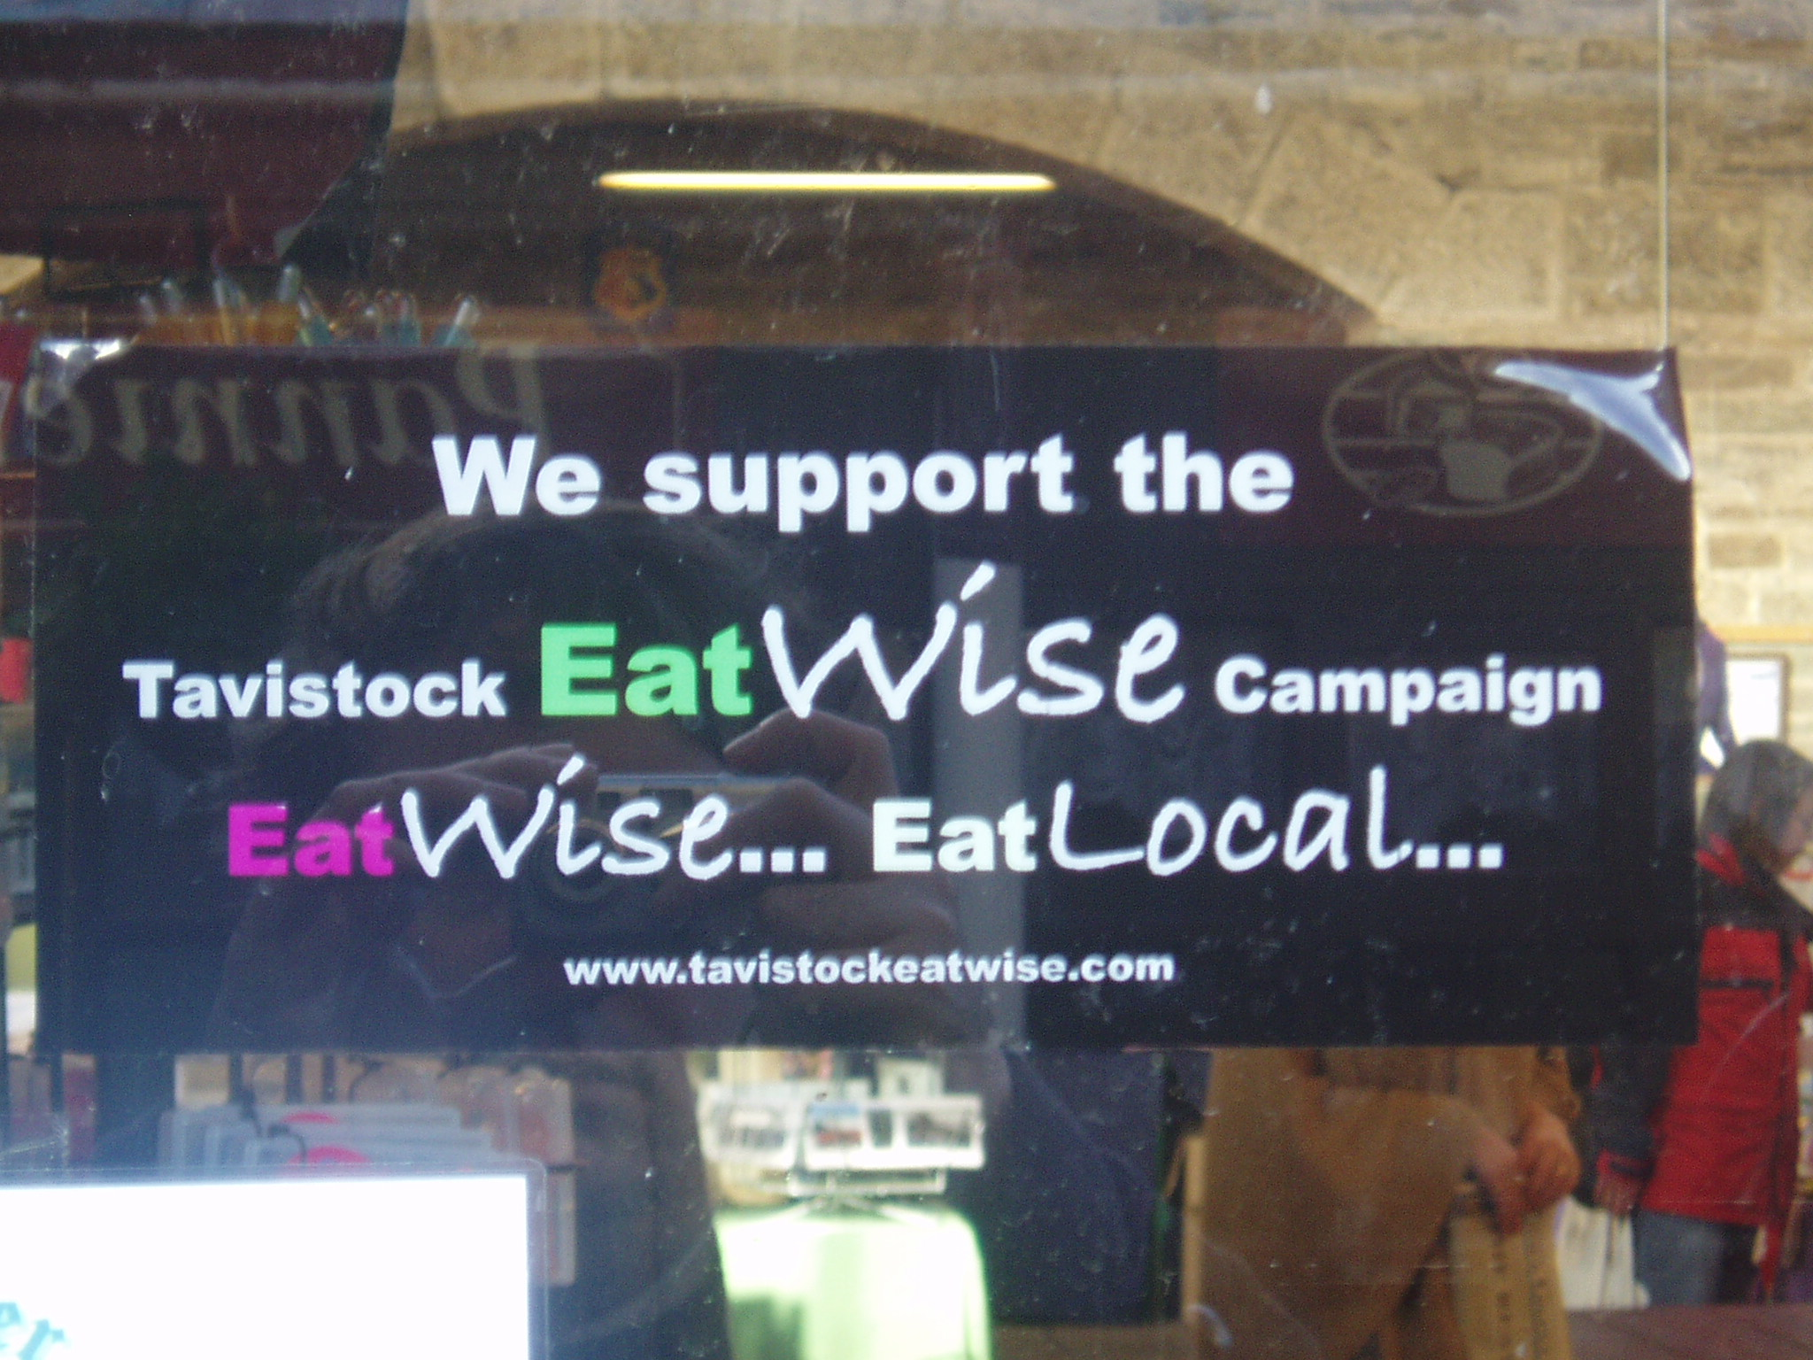
Re-localisers
Re-building and strengthening local markets and supply chains to keep money within the local economy is also a response to globalization
Devon already a leader, especially for local food systems
Question: Is relocalisation enough?

Slide 32
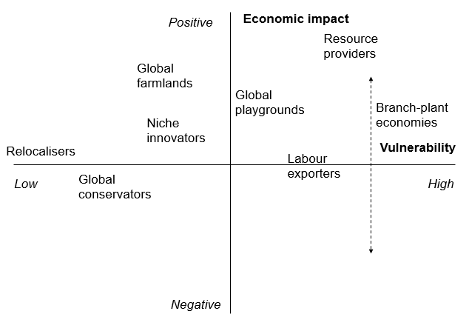
Strategies not exclusive, but can overlap and complement each other
Different levels of return, but also of risk
Opportunities may be shaped by geographical context and resources
Successfully pursuing a strategy also requires successful local mobilisation

Slide 33
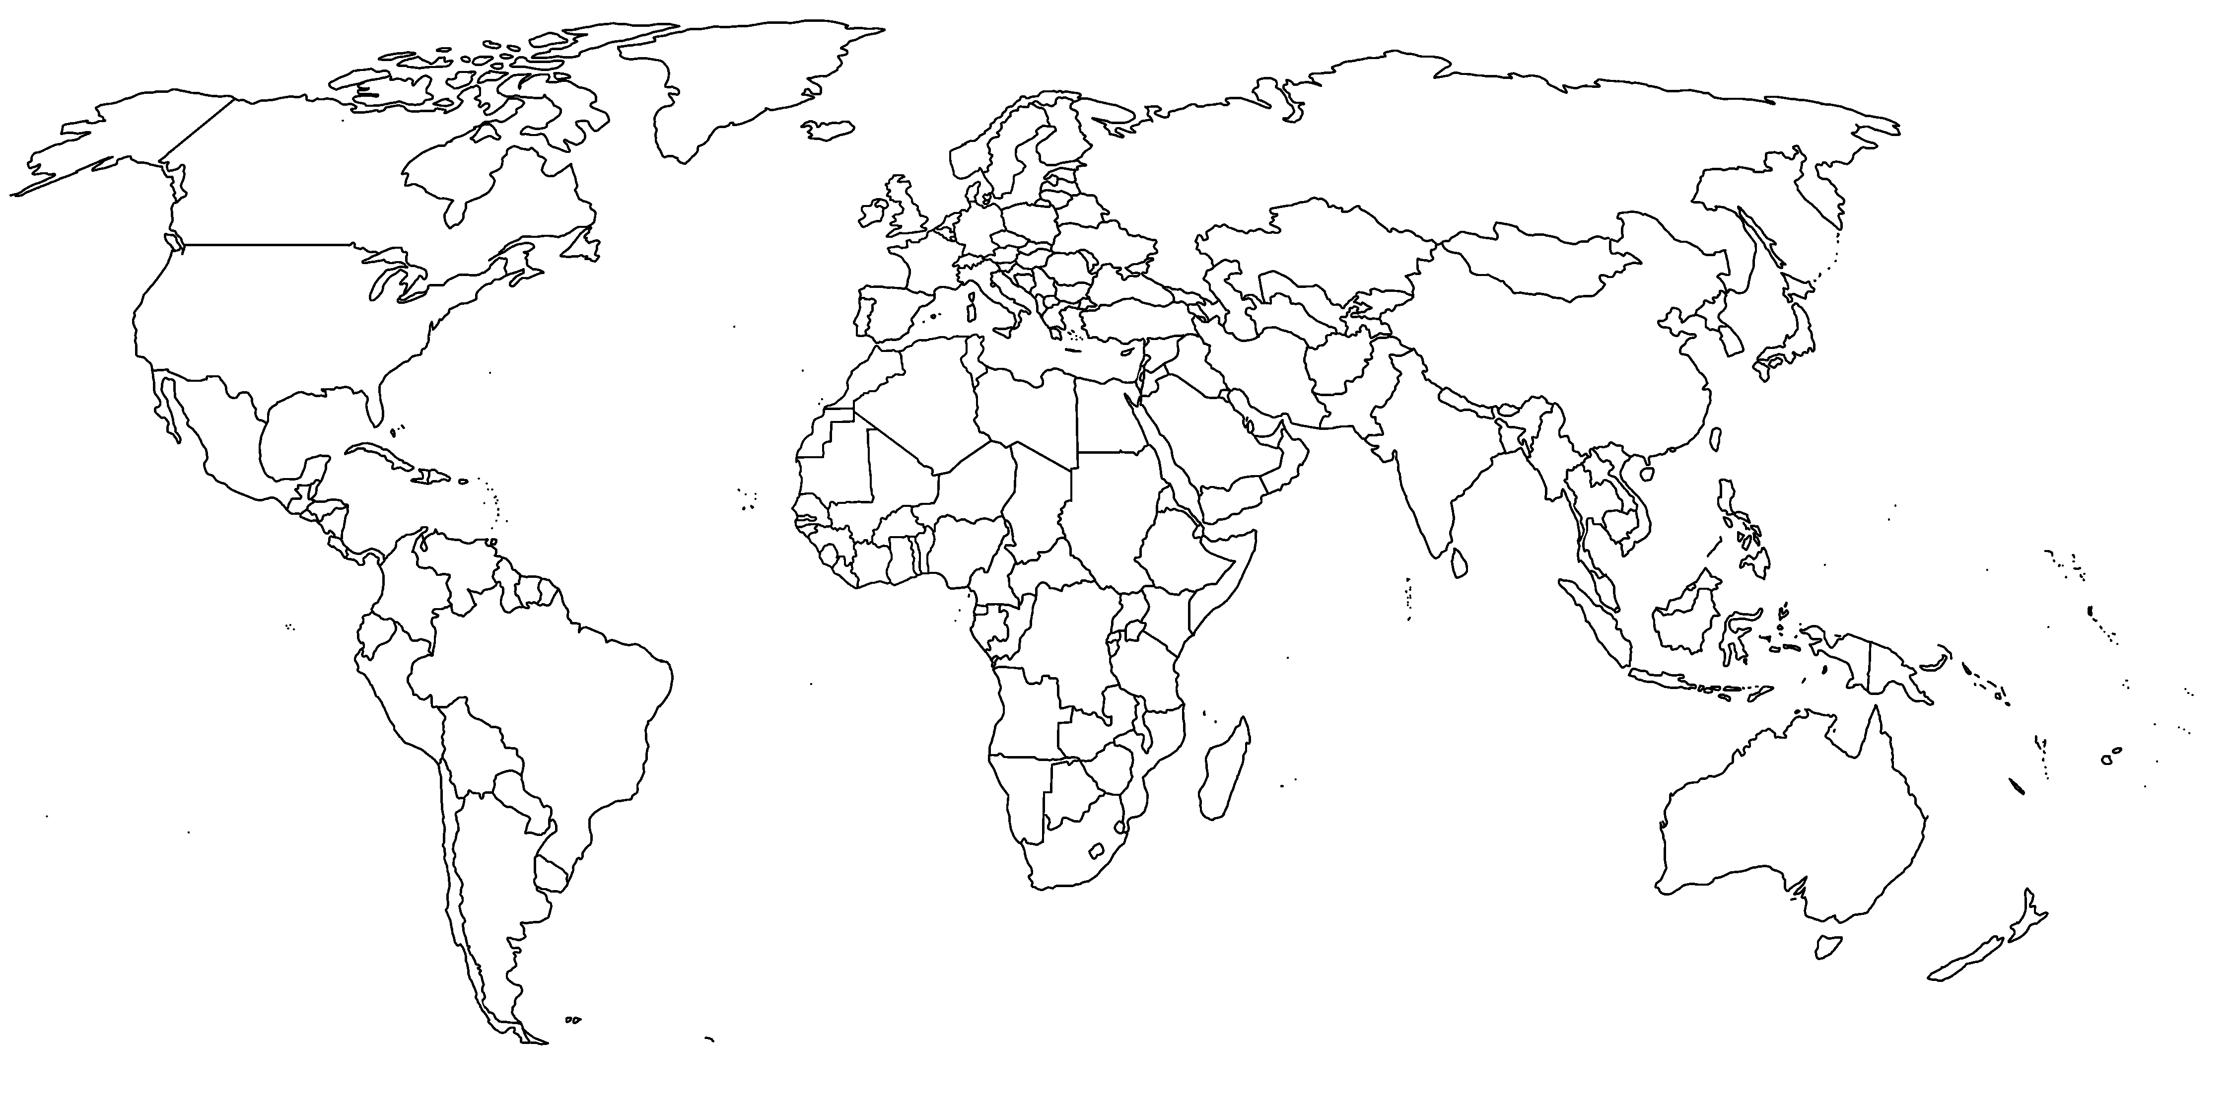

GLOBAL-RURAL
European Research Council Advanced Grant
Exploring globalization in rural regions
Applying an assemblage approach
Sweden
Newfoundland
Wales
West of Ireland
China
Sardinia
Taiwan
Liberia
Kenya & Tanzania
Australia
Brazil
New Zealand

Slide 34
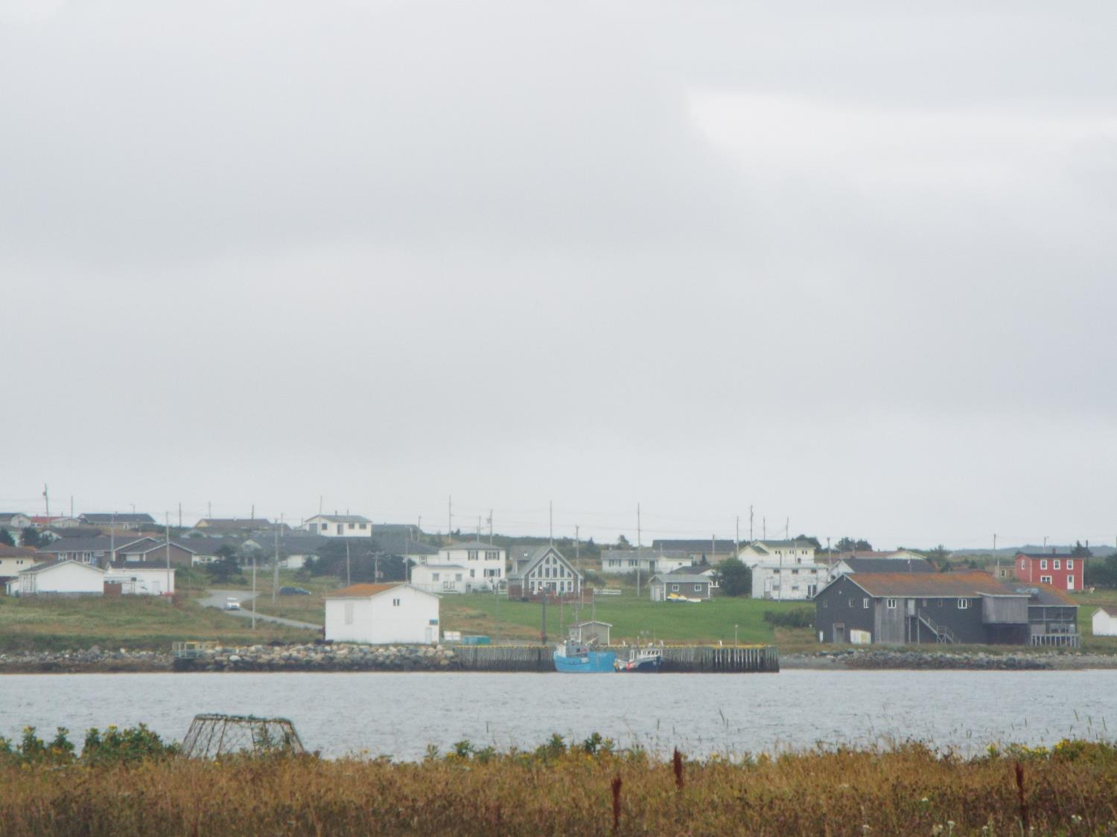
Trepassey
Newfoundland, Canada

Slide 35
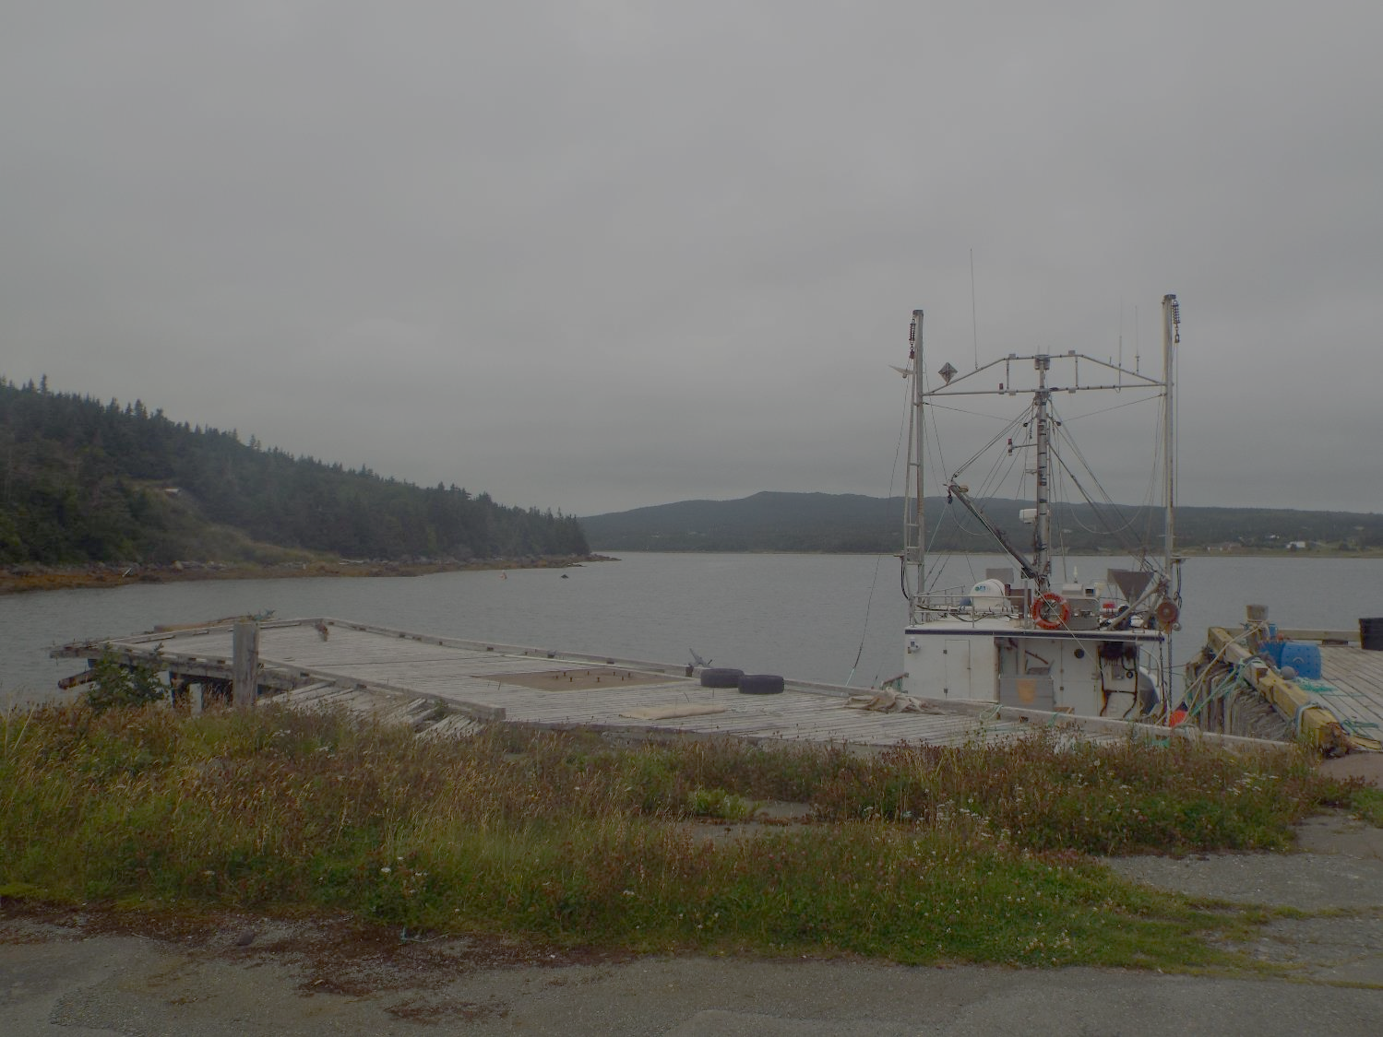
Trepassey
Historically a fishing community
Fish plant built in 1954 provided stable employment > growth of community
Deep sea trawlers working the Grand Banks, in competition with crews from around world

Slide 36
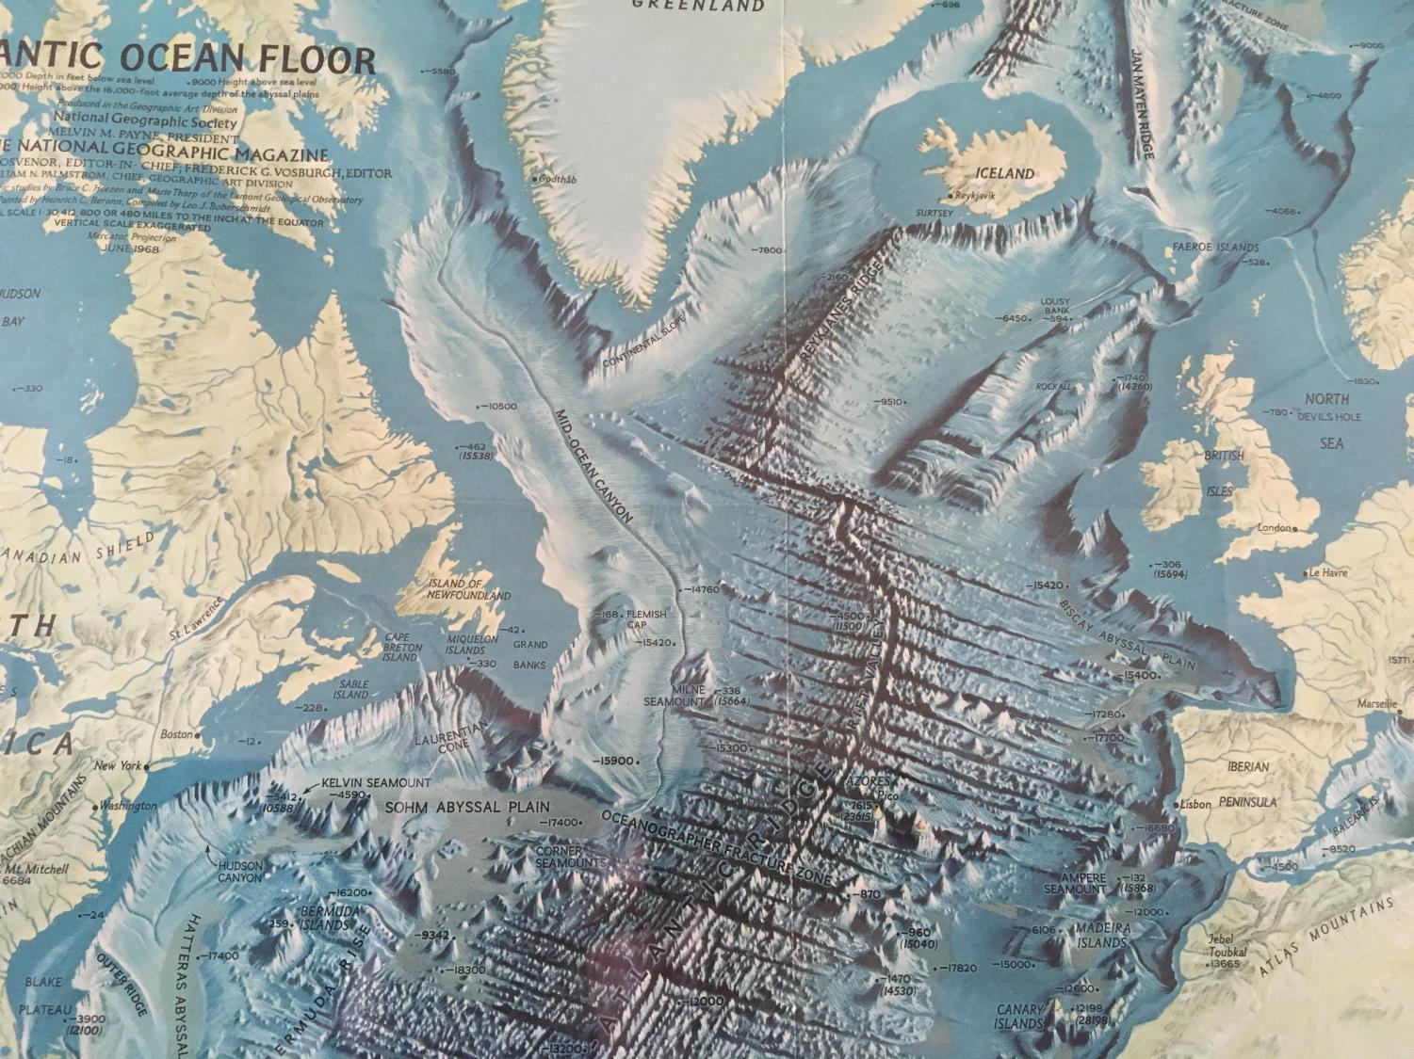
The Grand Banks and the Global Fisheries Assemblage
1980s
USSR
Iceland
Faroe Islands
Norway
Greenland
Britain
Finland
Denmark
Poland
Poland
East Germany
East Germany
Ireland
West Germany
Netherlands
Belguim
Canada
France
Spain
USA
Portugal
Bulgaria
Cyprus
Israel
Italy
Romania
South Korea
Japan
Cuba
China

Slide 37
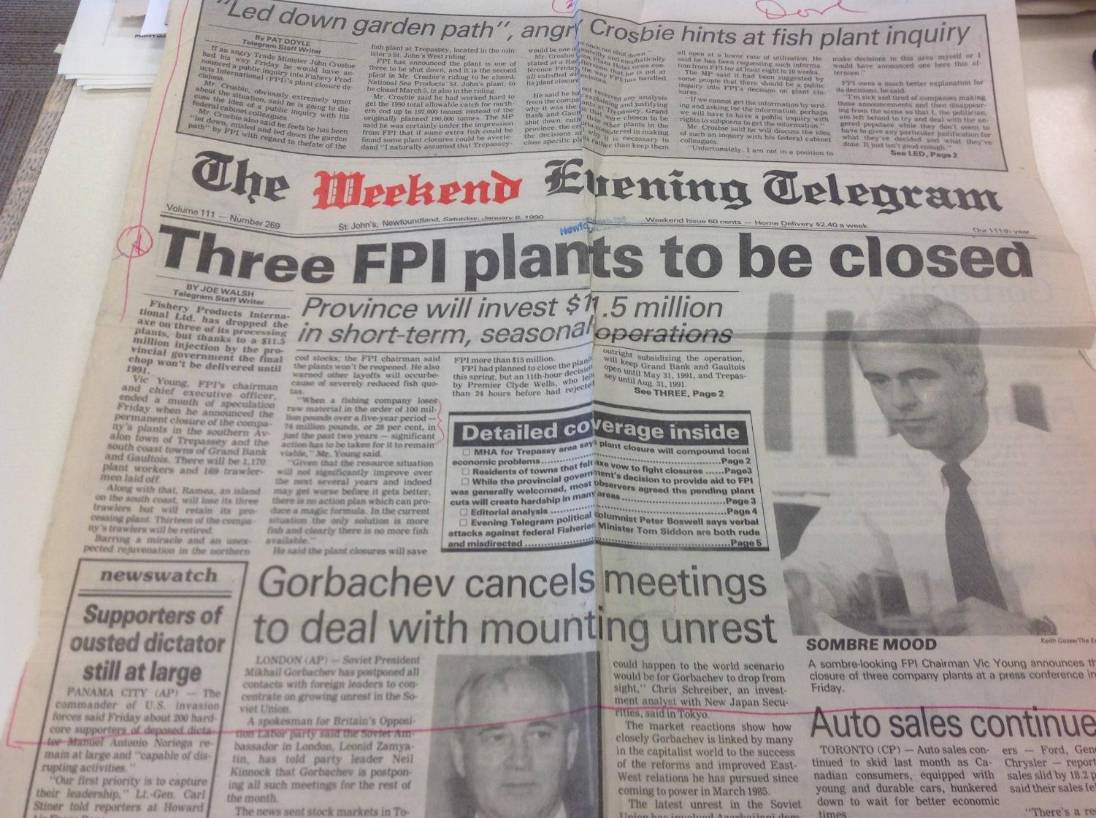
Overfishing of cod stocks
Closure of Trepassey FPI fish processing plant - September 1991
Moratorium on cod fishery – June 1992
Trepassey population fell by 60% between 1991 & 2016
Initial government support but poorly used

Slide 38

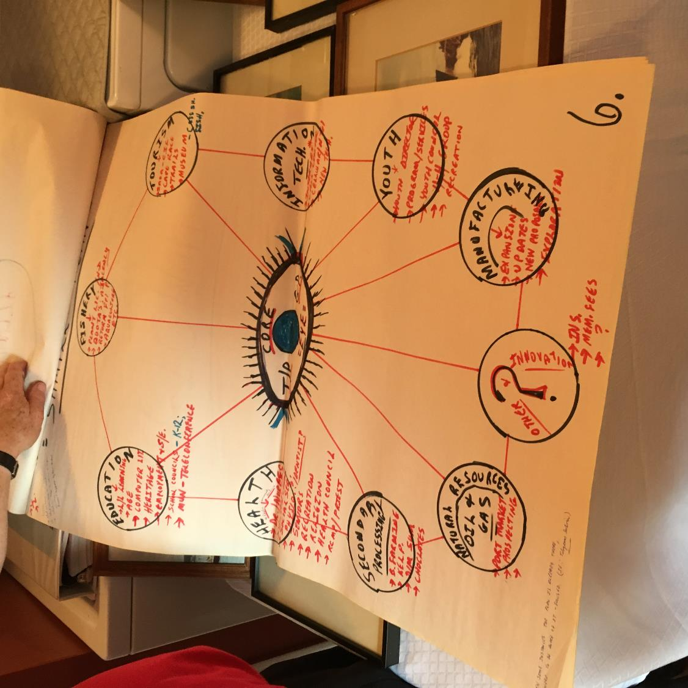

Slide 39
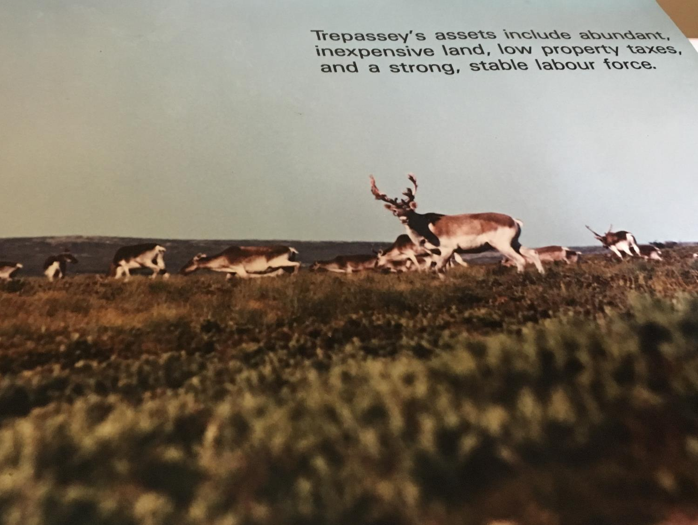
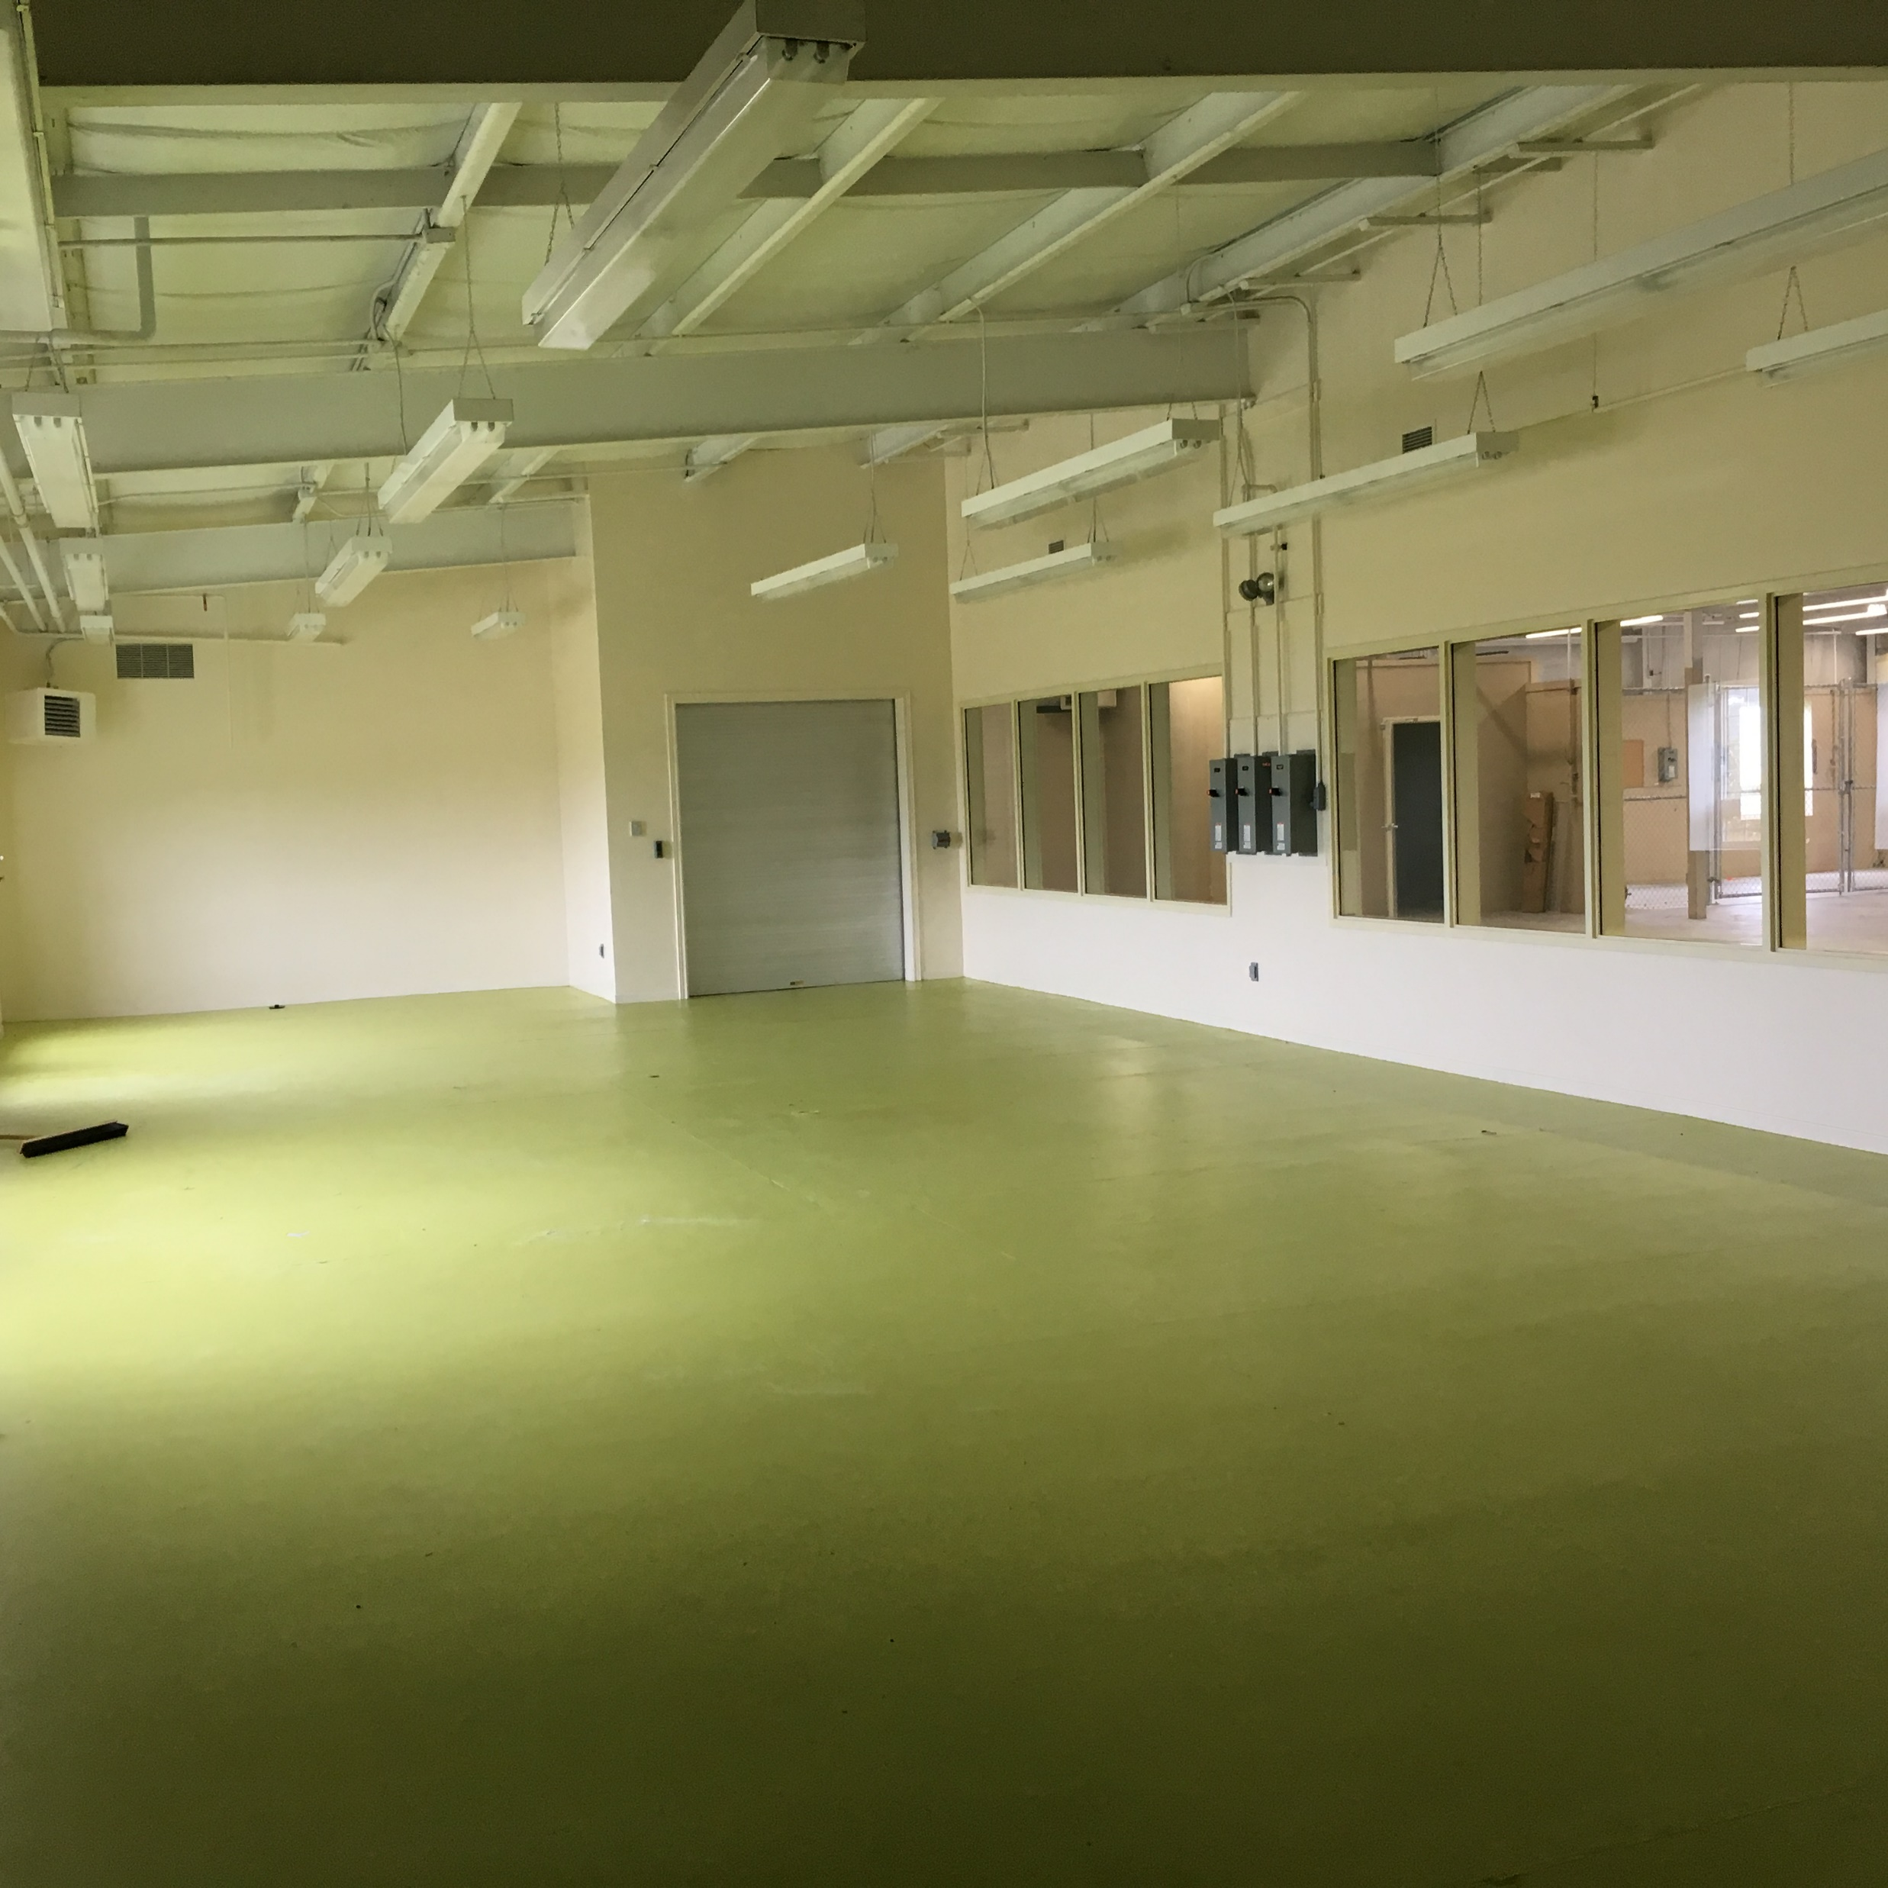
Emphasis on a combination of ‘branch plant economy’ & ‘niche innovation’ approaches
Bought back & redeveloped plant site as factory units
Promotional material stressing local resources and amenities
Mixed success in attracting investment

Slide 40
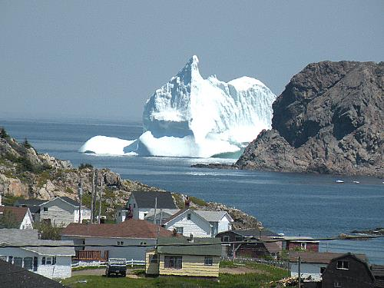
Iceberg Industries
Bottled water from icebergs
Exports to US
30 employees
Business failed 2002

Slide 41
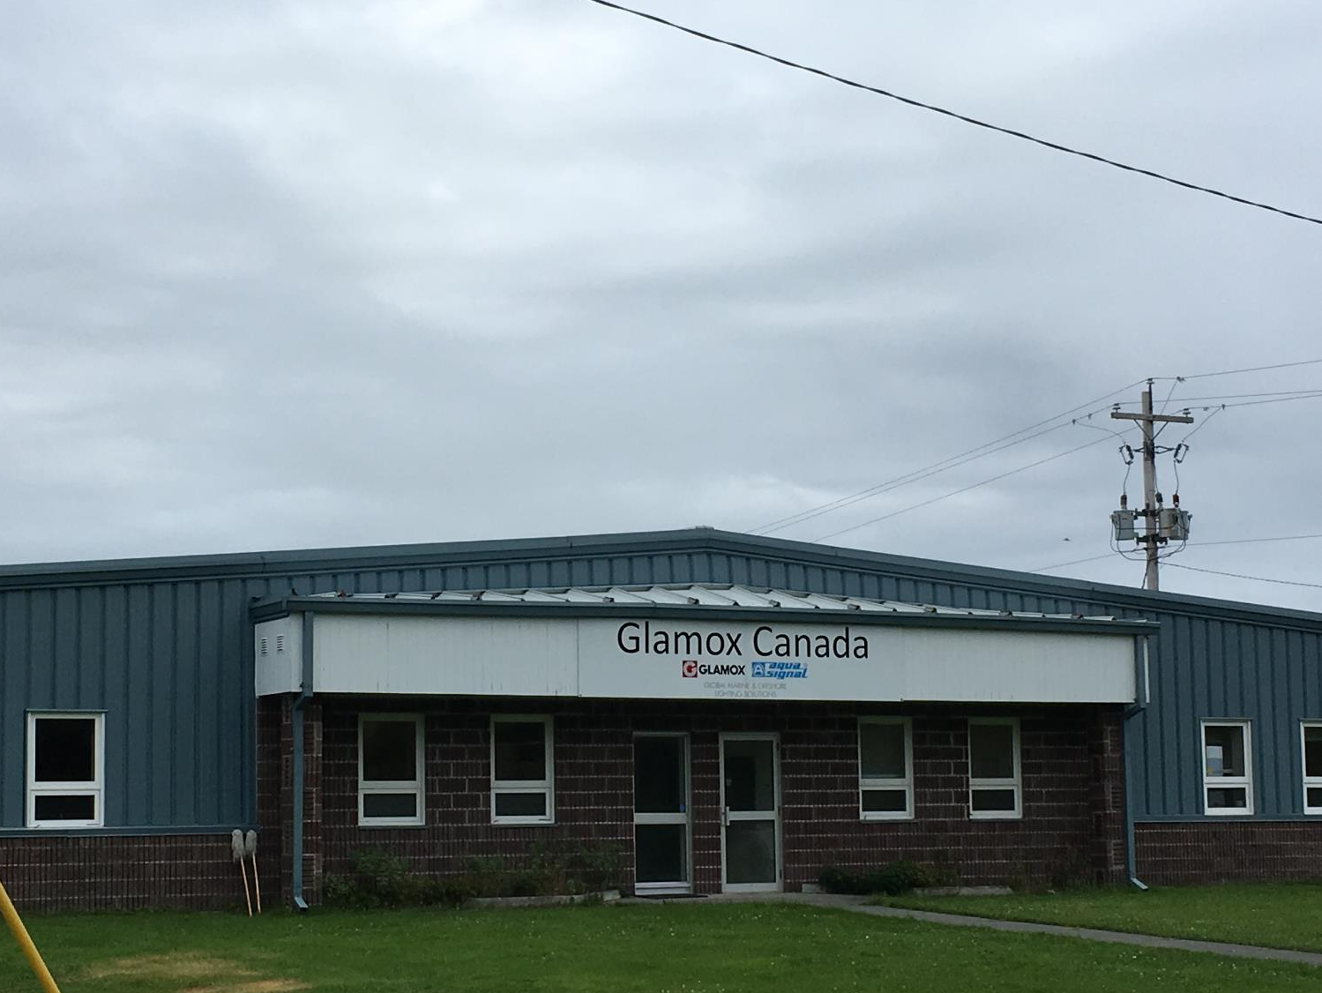


Glamox
Norwegian company
Manufacturing maritime lighting for oil rigs, cruise ships and naval ships
Attracted to rural coastal location

Slide 42
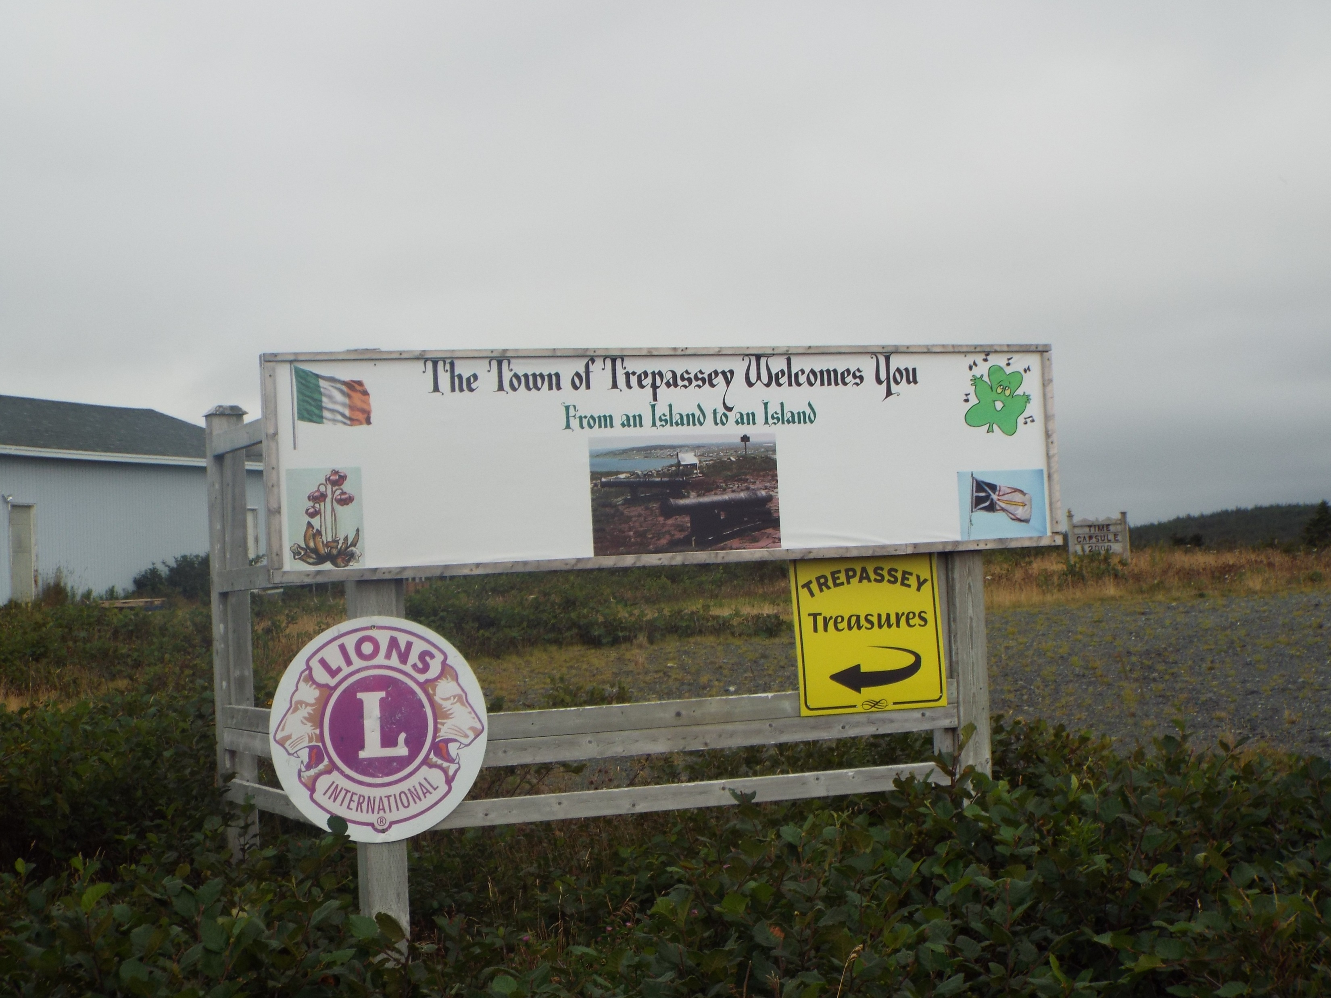
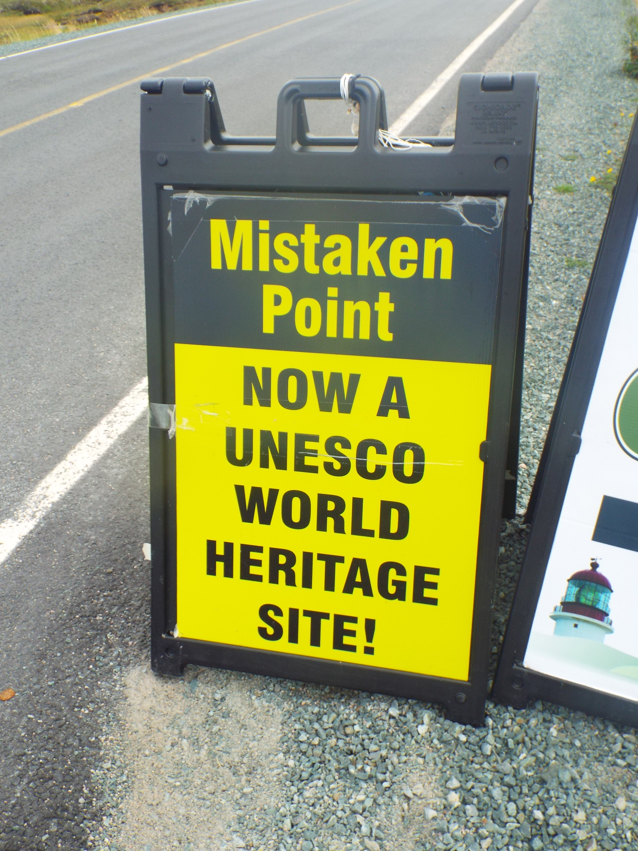
Tourism
Based on Irish heritage, natural environment and globally-important fossils at nearby Mistaken Point
Problems of peripheral location – getting noticed and getting people there

Slide 43
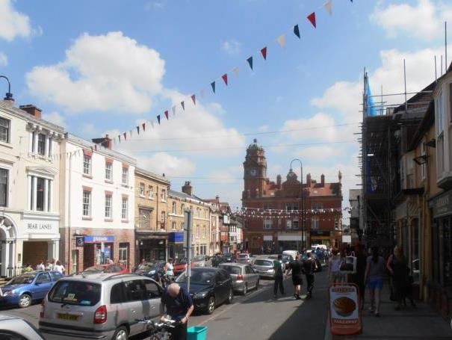
Newtown
Mid Wales

Slide 44
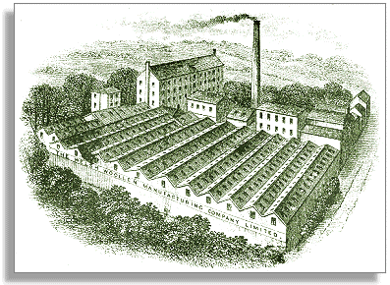
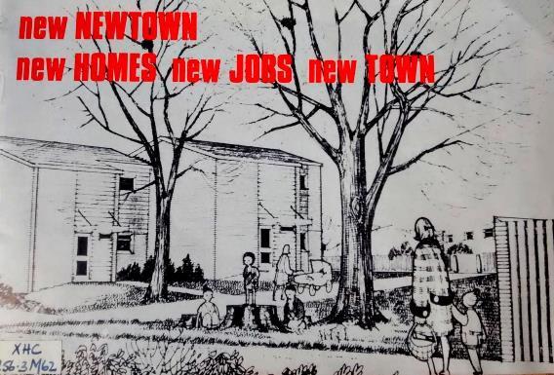

Newtown
Historically a woollen mill town, industry declined in late 19th and early 20th centuries
Development plan adopted in 1960s
Repositioned as a branch plant economy
Laura Ashley operated a global business from Newtown during 1980s
Industries squeezed by global competition
Laura Ashley moved production to eastern Europe and Asia
Laura Ashley bought by Malaysian company in 1998 and left Newtown

Slide 45
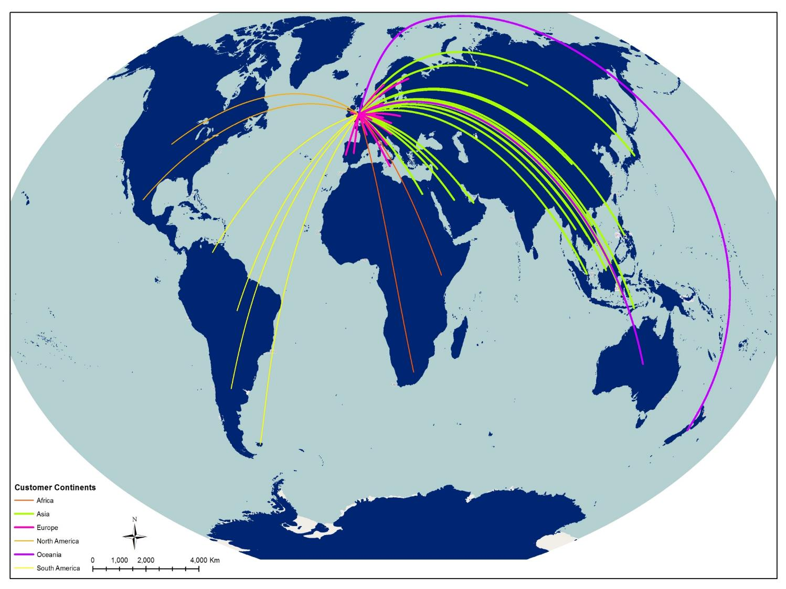
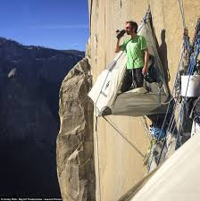

Niche Innovation?
Niche innovation by individual businesses to sell specialist products into global markets
Not coordinated or supported as part of a government scheme

Slide 46



Re-localisation?
Community efforts focused more on re-localisation, especially local food
  Refurbishment of Market Hall by Land & Food Trust
  Community farm/garden
  Food Festival
Responses to arrival of McDonalds & Tesco
Strengthening local networks but not attracting external visitors or capital?

Slide 47

Niche Tourism?
Attracting domestic and international tourists through celebrating industrial heritage
Bidding for Heritage Lottery Fund money
Two rival schemes and groups working on ideas for museums
Lack of coordination

Slide 48






Slide 49
Lessons
Rural communities and small towns do not need to be the victims of globalization
Communities can play a role in shaping their own futures
Both exposure to globalization and opportunities to respond may be shaped by factors including geographical location, local resources etc
Effective responses to globalization require strong and coherent community mobilisation around realistic goals

Slide 50
Lessons
Individuals are needed to act as catalysts, with clear visions and the ability to motivate others
Communities need to work together towards common goals and avoid factionalism
The strongest plans emerge from reflection by the community on its identity, resources and potential
Combine different strategies, e.g. relocalisation and niche innovation
Relocalisation works best when it combines economic localism with cultural cosmopolitanism

Slide 51
Lessons
Support local businesses to expand and sustain themselves by selling to international niche markets
Attract businesses that value the environmental qualities of the countryside, and will stay
Re-imagine local resources to develop tourist attractions that stand out and will appeal to national and international visitors
Use the skills, experiences and contacts of migrants into the community; encourage migrant entrepreneurship
Harness networks of out-migrants from the community, to find new opportunities for local businesses, promote tourism and support community development initiatives

Slide 52

Stop the world?
We can’t!
But we can make a difference to the future for our community
Presentation slides available at www.global-rural.org

