Slide 1




Assemblage, Place, Power and Globalization
RGS-IBG Annual Conference, Exeter, September 2015
Michael Woods, Jesse Heley, Laura Jones, Anthonia Onyeahialam, Marc Welsh
Aberystwyth University
m.woods@aber.ac.uk @globalrural

Slide 2
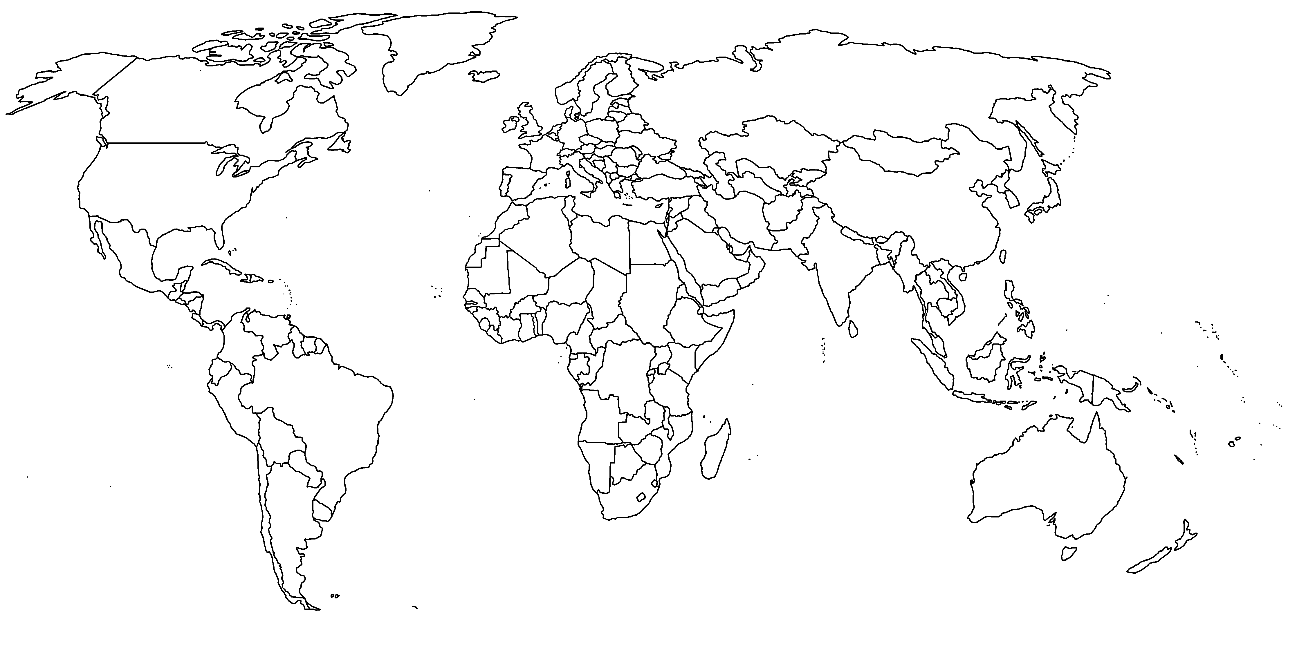

Norrland Sweden
Newfoundland
Wales
West of Ireland
Hebei and Shandong provinces
South of Spain
Tanzania
Queensland
Rio Grande do Sul
Hawkes Bay
GLOBAL-RURAL project
European Research Council Advanced Grant
2014-2019
@globalrural
www.globarlruralproject.wordpress.com

Slide 3
Background
How to operationalise a relational approach to globalization?
Attracted to assemblage for its emphasis on emergence, multiplicity and indeterminacy
Drawing on Foucault and Latour, but especially DeLanda’s (2006) Deleuzian-inspired rendering of assemblage theory

Slide 4
DeLanda’s Assemblage Theory
DeLanda posits 5 core attributes of assemblages:
1) Assemblages are composed of both material and expressive components, and individual components may have both material and expressive roles
2) An assemblage is stabilized and destabilized through processes of territorialization and deterritorialization.
3) An assemblage is given an identity through coding, including practices of naming, classification and rule-setting. Decoding processes dissent from established meanings, break rules and give rise of heterogeneity.

Slide 5
DeLanda’s Assemblage Theory
4) Assemblages are dynamic, contingent and engaged in recurrent interactions with other assemblages, from which larger assemblages have the possibility to emerge.
5) Assemblages are defined by their relations of exteriority; they can be broken down in components which may themselves be assemblages, and relations between components can be modified without changing the nature of the component itself.
“a component part of an assemblage may be detached from it and plugged into a different assemblage in which its interactions are different” DeLanda (2006) A New Philosophy of Society, p. 10.

Slide 6
Assemblage and Globalization
Work on ‘global assemblages’
Sassen (2006) – purely descriptive use of ‘assemblage’
Collier and Ong (2005) – global assemblages as “systems that mix technology, politics and actors in diverse configurations that do not follow given scales or political mappings” (Ong 2005, p 338)
  Emphasis on technological, administrative and ethical regimes articulated through global assemblages and how these reshape ways of ruling and living
  Global not necessarily spatial, also global as universal
  See also Hollander (2010) on the global ethanol assemblage

Slide 7
Assemblage and Globalization
Work on process of assembling the global
Murray Li (2007, 2014) – Foucaldian informed ‘practices of assemblage’
  Not explicitly about globalization
Latour (2005) – Global exists only in sites in which it is assembled from components
  Study of the global must start by localizing the global back to these sites
  Only then can the global be re-assembled by laying “continuous connections leading from one local interaction to other places, times and agencies through which a local site is made to do something” (Latour 2005, p 173)
  Global not necessarily spatial, also specific to general

Slide 8
Assemblage and Globalization
“Capitalism has no plausible enemy as it is ‘everywhere’, but a given trading room in Wall Street has many competitors in Shanghai, Frankfurt and London – a computer breakdown, a sneaky movement by a competitor, an unexpected figure, a neglected variable in a pricing formula, a risk accounting procedure – that may shift the balance from an obscure profit to a dramatic loss. Yes, Wall Street is connected to many places and in this sense, but this sense only, it is ‘bigger’, more powerful, overarching. However, it is not wider, larger, less local, less interactive and less an inter-subjective place than the shopping centre in Moulins, France, or the noisy and smelly market stands in Bouake, Ivory Coast. Don’t focus on capitalism, but don’t stay stuck on the screen of the trading floor either: follow the connections, ‘follow the actors themselves’”
Bruno Latour (2005) Re-assembling the Social, pp 128-9.

Slide 9
Assemblage and Globalization
Adding DeLanda provides a bridge and another dimension
Emphasis on stabilization of assemblages and interaction between assemblages
1) Globalization involves re-arranging components in assemblages
  Adding, detaching, altering material or expressive roles, reconfiguring relations between components, transferring components between assemblages
  Branch plants sold by one company to another; international land transactions; commodities trade transnationally; migrants moving from one social assemblage to another.

Slide 10
Assemblage and Globalization
2) Globalization occurs through the recurrent interaction between assemblages
  Aligns or fuses capacities to produce new translocal assemblages with global reach
  E.g corporate mergers; coalescence of social movements; tendency of trading blocs (e.g. EU, NAFTA) to negotiate agreements to create more extensive trade areas

Slide 11
Assemblage and Globalization
3) Globalization also occurs through the deterritorialization of assemblages
  New connections made or relations between components re-ordered to overspill the boundaries of the assemblage
  E.g. Company starting to export; household sending member abroad as a migrant worker.
  Literal forms of deterritorialization as detachment from territory (e.g corporate divestment, refugee fleeing from home)

Slide 12
Assemblage and Globalization
4) Globalization proceeds through cycles of coding, decoding and recoding
Involves processes outlined in Li’s (2007) Foucaldian model
Includes linguistic coding of scale (e.g. local, regional, national, international)
Decoding as internal rules of assemblages are transgressed (e.g. tax avoidance by transnational corporations; illegal immigrants)
Global assemblages develop their own internal codes and rules and give rise to new transnational regulatory assemblages

Slide 13
Assemblage and Globalization
5) Globalization fostered by natural tendency of (global) assemblages towards internal homogeneity
  TNCs standardizing supplies, products and processes
  Tourism operators making the exotic familiar
  Supra-national organizations adopt and promote universal values and standards
  Neoliberalism pushing global economic assemblage towards trade liberalization and eradication of trade barriers.

Slide 14
Three further principles
There is no predominant direction to the exercise of power or agency in globalization
  The global does not impose its will on the local
  Scale is not a natural hierarchy but is present as reach and magnification
  The territorialization of a smaller assemblage can impact on the territorialization of a larger assemblage of which it is part
Globalization is not a linear process
  Territorialization/deterritorialization, coding/decoding
  No clear line of causality
  Rhizomic assemblages reproduce through mimicry and imitation (e.g. social movements, cultural fashions, technological mimicry)

Slide 15
Three further principles
Globalization is a more-than-human phenomenon
  Global assemblages can only be global because of incorporation of non-human components that enable them to transcend space (e.g. jet engines, fibre optic cables, satellites, refrigeration technologies etc)
  Non-human components only arranged in this way and inscribed with meaning through human agency
  Some non-human entities escape from globalizing assemblages to form new dissident assemblages (e.g. invasive species and pathogens)

Slide 16
Assemblage and Place
DeLanda discusses neighbourhoods, cities and nations as assemblages
  Material components including buildings, public spaces, infrastructure
  Expressive components including building facades and iconic skylines
  Territorialization through residential congregation and segregation and connectivity between places
McFarlane (2011) on the city as assemblage, combining with dwelling theory

Slide 17
Place and Globalization
1) Globalization impacts on places through the interactions between place-assemblages and translocal social, economic, cultural, political and technological assemblages
  Place- and translocal assemblages share components, but with different roles
  The relations of a component in a translocal assemblage may change without affecting the material or expressive role of the entity in a place-assemblage (e.g factory switched to producing goods for new market, or taken-over by another TNC)
  Reterritorialization of a translocal assemblage impacts on the material role of a component in a place-assemblage (e.g. closure of a factory; FDI; arrival of new migrants)
  Entities lose material role in place-assemblages due to reterritorialization of translocal assemblages, but retain an expressive role

Slide 18
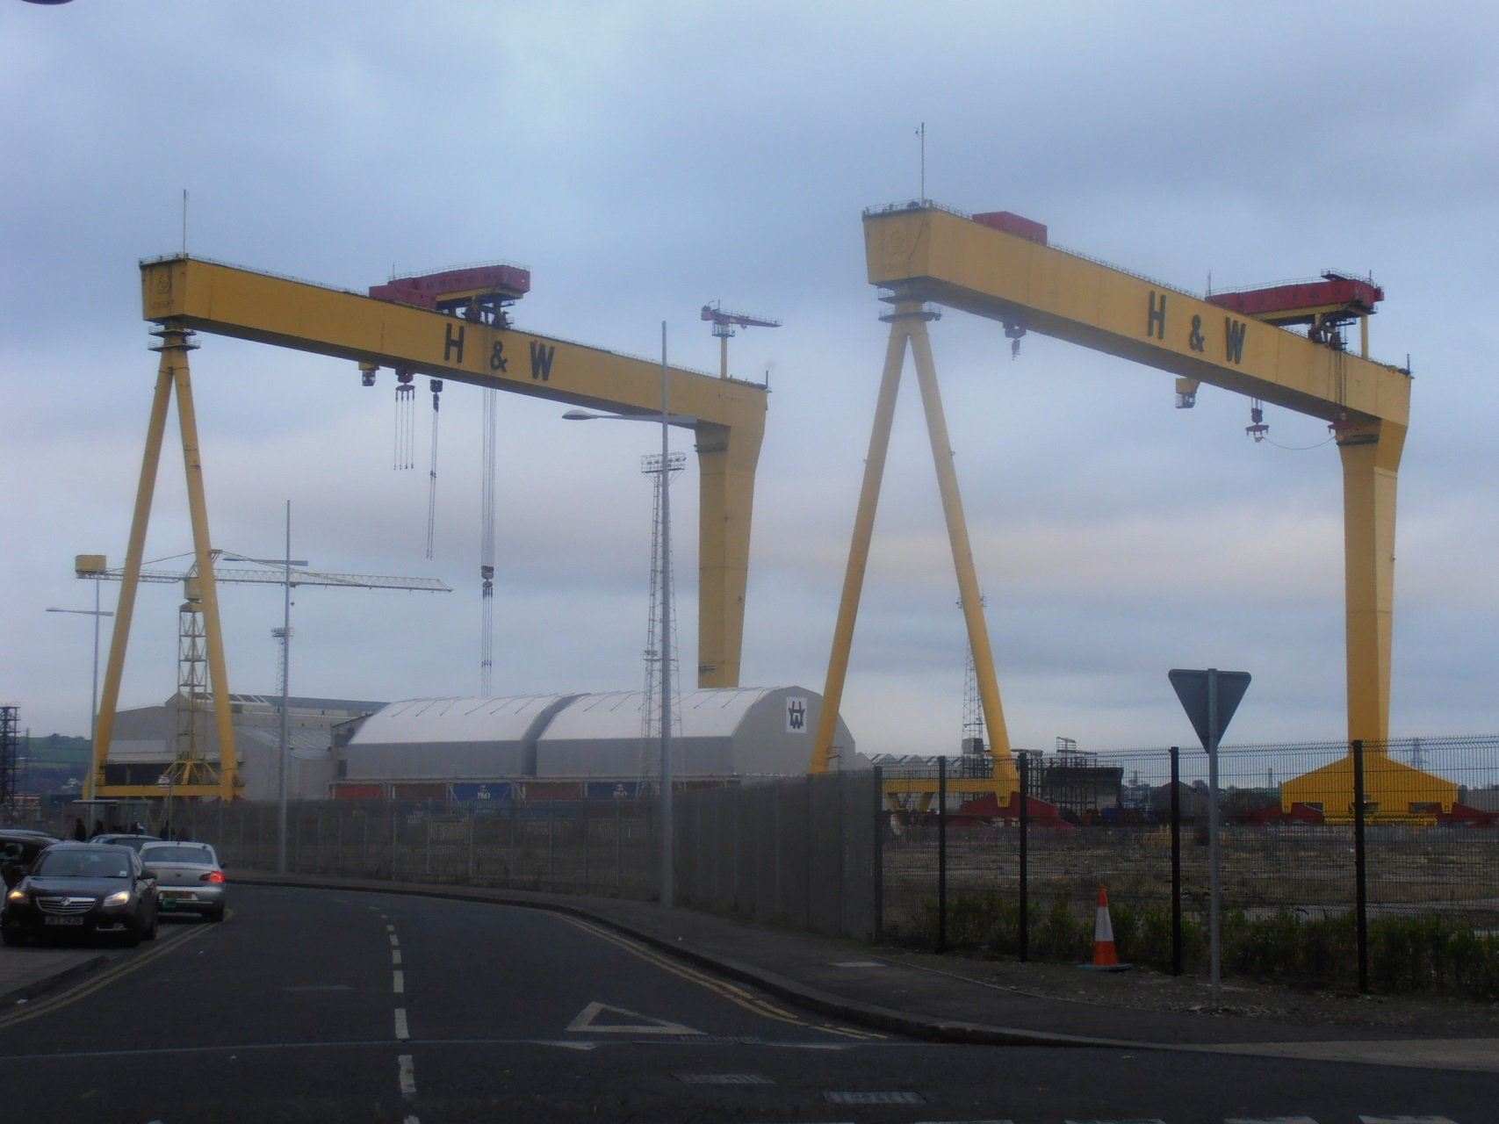
Samson and Goliath, Belfast

Slide 19
Place and Globalization
2) Effects in translocal and place assemblages linked by developments in assemblages of connectivity that provide conduits between places
  Enabling and constraining effects
  Budget air travel enabled expansion of international tourism, transformed new destinations, denuded traditional resorts, but is constrained by location of airports, landing fees and distance range of aircraft

Slide 20
Place and Globalization
3) Patterns of deterritorialization and re-territorialization in translocal assemblages prompt patterns of deterritorialization and re-territorialization in place assemblages
  FDI and divestment, booms in international tourism, out- and in-migration all deterritorializing pressures on place assemblages as they dilute internal homogeneity and/or transgress spatial boundaries
  New forms of territorialization and connectivity introduced, which may be spatial or organizational

Slide 21
Place and Globalization
4) Globalization can prompt processes of decoding and recoding in place-assemblages as meanings are re-negotiated and ‘rules’ no longer hold effectively
  Changes in formal codes, e.g. land use planning policies
  Changes in informal rules of everyday social interaction, e.g. language, customs and cultural practices
  Re-coding from incorporation into translocal assemblages and tendency toward internal homogeneity, e.g. new rules for areas designated as national parks, nature reserves etc..

Slide 22
Conclusions
Globalization as a messy process that has no singular, pre-determined impact on place
Agency in globalization is distributed, dependent on capacities constructed in localized acts of translation
Places are not inherently powerful, but are dependent on the distributed agency in the components and relations that constitute them
Distributed agency does not mean that power is evenly dispersed.
Neither is the determination of a place-assemblage’s capacities apolitical.
Place-assemblages are always contingent, always open to other possible ways of being

