Slide 1
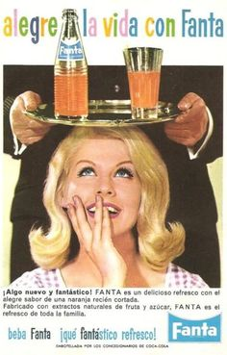
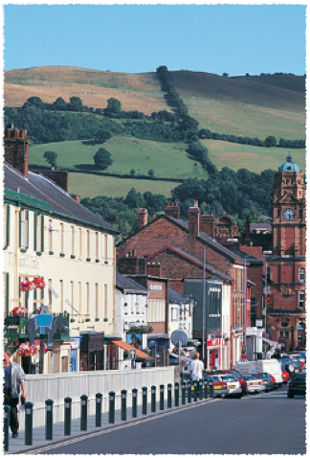
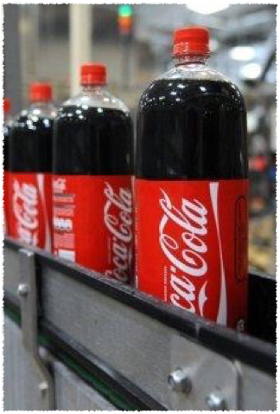

Bottling Globalisation in Rural Localities
Marc Welsh, Jesse Heley
Notes:
Aims of Session today – bit of theory, a bit of context, a bit of case study exploring the theory

Slide 2


Background
European Research Council Advanced Grant, Feb 2014 - Jan 2019
Understanding globalisation and its impacts in rural localities
5 work packages
  (Re-)Assembling The Global Countryside
  Mapping And Narrating The Global Countryside
  Everyday Globalisation In A Small Town
  Differential Global Engagements In Emerging Rural Economies
  Rural Assemblages And Grounding Global Challenges
Notes:
Long term research project - Capturing ways the global interacts with place
Globalisation as a complex and variable set of spatial processes acting upon and instantiated through places
We have 30 months to study one rural place in depth – Newtown, a rural town of just over 10,000 people in Powys, Wales –
Part of research includes snapshots of the food landscape within the town.
Food is not static, it moves – and somewhere like Newtown is multiply a site of consumption, a site along a distribution route, and a site of production.
One dimension of capturing that ‘motion’ involved mapping the distribution of food products sold at different sites across the town – looking at sourcing, sale and provenance but …
Through this we came to that icon of banal insidious globalisation – the soda
Subject of today’s talk. But first …. The theory.

Slide 3
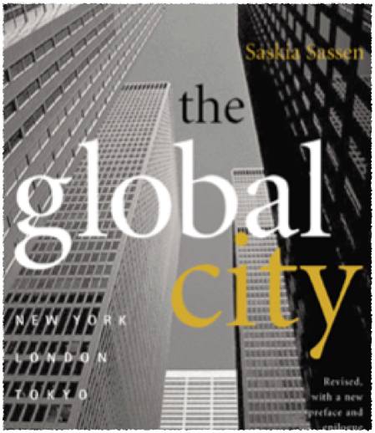
Research rationale
Bias to the ‘global city’
Growing concern in rural research with transnational flows and networks, but …
Tendency to study spectacular examples
For most rural localities, the most significant markers of globalisation are arguably more subtle and mundane

Slide 4
The Relational Rural
(Rural) places are not discrete, bounded territories that share an essential absolute rurality
(Rural) localities are always connected to other places through social, economic and political relations; and defined by these relations
(Rural) places exist as complex assemblages of physical and social elements, all of which are situated within wider networks and relationships
This relational perspective is consistent with an assemblage approach

Slide 5

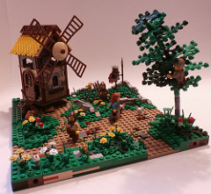
Assemblage approach
“Assemblages are composed of heterogeneous elements that may be human and non-human, organic and inorganic, technical and natural” (Anderson and McFarlane 2011, 124)
Assemblages are dynamic, achieving various levels of stability
Elements can become detached from assemblages, become a composite of another assemblage, and become part of multiple assemblages simultaneously
Components can have material and expressive roles (being of physical and/or allegorical significance)
Interactions generate stability and possibility
Notes:
Assemblage – composite of elements, human and non-human, technical natural and social – in some form of semi-stable relation or relations.
While elements of an assemblage can become detached, or sit within multiple assemblages, the assemblage may persist.
What assemblage theory provides is an attention to how the whole becomes materialised, and what work is involved in its maintenance or its transformation.

Slide 6
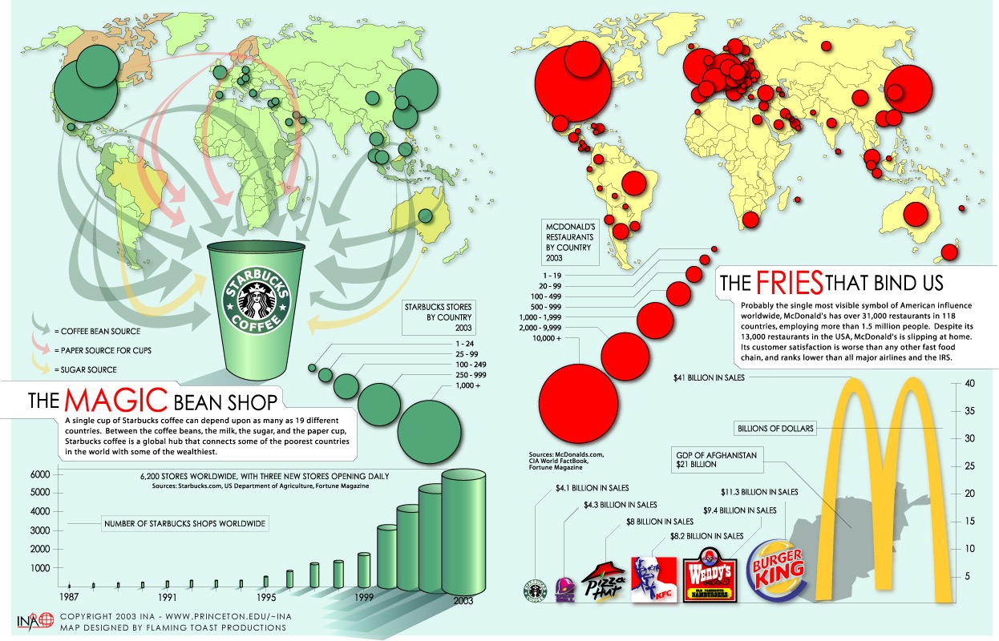
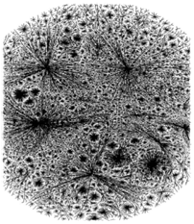
Assemblage & globalisation
‘A process (or set of processes) which embodies a transformation in the spatial organization of social relations and transactions – assessed in terms of their extensity, intensity, velocity and impact – generating transcontinental or interregional flows and networks of activity, interaction, and the exercise of power’ (Held et al 1999, 16)
Four dimensions of globalisation: the extent of networks of relations and connections; the intensity of activities and flows through these networks; a temporal dimension of the speed of the interchanges; and the impact of these phenomena (Walby 2003)
Tendency to define the type and extent of a global network (e.g. regional economy, product footprint) and then focus on components
Notes:
Political economy - GPN
Process or set of processes – interconnection, intensity and speed increasing, but doing so differentially.

Slide 7
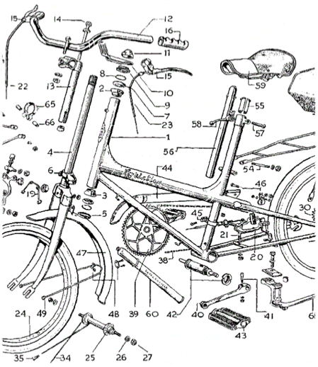
Assembling globalisation
Globalisation - outcome and description (not a force acting upon) of processes that drive integration, interaction and functional interdependencies across space.
Assemblage – concerned with how components are brought together, their relations regularised, stabilised and broken.
Putting the material back in the post-structural
Bottom-up approach
Discursive and material - components and systems have different properties, differing potentialities, differing capacities to interact.
Components and systems change over time
Each component is defined by other components of the system (relations of interiority) but redefined by external relations (relations of exteriority).
Assemblage theory is therefore a method for capturing emergence and change, and cohesion and (transient) stability (territorialisation).
Notes:
Globalisation - Outcome and description of changes in interaction
Assemblage – concerned with interaction – relational
But crucially its adherents emphasise emergence – that structures emerge and are stabilised through regularised interaction but these as not pre-givens, not static, but made and remade and crucially can change
Attentive to discursive and material components of assemblages
Components defined by their relations – primarily by those within the assemblage (interiority), but potentiality it defined by external relations (exteriority)
Assemblage theory therefore is more about providing a way of looking, a method, particularly one for capturing emergence and change, cohesion and stability of interactions between combinations of actors (human and non-human)

Slide 8
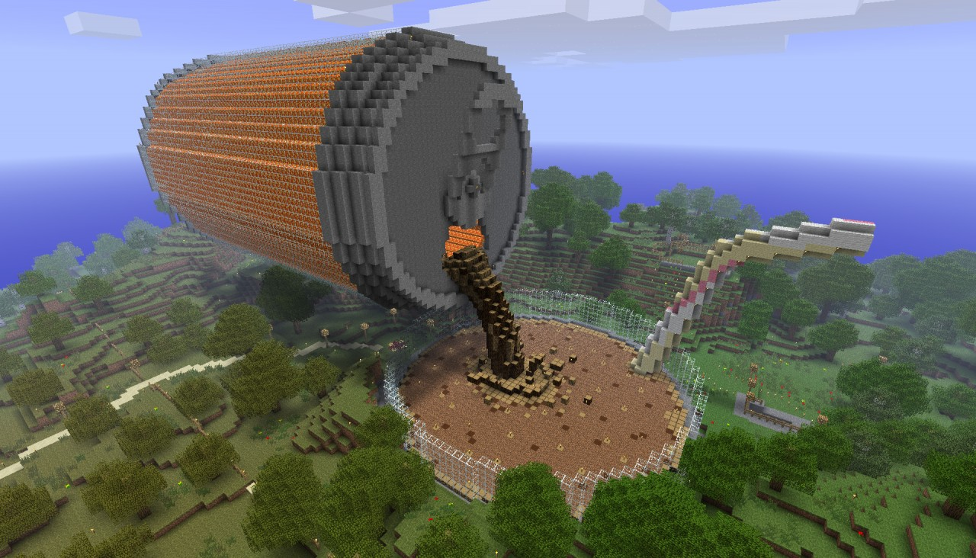
Stabilising the assemblage – capturing change and cohesion
What is stabilised?
How is it stabilised?
Who and what is brought into/excluded from the assemblage?

Slide 9
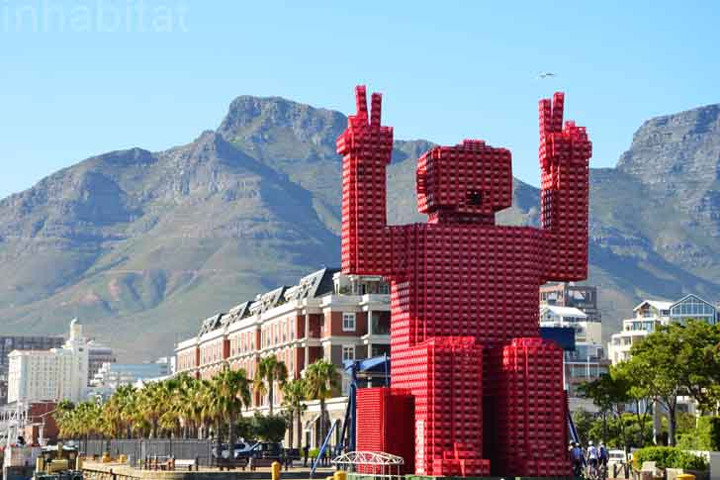
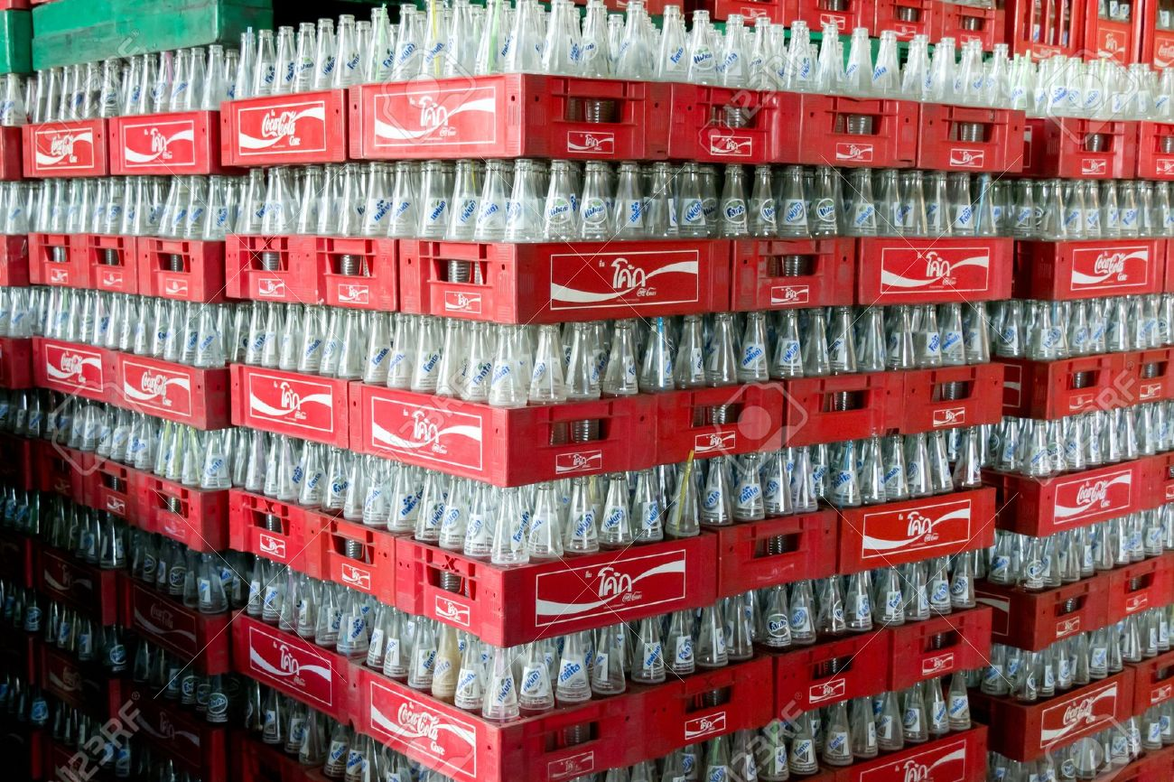
Bottling Globalisation
Iconic symbol of globalisation - the ever present water-based sugar delivery system – the soft drink.
The global drinks assemblage
Ubiquity combined with place based uniqueness.
UK - consume 14.8 billion litres of fizzy drinks, fruit juices, flavoured waters and dilutables a year
Cost/worth of £15.7 billion.
Carbonates make up 43% of this market
The ‘typical’ British person consumes 100.5 litres of carbonates per year
  Source: British Soft Drinks Association 2015
Notes:
consists of complex integrated supply chains, interacting and complex corporate, legal and political structures, changing markets and marketing, a complex set of interdependent but independent contributors (including the ever important citizen consumers)
So us Brits consume a lot of soft drinks. But those consumption choices are framed by a host of factors, including the embedding of citizen consumers into the global drinks assemblage.

Slide 10
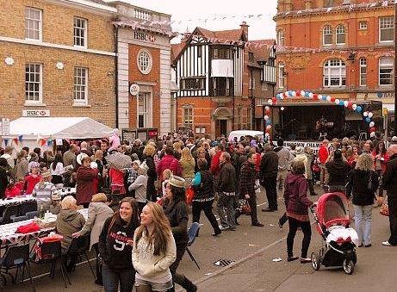
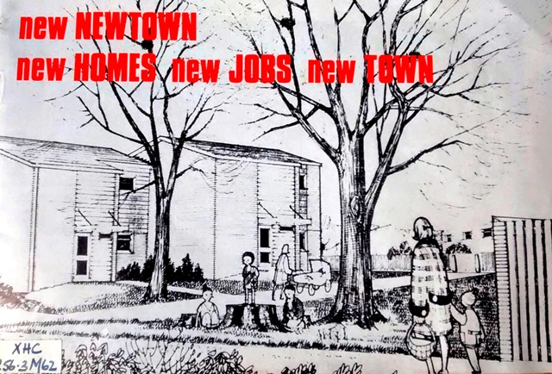
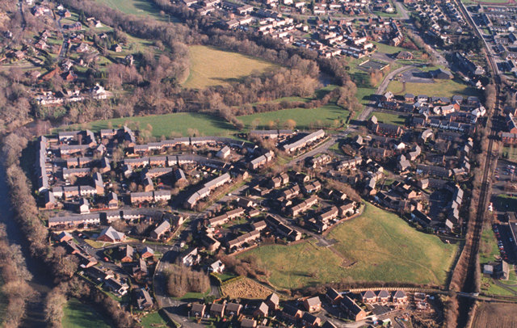
Newtown – every town
the oldest New Town in the UK (Est: 1282)
Birthplace of Robert Owen – hugely influential - radical thinker, secularist, utopian socialist, communitarian.
Also the “Home” of flannel, of Mail Order, and secret war time factories, and Laura Ashley, and …
Home of 11,000 people, 11,000 potential citizen consumers
        64 sites for sale of food products (shops, cafes – not public houses)
        243 different brands of non-alcoholic drinks for sale in these shops
Notes:
One of the places that consume and act as a transit point for a lot of these ‘carbonates’ is Newtown, in mid Wales
designated a “New Town” and doubled in size in 1970s)
Variously a Market Town, Wool Town, Industrial Town and in the current era trying to recast itself as a food tourism town
Robert Owen - Ideas informed early British socialism, building blocks for emerging ideas about class and class conflict, the co-operative movement, workers’ rights and the emerging trades union movement.
– may not seem much in an urban centre like Toronto, but surprised us.

Slide 11
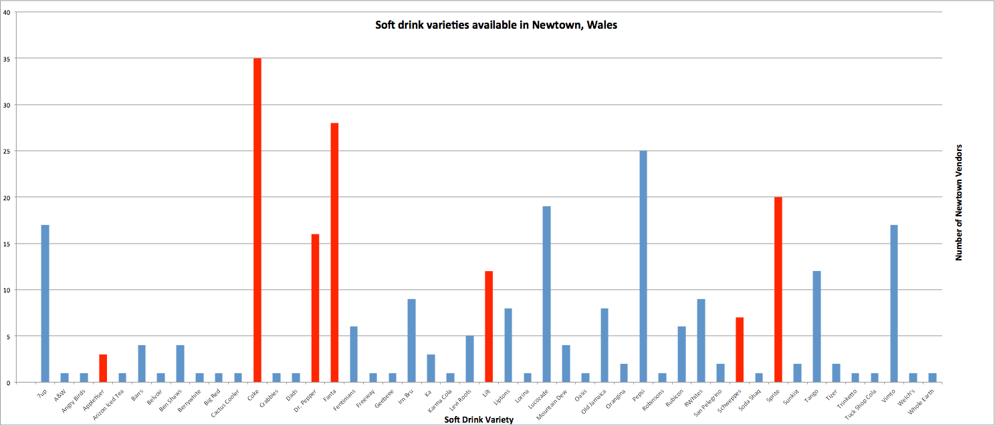
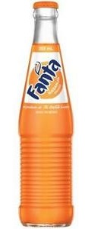
Brands in red are brands of the Coca-Cola Company
Coca-Cola has a product portfolio containing over 3,500 beverages
The company is the 84 largest economy in the world
Notes:
Many of these consumers drink sodas. This bar chart simply displays the prevalence of particular brands of soda in the town – coke is found in 35 different (actually MOST) shops throughout the town. Mirroring the real world Fanta is the second most popular brand.

Slide 12
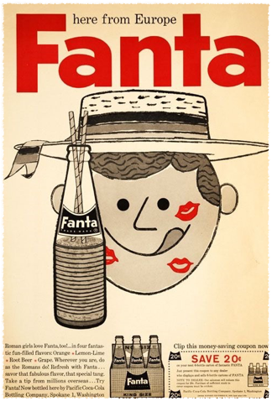
The Fanta story
Second oldest brand of the Coca-Cola Company, and the second largest brand outside the US. Fanta is consumed over 130 million times per day worldwide
Fanta orange flavour introduced in Italy, 1955. Naples bottler first to produce and sell Fanta Orange using local citrus ingredients
1960, Fanta arrives in US. Stopped selling nationwide in 1980s, but retained in regions with high immigrant populations. Re-introduced in 2001 with a strong marketing campaign. Now one of the top 10 best selling soda brands in the US.
Over 90 flavours available worldwide, not including discontinued varieties. Many flavours are only available in certain regions, dependent on taste preferences and availability/cost of ingredients
Flavours include Peach Mangosteen (Albania), Sweet Lemon (Buenos Aires), Ice Kiwi Lime (Australia) and Green Apple (frozen limited edition available in McDonalds)

Slide 13
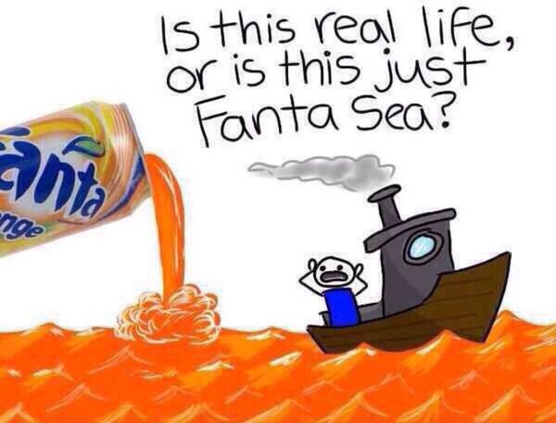
Fanta Sea

Slide 14

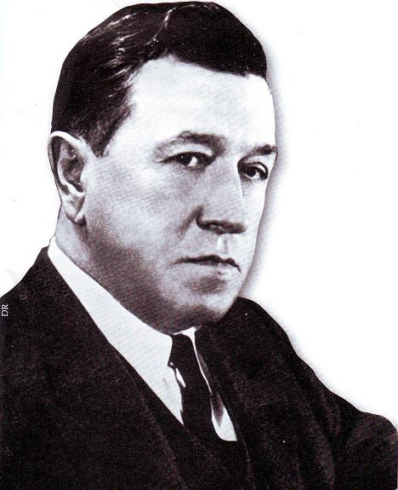
Fantasie
Coca-Cola had developed a highly profitable business in Germany prior to WW2. 1939, there were 43 bottling plants and in excess of 600 local distributors
During the war, there was a degree of contact with the Atlanta HQ via Switzerland. By 1941, however, supplies of Coca-Cola syrup had ceased
Solution - create a new drink from the leftovers of food processing industry, including whey and apple finer (byproducts of cheesed cider making, respectively)
Bottling plants kept open, with 3 million cases of Fanta sold in Germany and occupied territories
Max Keith: “Coca-Cola GmbH still functioning. Send auditors”

Slide 15
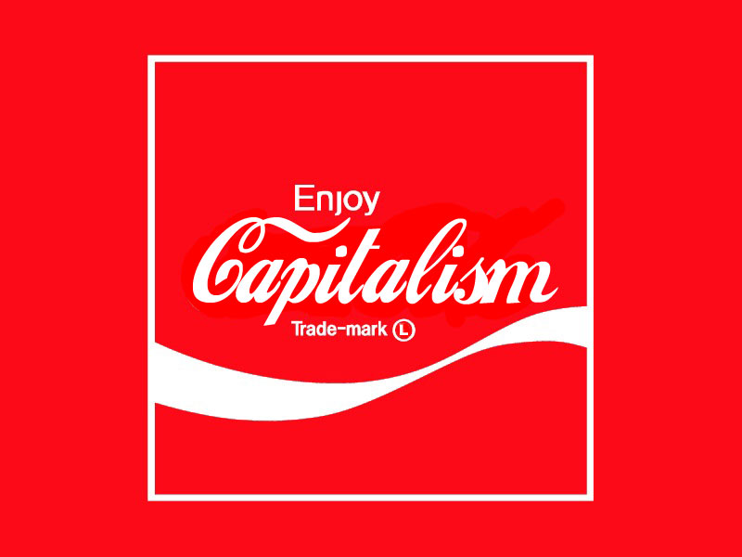
Stabilising the Coca Cola assemblage

Slide 16
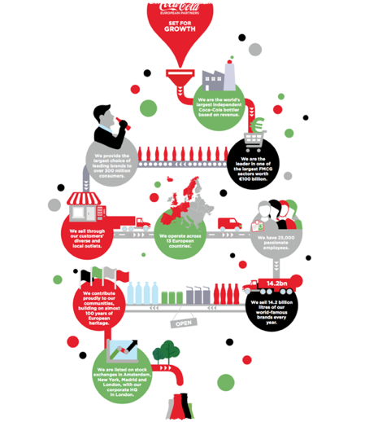

Coca-Cola capitalism
Coca-Cola = first beverage brand to employ the ‘industrial age formula of mass manufacturing + mass distribution + mass communications to manufacture at scale, distribute beyond local market and build awareness and demand with consumers’
Applied this formula to new brands, developed in-house (inc. Diet Coke, Fanta) or through acquisition (inc. Minute Maid) - “horizontal integration”
Historically averse to “vertical integration” and taking ownership of entire value chain. Preference for other companies to assume risks and to compete for contracts for components (inc. sugar and caffeine) bottling and distribution.
Increasingly taken control of production and bottling process through partly- and wholly- owned subsidiaries (Coca-Cola Enterprises, Coca-Cola Amatil)

Slide 17
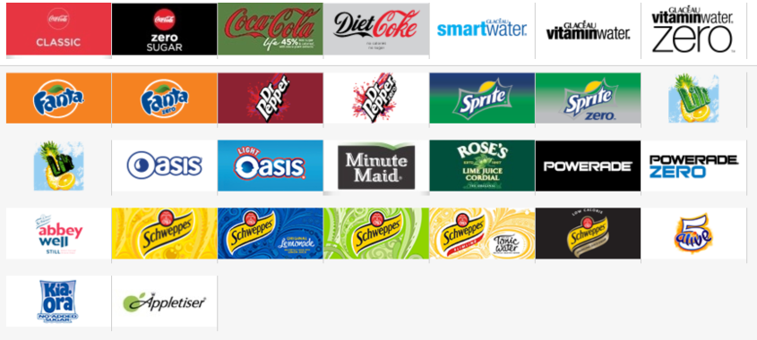
Coca-Cola GB
Coca-Cola Great Britain (CCGB)
  18 brands and 82 different drinks, employing 134 people
Coca-Cola European Partners
  CCGB bottling partner employing 4000+ people
  Manufactures and distributes drinks for other brand owners including Monster, Capri-Sun and Appetiser
  6 plants in UK
  Wakefield plant largest soft drinks factory in Europe, covering an area of 41 acres and has 72,000m² of buildings
‘Although the overseas business model keeps the bottling corporations separate, the parent company typically and deliberately owns no more than a 49 percent share of any franchise operation. Holding less than a majority share allows Coca-Cola to control the bottling operations in various countries without being saddled with legal or moral responsibility for anything the local bottlers do with respect to labour rights, water use, or environmental damage ..’ (Nestle 2015, 96)

Slide 18
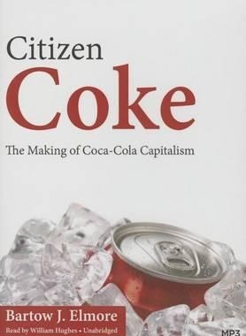
Coca-Cola capitalism
‘This is the brilliance of Coca-Cola capitalism. By not owning its many distributors and by relying on native intermediaries in foreign nations, Coke could claim that it was a critical component of the local economy, a company that encouraged a variety of regional purchasing transactions, and therefore a worthy beneficiary of local public resources and natural capital. Once embedded in the host communities, Coca-Cola became very difficult to dislodge, even in places where it caused serious environmental problems, because killing Coke meant killing jobs.’ (Elmore 2015, 189)

Slide 19
What is being stabilised …
the product,
the production,
the producers
the consumers
ongoing, mutable, negotiated, highly political

Slide 20
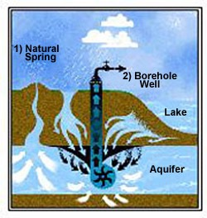


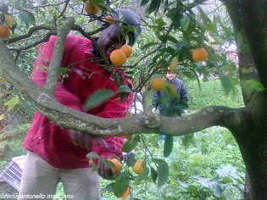


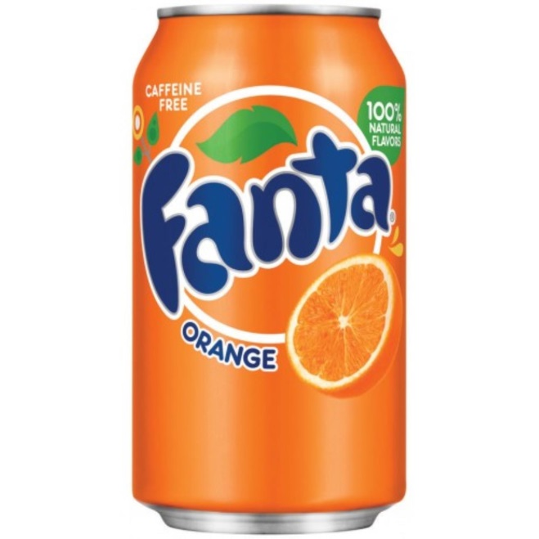
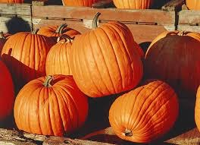
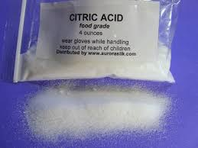
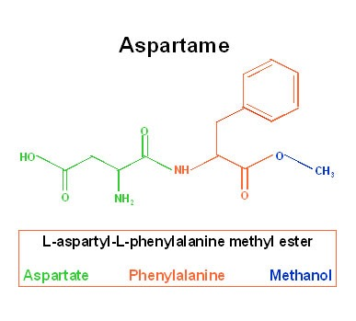
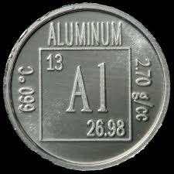

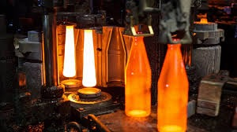

Slide 21
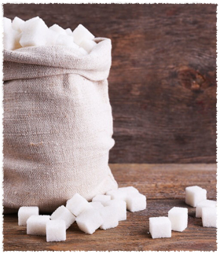
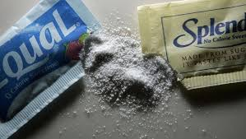
Sugar
Substitutionism- Foodstuffs composed of readily interchangeable commodities whose inclusion is determined by cost and technical criteria. (Goodman et al 1987)
‘If a manufacturer can save money by substituting one ingredient with another without damaging the appeal of the final food, then they will’ (Richardson 2015, 35)
3 distinct moments of substitution in sugar production
  Sugar from beet instead of cane - reduced reliance on production in Americas and East Indies during C19
  Invention of corn and wheat syrups in the US during the 1970s though introducing enzymes to wet-milled starch = High Fructose Corn Syrup (HFCS)
  Invention of artificial sweeteners including saccharin, aspartame and sucralose
Attempts to reduce biological uncertainty out of production through a reduced reliance on on ‘capricious natural processes’.
Food manufacturers have developed closer ties with chemical and pharmaceutical firms

Slide 22
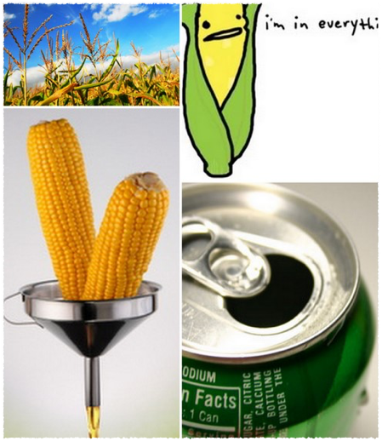
Sugar, HFCS and the US
US historically sought to maintain a high price for sugar for socio-economic reasons, and has variously subsidised sugar and grain production
HFCS provided a means of disposing of grain surpluses at a time when sugar prices were unstable and high
  Agri-conglomerates lobbied government representatives for the reintroduction of import quotas
  Massive spike in sugar price, inducing industrial sugar consumers to find alternatives
Coca-Cola switched to HFCS in the US in 1984
HFCS increased their share of the sweeter market from 5% in 1975 to 44% in 1989
Average American consumes 27 kilos of HFCS per annum (Manning 2005)

Slide 23
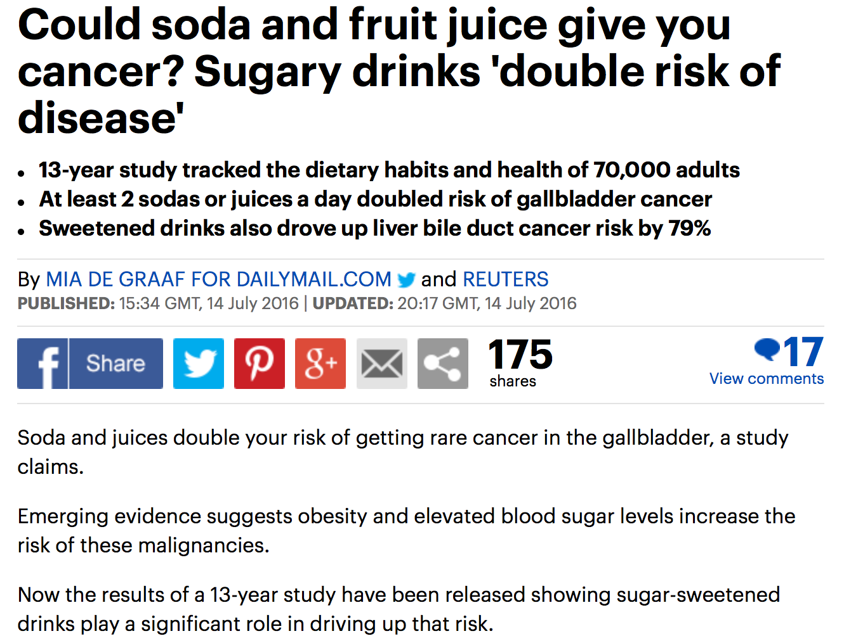
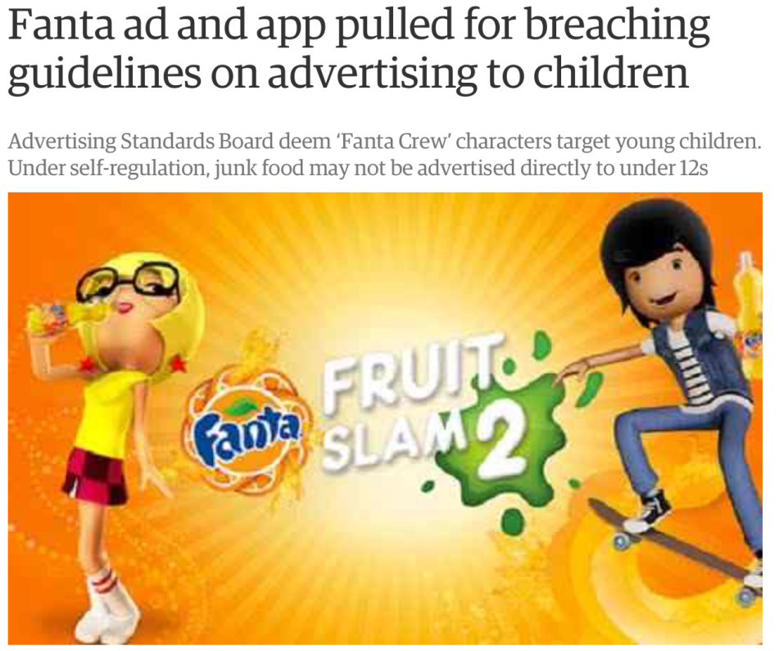
Biology and symbolism
Growing public concern with levels of sugar consumption, HFCS intake and artificial sweetener use
Obesity, cancer, heart disease, diabetes, liver damage, increased likelihood of violence, premature ageing, premature birth, alterations of brain chemistry, early puberty, increased risk of Alzheimers
Shifts in the Fanta assemblage - Diet drinks, ‘real sugar varieties’, alterations in advertising campaigns

Slide 24

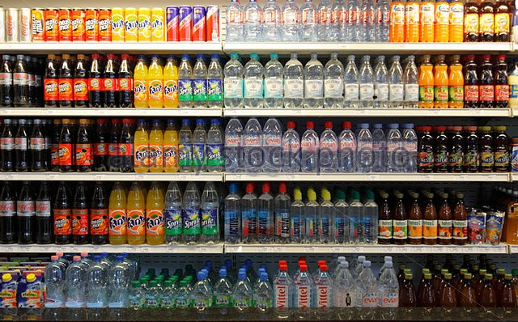

Global assemblages
What is stabilised? – a global drinks assemblage
  relations between a spatially distanced set of actors/components
  complex of ideas around product, value, and meaning to different components of the assemblage (e.g. as wage relation, shelf space, super sweet goodness, background banal ubiquity)
  The product itself
How is it stabilised?
  Coca cola capitalism
  Differentiation and adaptation – local forms
  Supply chain – components secured
  Markets, market making and marketing
  Distribution and logistics
Who is brought into and who is excluded from the assemblage?
All of the above change - relations are made, remade and replaced and new forms emerge (e.g. 1940s to 2016)
But Fanta lives on …

Slide 25


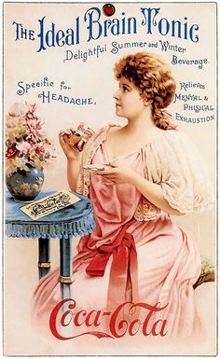
Prof. Michael Woods, Dr Jesse Heley,
Dr Laura Jones, Dr Marc Welsh,
Dr Anthonia Onyeahialam, Dr Francesca Fois, Mr Fidel Budy, Ms Elizabeth Saunders
www.assemblingnewtown.org
https://globalruralproject.wordpress.com

