Slide 1
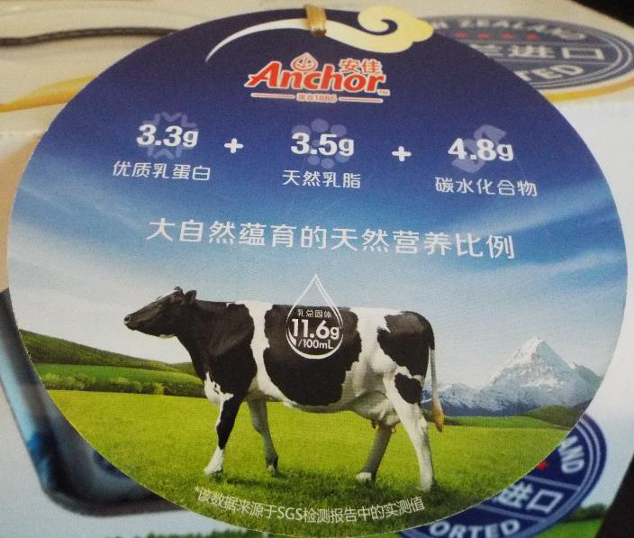
(Dis-)Assembling the Global Countryside: China and the New Zealand Dairy Assemblage
Presentation slides available at: http://globalruralproject.wordpress.com
Michael Woods

Slide 2
European Research Council Advanced Grant
Five years from February 2014 to January 2019
Aims to advance understanding of globalization and its workings in and through rural localities, with a particular emphasis on developing the conceptual and methodological application of assemblage theory to the analysis of globalization.

Slide 3
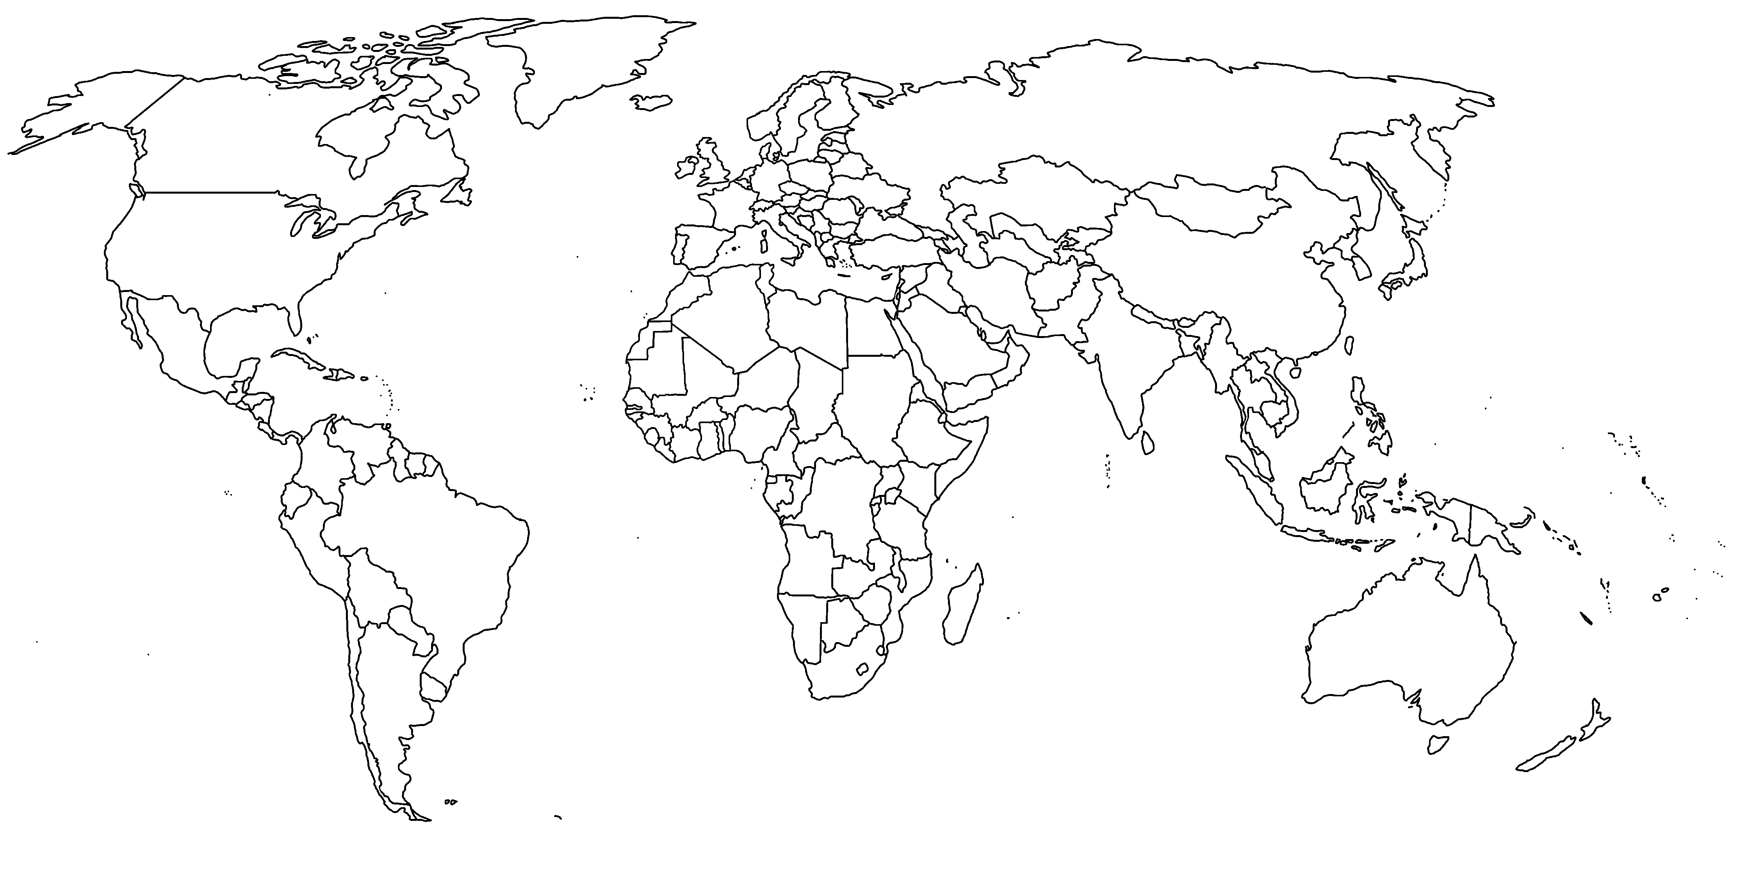
Case Studies
Sweden
Newfoundland
Wales
West of Ireland
China
Sardinia
Taiwan
Liberia
Australia
Southern Africa
Brazil
New Zealand

Slide 4
GLOBAL - RURAL
Project Leader: Michael Woods
Co-investigator: Jesse Heley
Post-Doc Researchers: Francesca Fois, Laura Jones, Anthonia Onyeahialam, Samantha Saville, Marc Welsh
PhD Students: Fidel Budy, Beth Saunders
Project Administrator: Reuben Knutson

Slide 5
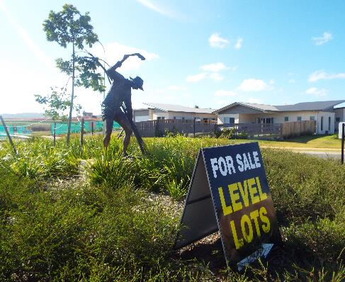
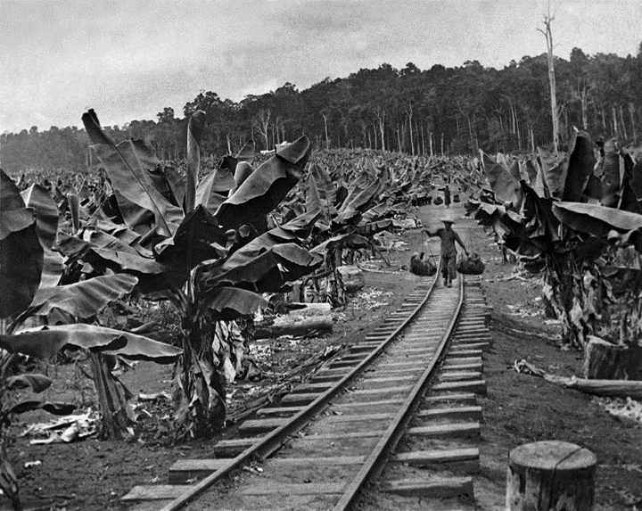
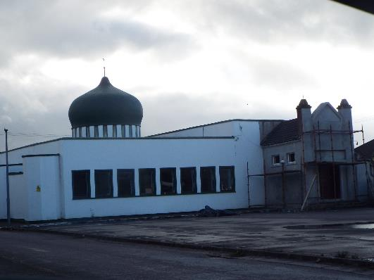
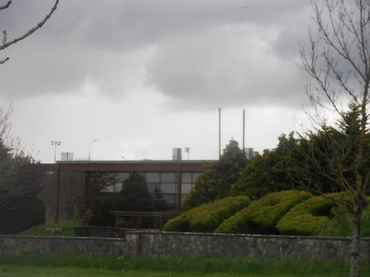
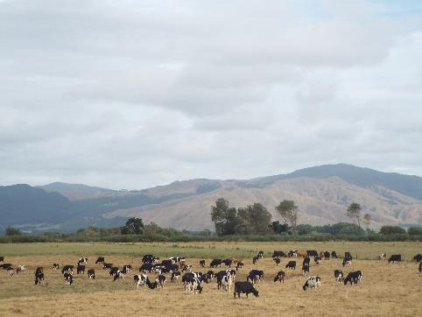
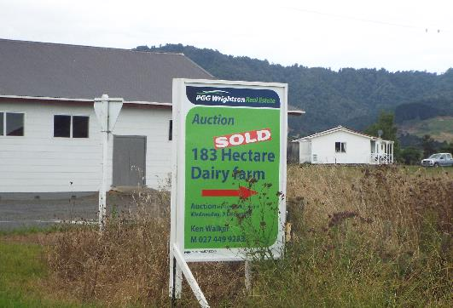
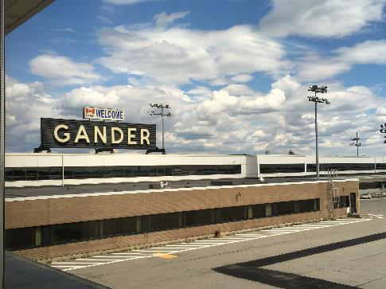
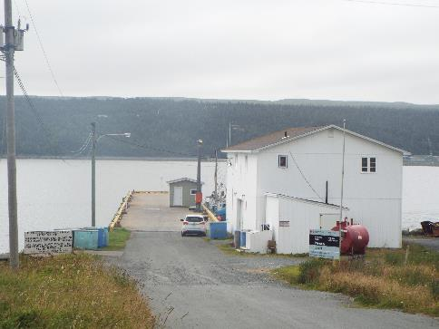
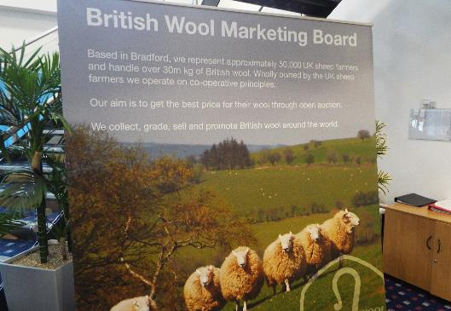
Immigration in rural Ireland
Sugar industry in Australia
Chinese farmers in early C20 Queensland
FDI in rural Co. Mayo, Ireland
Dairy industry in New Zealand
Foreign land sales in New Zealand
Changing connectivity & Gander airport
Global fisheries and rural Newfoundland
The Welsh wool assemblage

Slide 6
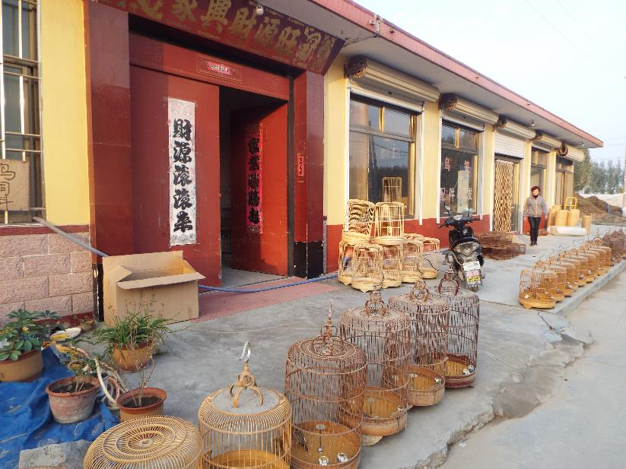
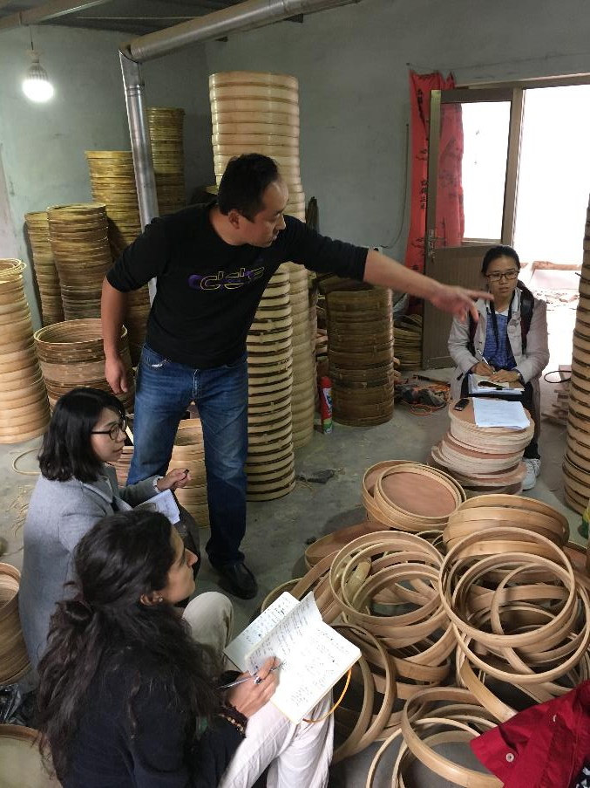
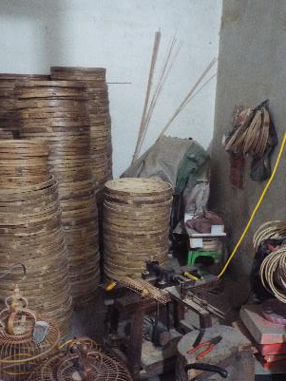
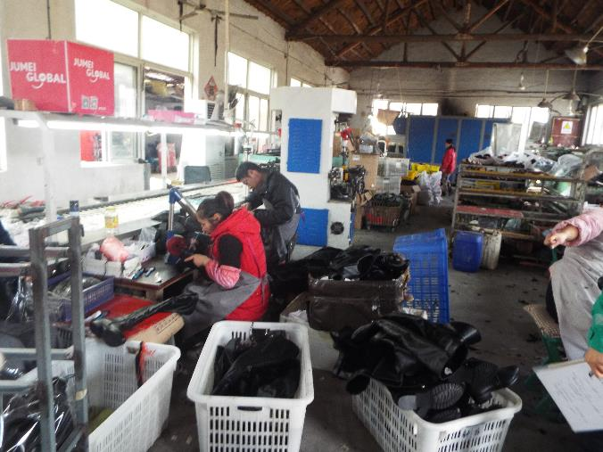
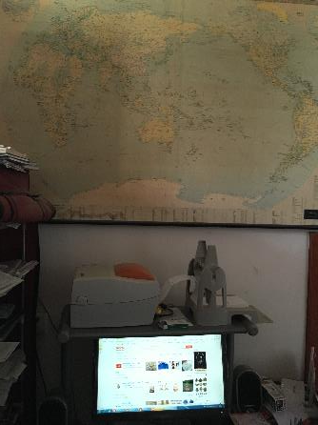
Da’ou village, Shandong, China

Slide 7
GLOBAL-RURAL
Further China case studies
Shoe manufacturing in Lan Cun, Shandong
Novelty manufacturing in Cao county, Shandong
Tourism and foreign investment in Tengtou, Zhejiang
Sugar industry restructuring in Guangxi
E-commerce in Guangdong
Migration in Henan
Agribusiness in Inner Mongolia
Case studies in Brazil
Rural development in the Itamboata valley, Bahia
Tourism and conservation in Chapada Diamantia, Bahia
Soya agribusiness in Rio Grande do Sul
Peasant agriculture in Pernambuco
Conservation in Amazonia

Slide 8
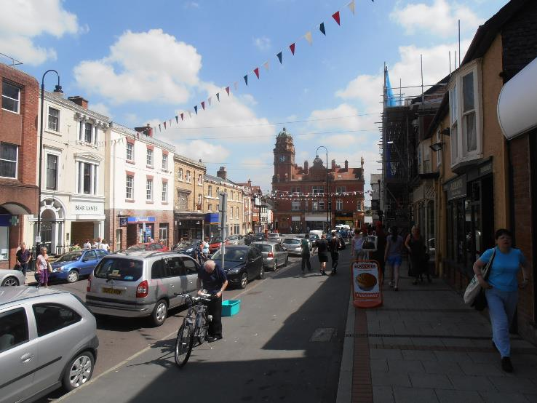
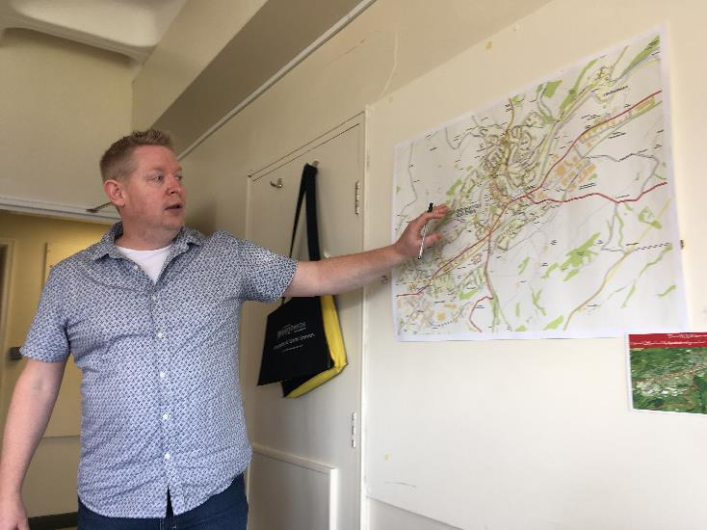
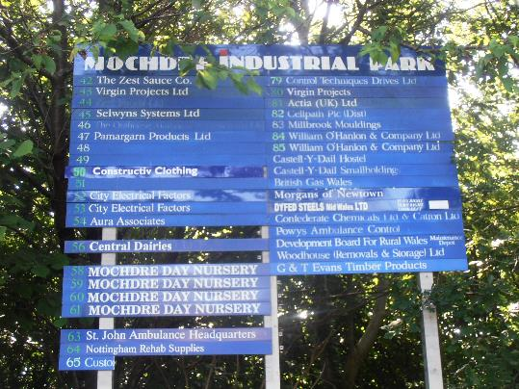
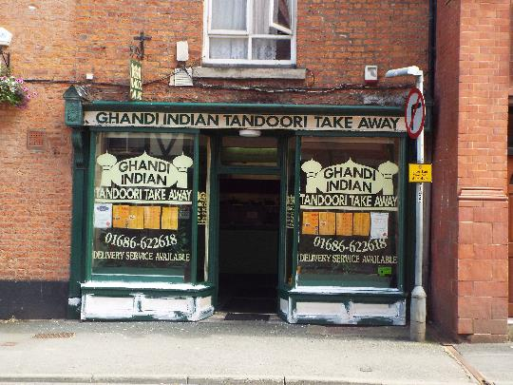
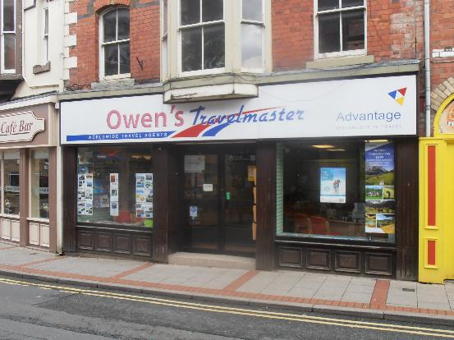
Newtown

Slide 9
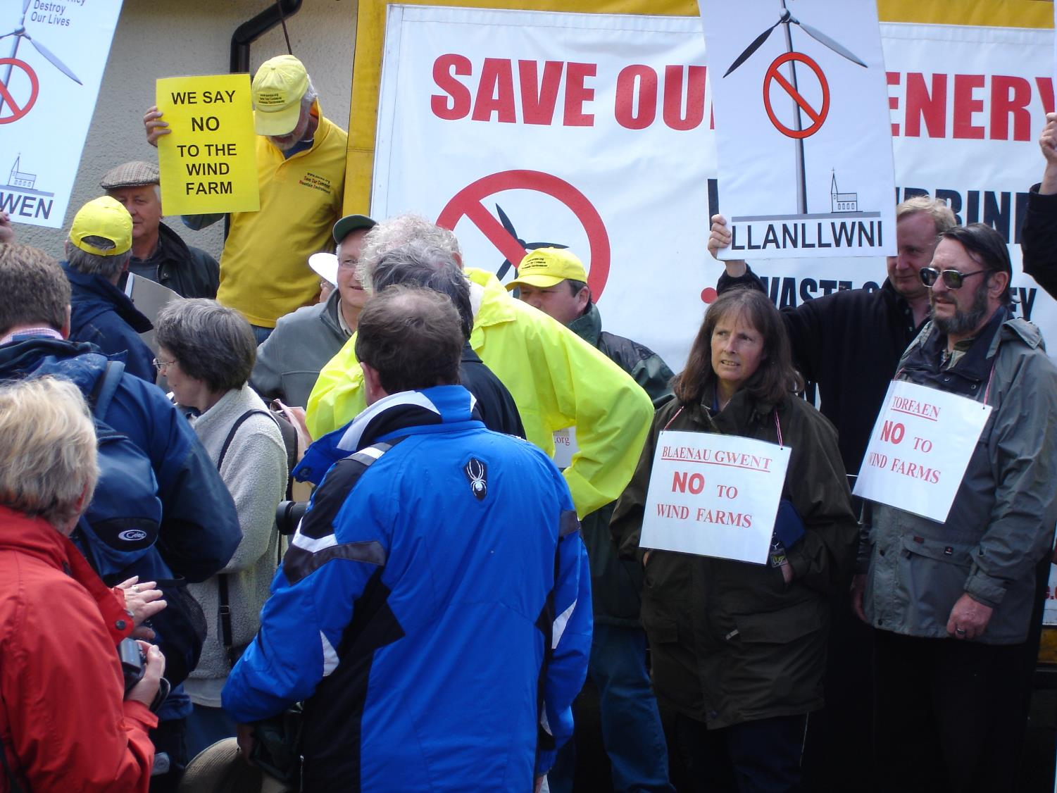
Grounding Global Challenges

Slide 10
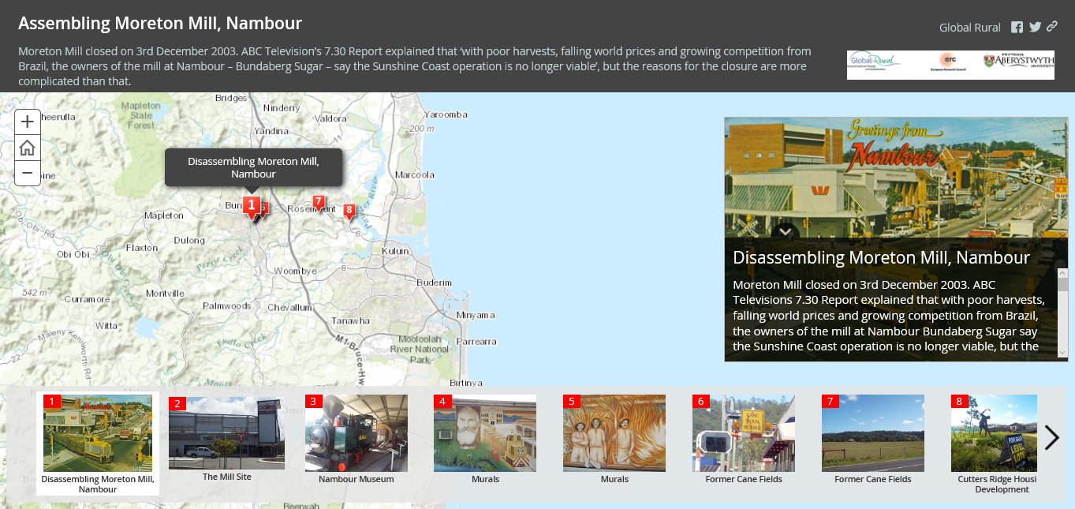
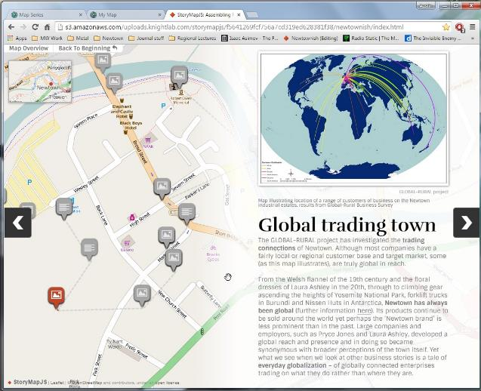
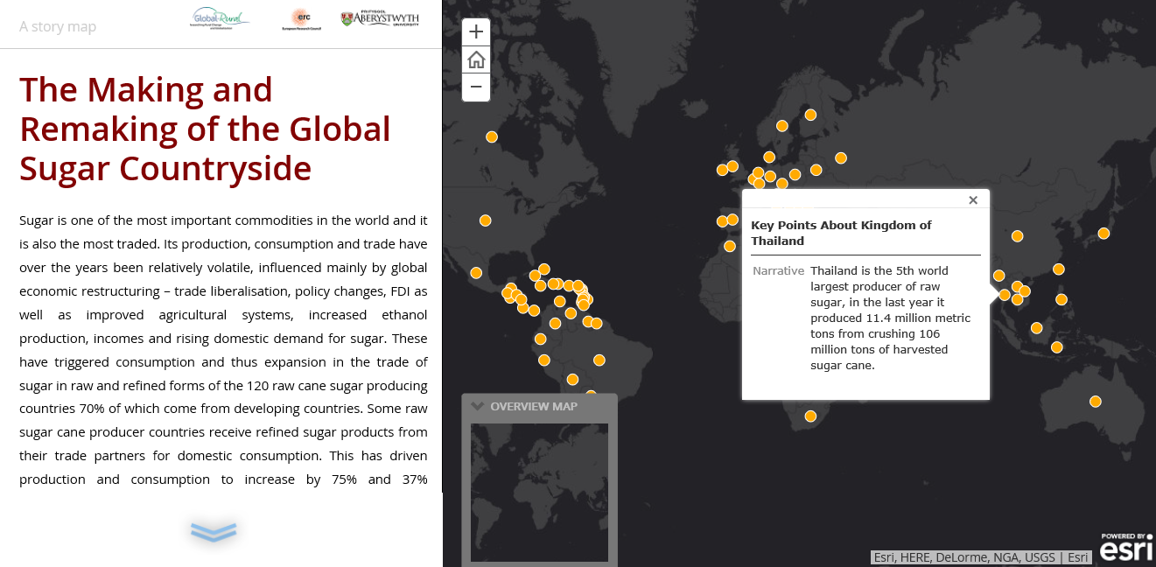
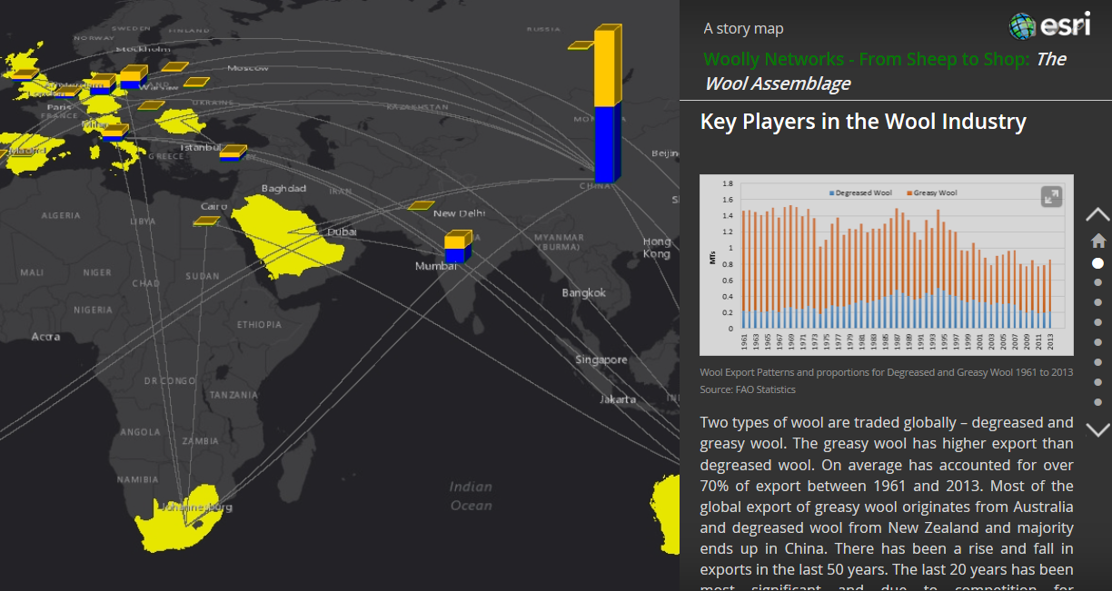

Slide 11
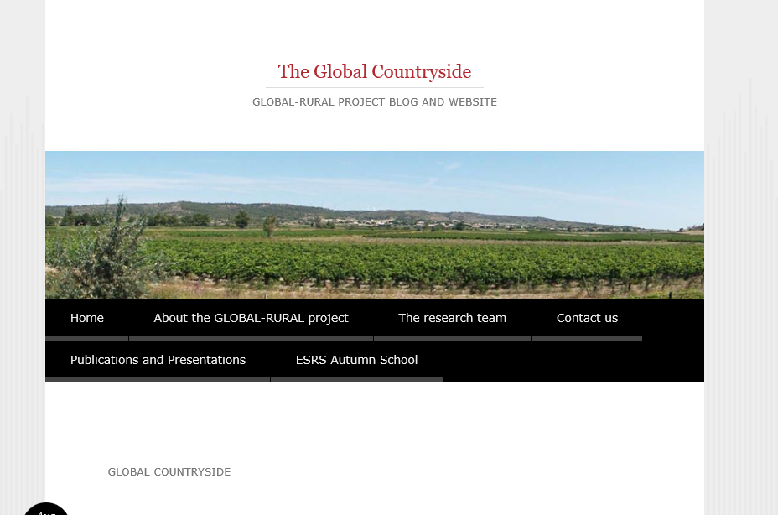
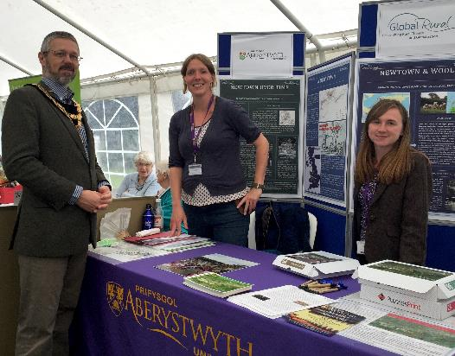
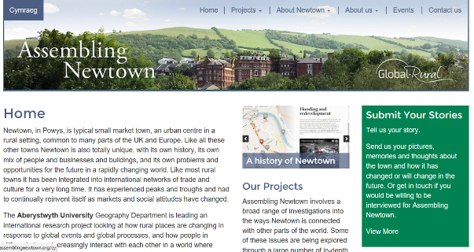
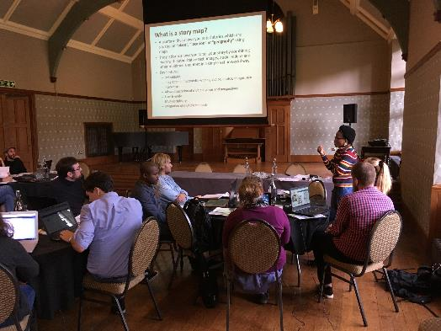
http://globalruralproject.wordpress.com
www.assemblingnewtown.org

Slide 12
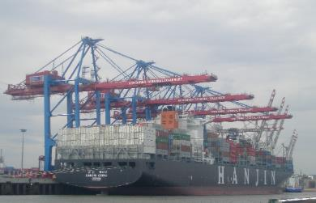
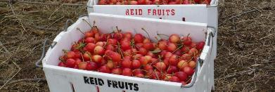
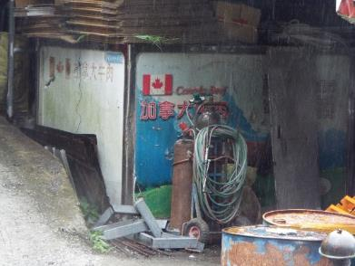
Rethinking Globalization
Globalization not as a top-down and homogenizing force
Globalization as inter-connectivity and inter-dependence, (re-)produced through localities
(Rural) communities and actors not as necessarily victims or beneficiaries of globalization, but as active agents n the reproduction of globalization
Focus on how global connections are made and re-made through micro-scale processes

Slide 13
Assemblage Thinking
The assemblage approach emphasizes emergence, multiplicity and indeterminacy, viewing the world as comprised by dynamic collections or entanglements of diverse heterogeneous components
Informed by Sociology of Science and Technology, but also post-structuralist social theory
Variants derived from work by Bruno Latour, Gilles Deleuze & Felix Guattari, Michel Foucault, Manuel DeLanda
Provides way of examining how structures or systems are put together (assembled) and how they change over time

Slide 14
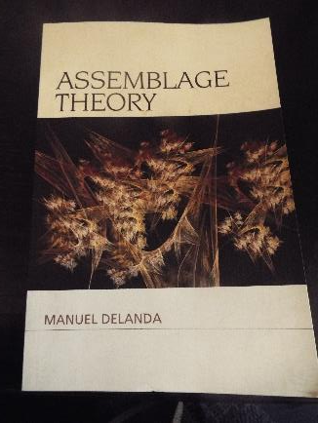
Assemblage Thinking
Principles of assemblages (DeLanda 2016):
Assemblages have a fully contingent historical identity, and each of them is therefore an individual entity
“Because the ontological status of all assemblages is the same, entities operating at different scales can directly interact with one another, individual to individual”
Assemblages are always composed of heterogeneous components.
Human and non-human, performing material and expressive roles.

Slide 15
Assemblage Thinking
Principles of assemblages (DeLanda 2016):
Assemblages can become component parts of larger assemblages
“Communities can form alliances or coalitions and become a larger assemblage, a social justice movement, for example, and organisations can form industrial networks and complex governments”
Assemblages emerge from the interactions between their parts, but once an assemblage is in place it immediately starts acting as a source of limitations and opportunities for its components
Communities enforcing local norms but also a resource for mobilisation

Slide 16
Assemblage Thinking
Parameters of assemblages (DeLanda 2016):
Territorialisation and deterritorialisation
What gives an assemblage shape: spatial territorialisation; organizational form; degree of homogenisation of components
Coding and decoding
What gives an assemblage identity: language, classification, statistics, mapping, pricing, branding, social conventions etc

Slide 17
Assemblage and Globalization
Globalization involves the assembling or re-assembling of components in new transnational configurations
Globalization occurs through recurrent interactions between assemblages
Globalization also occurs through the deterritorialization and reterritorialization of assemblages
Globalization proceeds through cycles of coding, de-coding and re-coding
Globalization is fostered by the tendency of assemblages towards internal homogeniety

Slide 18
Assemblage, Globalization and Place
Globalization impacts on places through the interactions between place-assemblages and translocal social, economic, cultural, political and technological assemblages
Effects in translocal and place assemblages linked by developments in assemblages of connectivity that provide conduits between places
Patterns of deterritorialization and re-territorialization in translocal assemblages prompt patterns of deterritorialization and re-territorialization in place assemblages
Globalization can prompt processes of decoding and recoding in place-assemblages as meanings are re-negotiated and ‘rules’ no longer hold effectively

Slide 19
China and the New Zealand Dairy Assemblage

Slide 20
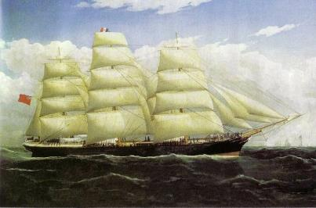
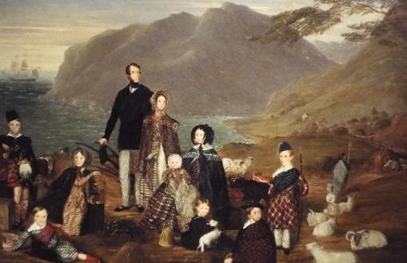
New Zealand and the Global Economy
Rural New Zealand ‘created’ through global encounters with Pacific Maori and European settlers
Agricultural economy based on commodity exports to Britain (lamb, wool, butter)
Facilitated by transnational circulation of people, capital, livestock and technologies (e.g. refrigeration, modified Cocksfoot grass seed)

Slide 21
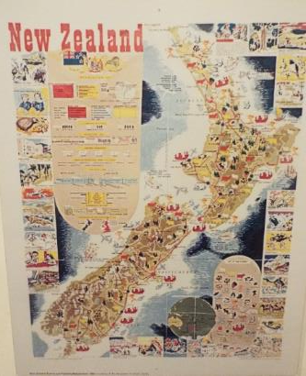
New Zealand and the Global Economy
British market closed by UK entry to European Economic Community in 1973
Search for new export markets for New Zealand produce
Substantial restructuring of New Zealand agriculture to make it competitive in a global market
Underpinned by ‘globalization discourse’ (Larner, 1998)

Slide 22
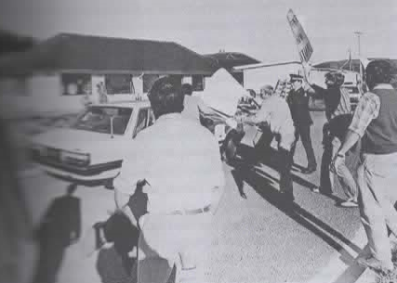
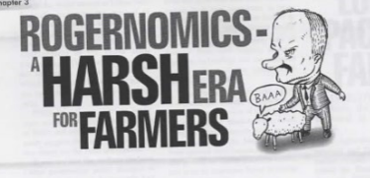
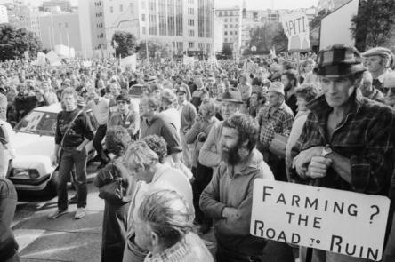
Agricultural Restructuring
Deregulation 1984
Larger farm sizes
More intensive farming
More corporate farming

Slide 23
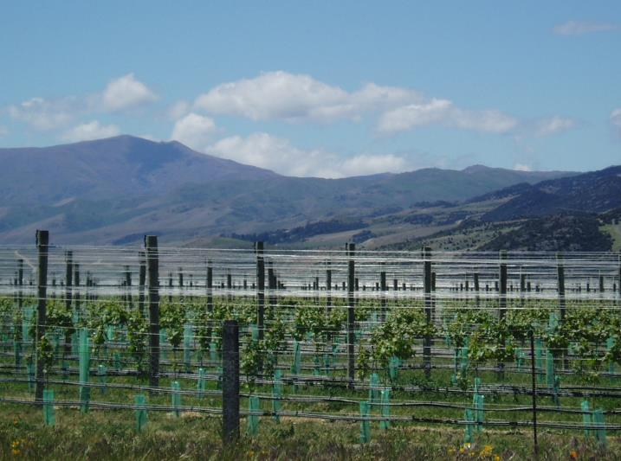
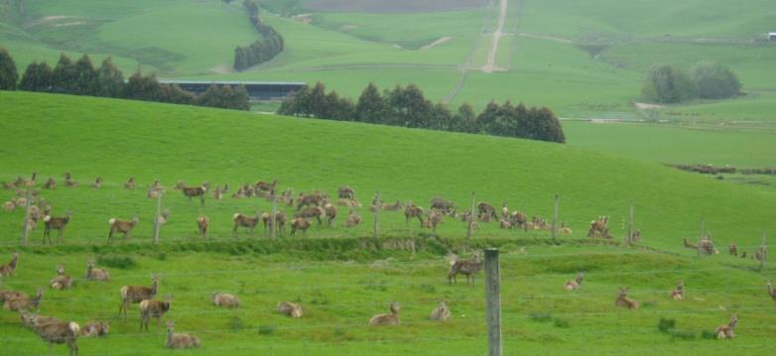
Diversification

Slide 24
Source: DairyNZ

Slide 25
Increasing demand for milk and dairy products in China
New Zealand as leading exporter of milk powder to China
Source: FAOStats

Slide 26
Applying Assemblage
How trade in milk powder with China was assembled (the ‘NZ-China dairy-export assemblage’)
How farms were re-assembled (through dairy conversions) to attach themselves to the NZ-China dairy-export assemblage
How changes in farm-assemblages have impacted on other assemblages (rural communities, rural ecosystems) with which they interact
How these assemblages respond dynamically to fluctuations in the Chinese market

Slide 27
Assembling NZ-China Trade
Strategic re-territorialisation of NZ dairy export assemblage following exclusion from UK market
Geographically – identification of new markets in Asia and Latin America
Organizationally – with restructuring of dairy industry and formation of Fonterra, but also development of operations overseas
“It was no longer enough… to set out from New Zealand with something to sell; the [Dairy] Board must establish bases in the world’s markets and become directly involved. It must become a major player in the business” Yerex (1989) Empire of the Dairy Farmers

Slide 28
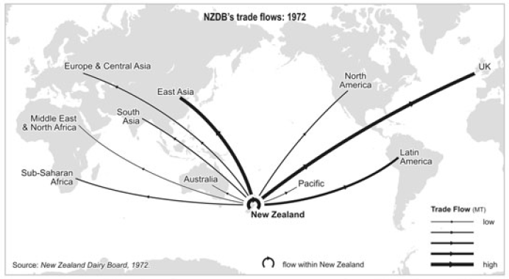
Trade flows of New Zealand Dairy Board 1972
Source: Gray and Le Heron (2010) in New Zealand Geographer

Slide 29
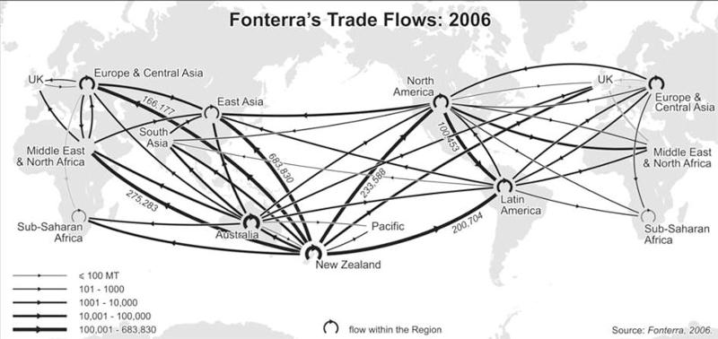
Trade flows of Fonterra (successor to NZDB) 2006
Source: Gray and Le Heron (2010) in New Zealand Geographer

Slide 30
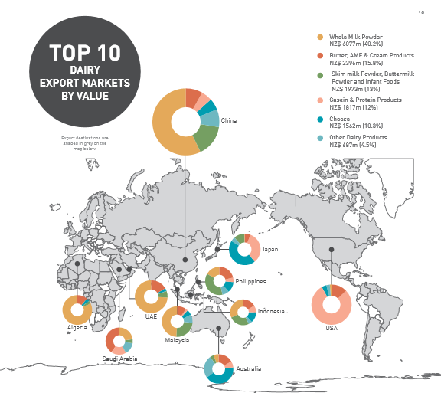
New Zealand Dairy Exports 2014
Source: NZMPI (2015) Situation and Outlook for Primary Industries 2015.

Slide 31
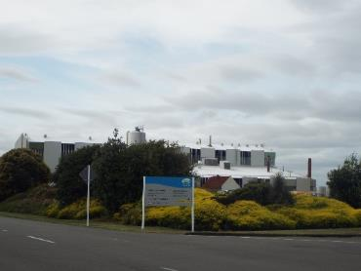
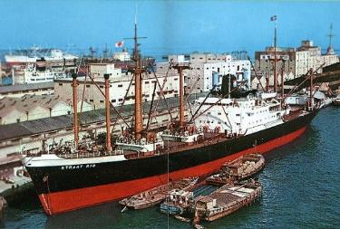
Assembling NZ-China Trade
Modifying the composition of the dairy export assemblage
Replacing butter with milk powder as the core commodity
Construction of milk power processing plants
R&D investment to improve techniques
Attention to different methods for reconstituting milk powder in different markets
Enrolling Royal Inter-Ocean Line to establish shipping route from NZ to China
Milk powder plant, Longburn, built 1965

Slide 32
Assembling NZ-China Trade
Sanlu food contamination scandal in China 2008
Milk powder and infant formula adulterated with melamine
New Zealand milk powder considered safe
Coding of New Zealand products in China as ‘pure’
Expressive function of NZ milk powder

Slide 33
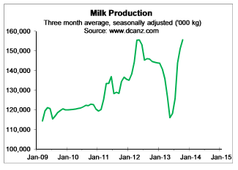
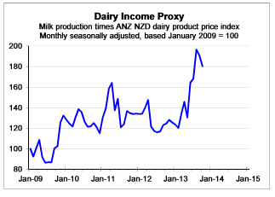
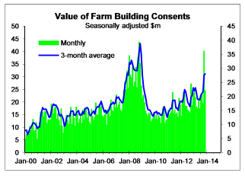
Assembling NZ-China Trade
Increased demand for milk from NZ farmers
Increased prices for milk (coding of milk in commodity markets)
Conversion of sheep and beef farms and forest land to dairy
Graphs from Dickens (2014) Insights into the dairy export boom and some interesting implications

Slide 34
Numbers of dairy cattle in New Zealand, 1955 (left) and 2005 (right)

Slide 35
Re-assembling the farm
Dairy conversion involves re-assembling the components of the farm
Dairy cattle breeds replacing beef cattle and sheep
New buildings, e.g. milking sheds
Irrigation systems
Purchase of feed supplements and/or planting of crops for silage
Additional labour requirements
Many of these new components are sourced from outside New Zealand

Slide 36
Re-assembling the farm
Maize planted as a silage crop
Hybrid seeds developed by US-based biotech firms DuPont and Corson
Signs mark the landscape of the global countryside with the proprietary knowledge claims of transnational corporations
DuPont’s Pioneer maize in Manawatu, New Zealand
Germany
Belgium

Slide 37
Re-assembling the farm
Irrigation systems required for higher water demand of dairy farming
Popular Centre Pivot Irrigation system manufacturers Valley, Rainer and Reinke all based in Nebraska, US
Reinke irrigation systems manufactured in China & exported to NZ via warehouse in Brisbane, Australia

Slide 38
Re-assembling the farm
Foreign workers on dairy farms granted visas, by origin (Source: Rawlinson & Tipples 2012, via Christie 2012)

Slide 39
Re-assembling the farm
Re-assembling the farm for dairy conversion also required capital, drawing on domestic and international sources
Borrowing from (foreign-owned) banks
Private investment by NZ individuals, including farmers
Farms bought by international buyers for dairy conversion

Slide 40
Re-assembling the farm
57 dairy farms with 28,312 hectares sold to foreign buyers in 2013 and 2014
54% to US buyers, 12% to Chinese buyers
Source: KPMG (2015) Overseas Investment in New Zealand’s Dairy Land

Slide 41
Rural Impacts
Farms are components in wider assemblages of rural communities and the rural environment
An assemblage approach helps to reveal how globalization-led dairy conversions impact on these related assemblages
Dairying’s draw on water resources and discharge of effluent and chemicals as changing the composition of aquatic assemblages with which it interacts

Slide 42
Rural Impacts
Also expressive functions of farming and farmland in rural landscapes
Dairy conversions opposed for changing the appearance of the landscape
“I feel it would be a catastrophe to see the Mackenzie Basin as green pasture land with herds of dairy cows grazing across the vista with a mountain backdrop. The reason I go to the Mackenzie is to see the different landscape; the barren yet beautiful tussockland is unsurpassed.”
Letter to Timaru Herald, 4 June 2009
“Even the colours are changing, the mosaic of tawny wheatfields and sheep country now broken by interloper greens and a more diverse palette of crops.”
New Zealand Geographic, 2010
Mackenzie Basin, South Island, NZ

Slide 43
Rural Impacts
Re-territorialization of rural communities, as new components are introduced and pressure places on existing arrangements and coding.
New Asian migrant populations – helping to support community services, revitalise churches etc
New requirements for professional services (e.g. vets)
Increased traffic on rural roads from milk tankers (increased cost for road maintenance) and increased electricity demands (for irrigation systems)

Slide 44
Dynamic Assemblages
Principle of assemblage approach is that assemblages are always contingent and dynamic
Attachment to new global markets has produced economic benefits for NZ dairy industry, but has also introduced new vulnerabilities
Exposure to effects of small changes in Chinese market, re-territorialisation of the global dairy assemblage, re-coding of the value of milk on world markets

Slide 45
Dynamic Assemblages
‘Perfect storm’ of:
Reduced demand from China due to over-stocking of milk powder in 2014
Closure of Russian market due to sanctions
Increased dairy production in EU following end of milk quotas

Slide 46
Dynamic Assemblages
NZ farmers responding with changes in the territorialisation and coding of the dairy assemblage in New Zealand
Making changes to the components of the farm:
“I think next year is just going to be shocking … when we got to this year of course we had a big rehash of the budget and we cut a whole lot of things out. Umm, we cut cost feeding this year and this type of thing you know. We haven’t bought in any maize this year. We’ve bought no barley because we only buy barley when we can, we just grew it ourselves and we just can’t afford to do it. Umm, what else are we cutting out? Umm, we bought on barley and we’re buying no maize so I grow all the maize I need but it won’t compensate for that amount of feed. In going to next year is all very well ‘cause going to next year we’ll make no silage, because we’ll have no barley for it. And I just don’t know where the centre line is. I don’t know say, I reckon the next thing will be reduction in um, um, a big reduction in er, um, cows. Yeah, we reduced our cow numbers quite a lot last year and um, yeah so this year um, we’re going to have to … yeah so um, we’ll reduce probably another , we might reduce our cow numbers by up to 100.”
Manawatu dairy farmer (Interview, Feb 2016)

Slide 47
Dynamic Assemblages
Seeking to detach from existing customers and attach to new assemblages
Farmers quitting Fonterra for competitor companies offer better deals or trading in niche products (e.g. Open Country)
Contracts directly with Chinese companies now building their own milk processing plants in New Zealand
Yashily plant at Pokeno

Slide 48
Dynamic Assemblages
Attaching to the liquid milk market in Asia

Slide 49
Dynamic Assemblages
Attaching to the liquid milk market in Asia
Fonterra’s new UHT plant supplying China, Hong Kong, Malaysia, Taiwan and Guatemala

Slide 50
Dynamic Assemblages
Reterritorialization of Chinese milk supply chains
Source: Situation and Outlook for Primary Industries, December 2015 Update

Slide 54
Dynamic Assemblages
Global assembling of Chinese dairying
Clover from California for fodder
Cattle from breeders in South Africa and Uruguay
Capital from New York-based investment company Kohlberg Kravis Roberts & Co

Slide 55
Dynamic Assemblages
Deterritorialization (1)
Dairy farmers selling up

Slide 56
Dynamic Assemblages
Deterritorialization (2)
The off-shoring of NZ dairying
Cows exported to establish dairy herds in China
Fonterra operating farms and processing plants in China
NZ farmers establishing farms in Chile and Uruguay
What do we mean by ‘New Zealand dairy industry?’

Slide 57
Dynamic Assemblages
Interconnection of assemblages exposes NZ dairy farms to consequences of distant acts of re-assembling and re-territorialization
World milk and dairy prices over-coded by the Global Dairy Trade (GDT) electronic auction established by Fonterra to set price of milk in New Zealand
Dairy farmers around world affected by re-assembling, re-territorialization and re-coding of NZ dairy assemblage
Germany
Sweden

Slide 58
Summary
NZ dairy farms and rural communities transformed by shifts in global economy and assembling of new translocal trade-assemblages
Trade-assemblages dependent on localised processes of assembling and reterritorialization of farms
Reterritorialization of farms enrolled globally sourced components
Changes in farm-assemblages affect changes in rural social and environmental assemblages
Interconnection of assemblages exposes NZ dairy farms to consequences of distant acts of re-assembling and re-territorialization

Slide 59
Summary
Globalization as an iterative process of ongoing dynamic interactions between the local and the distant
Global commodity chains and new markets are actively assembled through situated actions and micro-scale modifications
As assemblages are inter-connected with shared components, the (re-)territorialization of translocal assemblages leads to the re-territorialization of place-assemblages
Exposure to distant events creates an intrinsic instability in global networks that requires the repeated adjustment and re-assembling of local and translocal assemblages

Slide 60
Michael Woods
m.woods@aber.ac.uk
Twitter: @globalrural
Presentation slides available at: www.globalruralproject.wordpress.com

